Slide 1

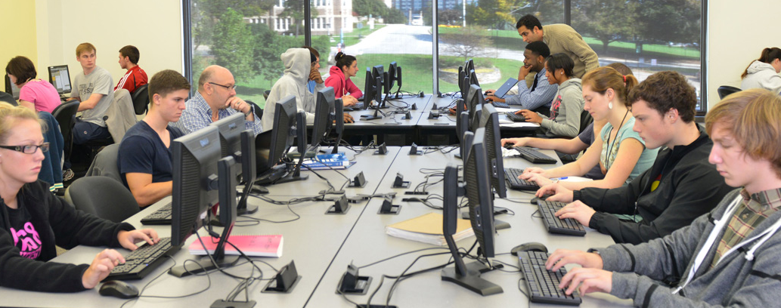
www.towson.edu/cis
@tu_cis

Slide 2
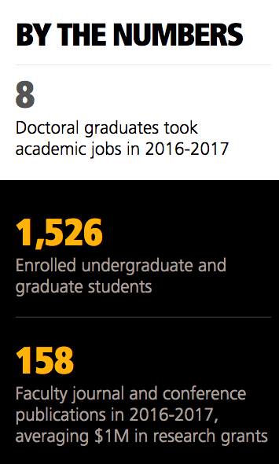
CIS
Three undergraduate programs
  Computer Science
  Information Systems
  Information Technology
Three graduate programs
  M.S. in Computer Science
  M.S. in Applied Information Technology
  D.Sc. in Information Technology
Faculty
  40+ full-time faculty
  50+ adjunct professors

Slide 3

Undergraduate Programs
B.S. Computer Science (~800 majors)
  ABET Accredited
  Two Tracks: Cybersecurity and Software Engineering
  National Center of Academic Excellence (CAE) in Cyber Defense
  Education (CAE-CDE)
  NSA CAE in Cyber Operations (1 of 19 in the nation)
B.S. Information Systems (~200 majors)
  Four tracks: Systems, Business, Interface Design, and E-Government
  Combined majors in Business Administration and E-Business
B.S. Information Technology (~500 majors)

Slide 4

Graduate Programs
M.S. Computer Science (~130 students)
  Three tracks: Software Engineering, Computer Security, and e-Commerce
M.S. Applied Information Technology (~200 students)
(affiliated with School of Emerging Technologies)
D.Sc. Information Technology (~60 students)
  One track: Computer Science
  Several students working on cyber research

Slide 5

Research
40 full-time faculty
  Adjunct faculty with industry experience
Broad areas of expertise
  Cybersecurity, Software Engineering, Data Sciences, AI, Bioinformatics, Social Networking, GIS
Numerous grants both for research and curriculum development
  Security Injections, Cyber-Physical Systems, Wireless Security, Bioinformatics, and Application Developments

Slide 6
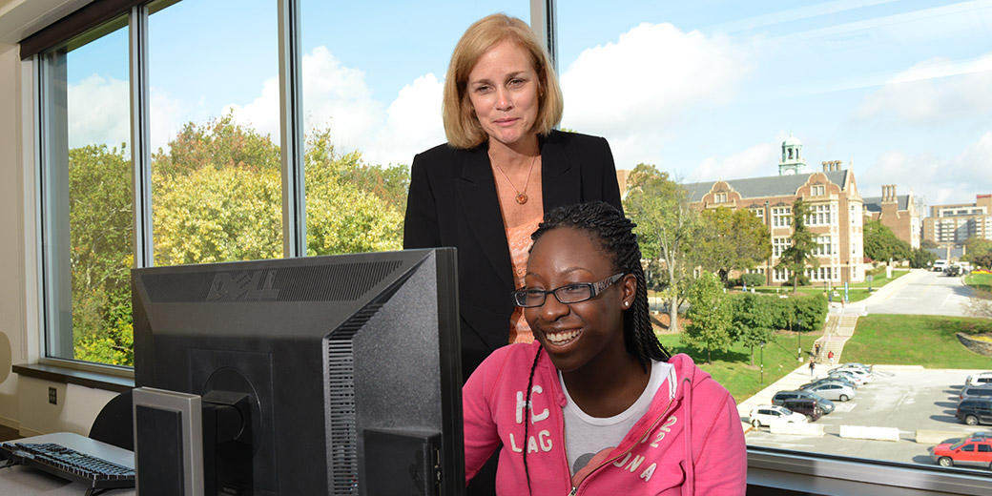
Cutting Edge Courses
Artificial intelligence
Bioinformatics
Computer graphics
Decision support systems
E-commerce
Human-computer interaction
Robotics
Mobile app development
Scientific modeling
Software engineering
Web-based programming
Operating systems security
Network security
Application software security

Slide 7
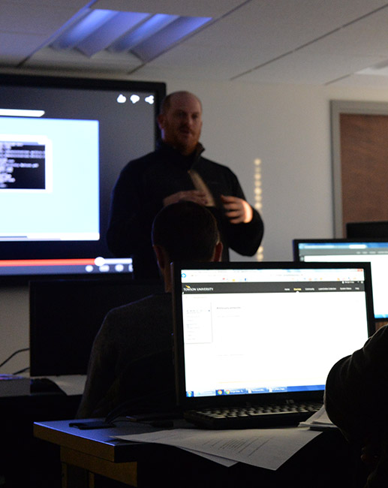
Classrooms and Labs
Smart classrooms
  Recording facilities
  Active learning labs
15 labs including:
  linux project lab
  software engineering lab
  NSF-funded security lab
  NSF-funded mobile development lab
  NSF-funded security injection lab
  bare machine computing lab
  human computer interaction lab
  Cyber-physical systems lab
  Computer vision lab
  Computer forensics lab

Slide 8












Where our Graduates are Employed

Slide 9
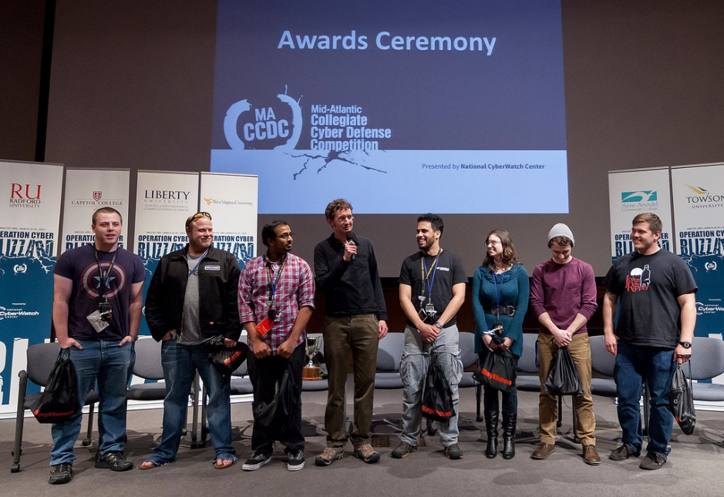
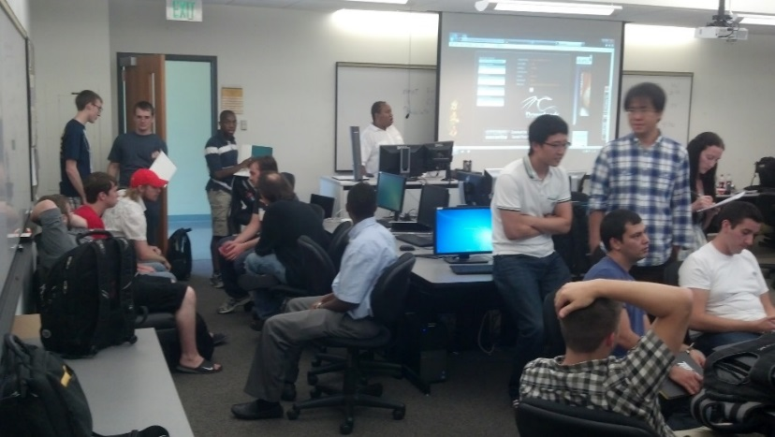
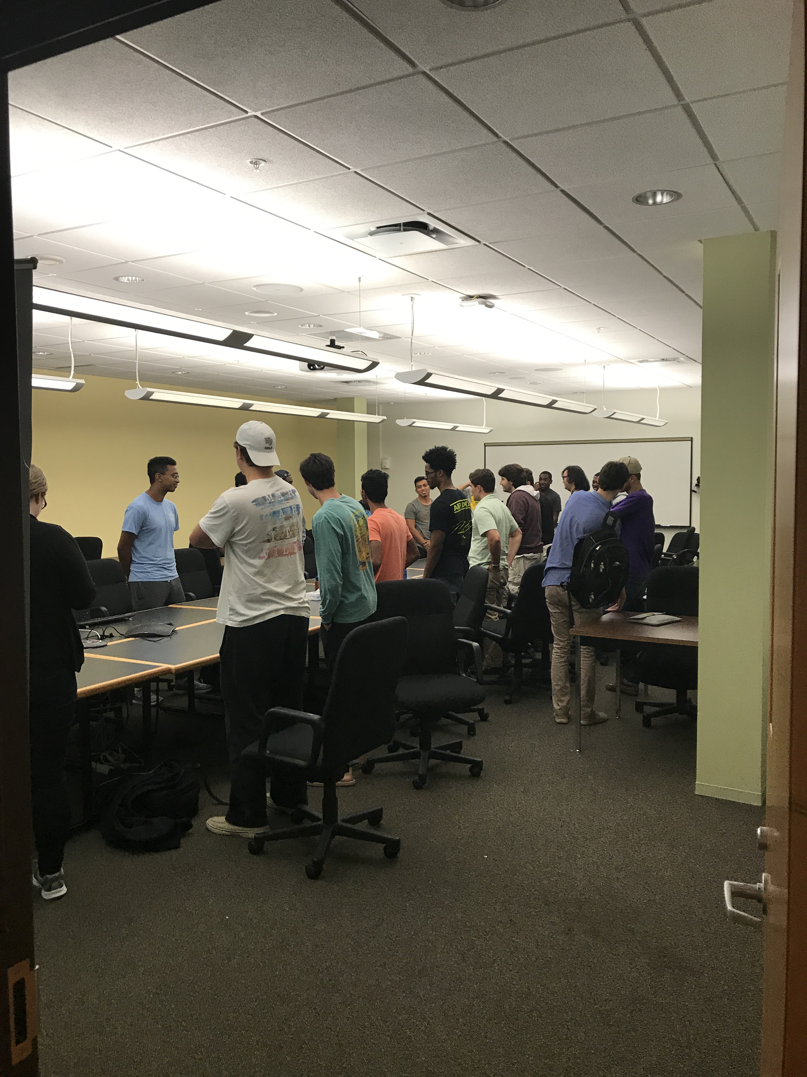
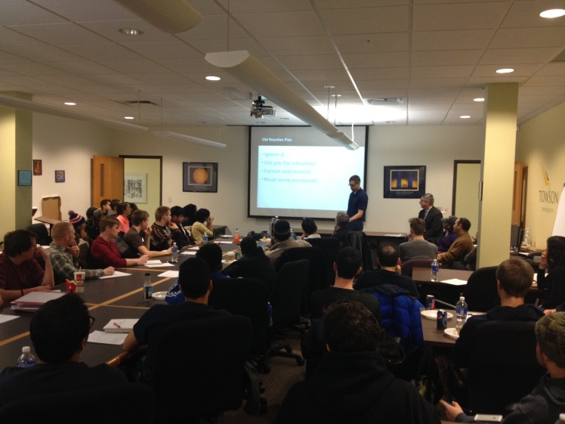
Learning outside the classroom
Active Security Club
Cybersecurity, Mobile Dev, and Research Seminar Series
Software
Engineering
Club

Slide 10
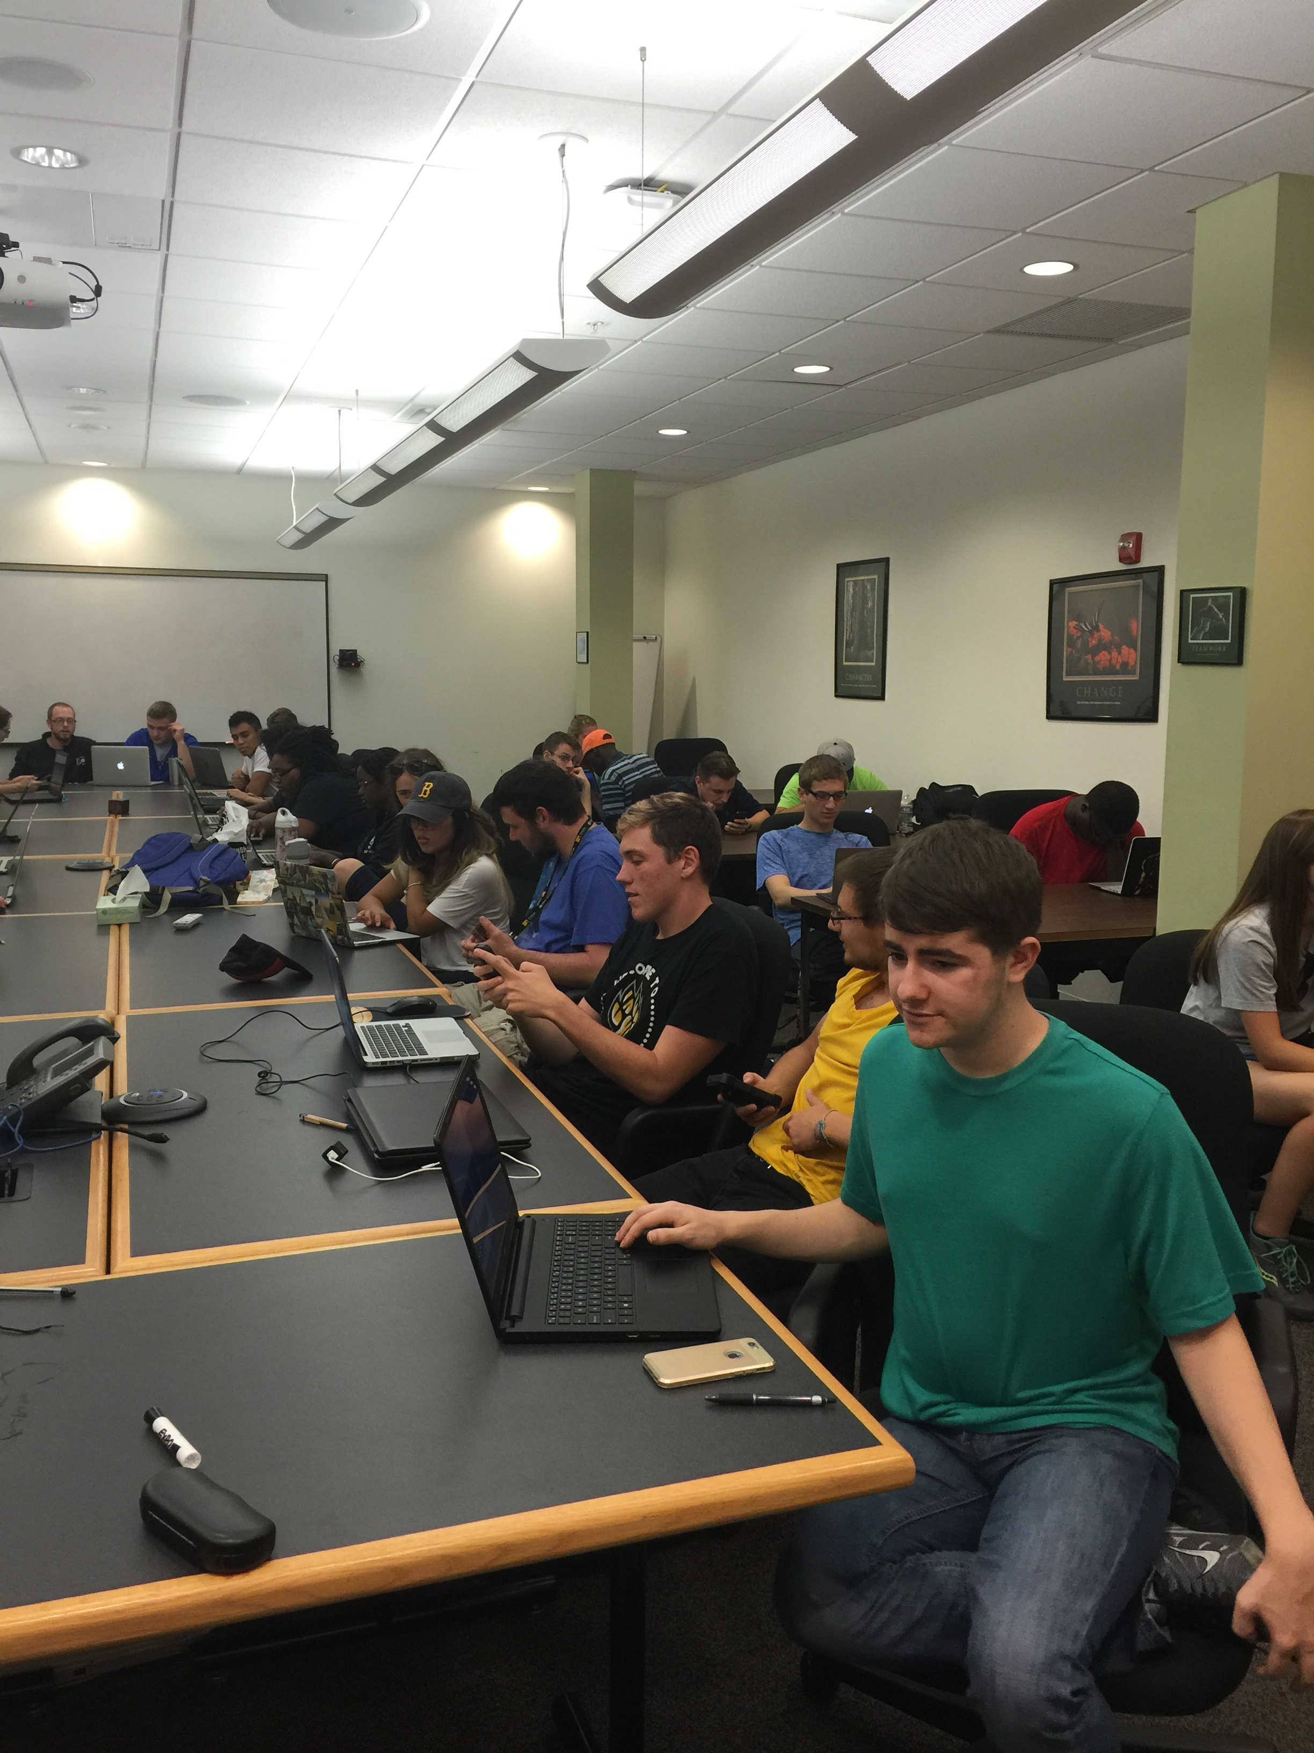
Student Resources
Research opportunities
Internships
Scholarships
Tutoring
Cyber Defense Team
Computer Security Club
Computer and Technology Club
UPE Honor Society
Software Engineering Club

Slide 11
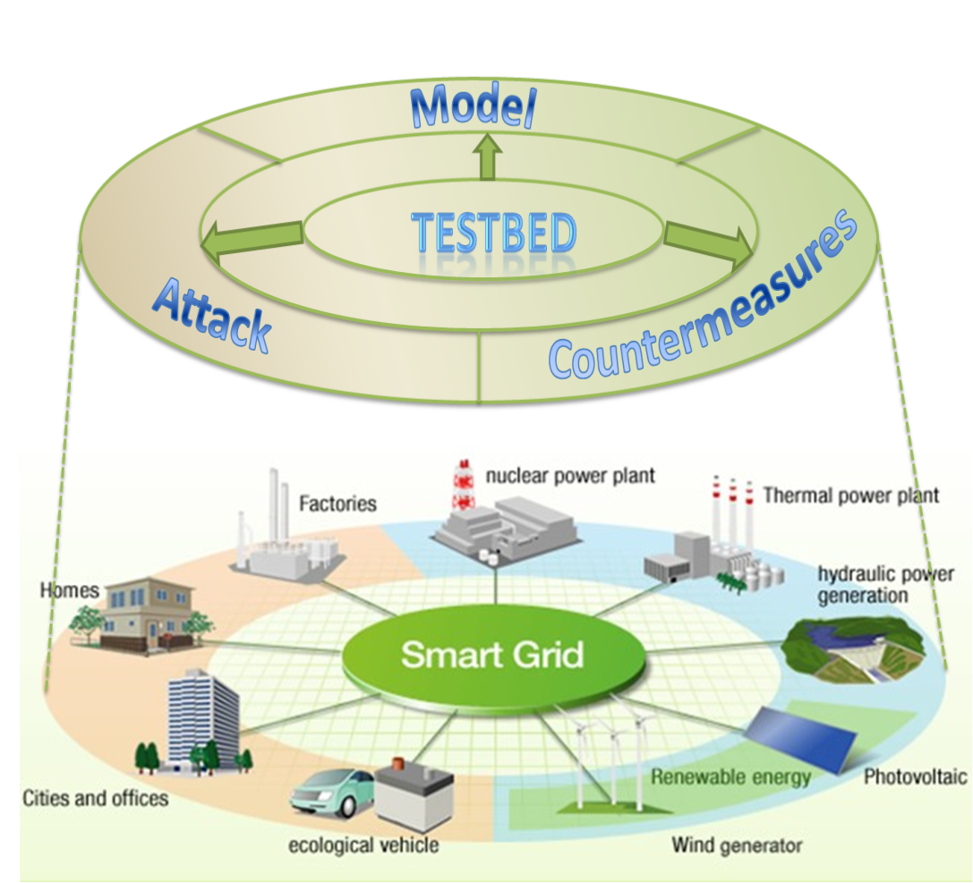
Cybersecurity Research Projects
Secured and Efficient Energy-based Critical Infrastructure
Cloud-Based Threat Monitoring and Detection on Heterogeneous Mobile Devices
Student learning and module effectiveness using eye-tracking

Slide 12
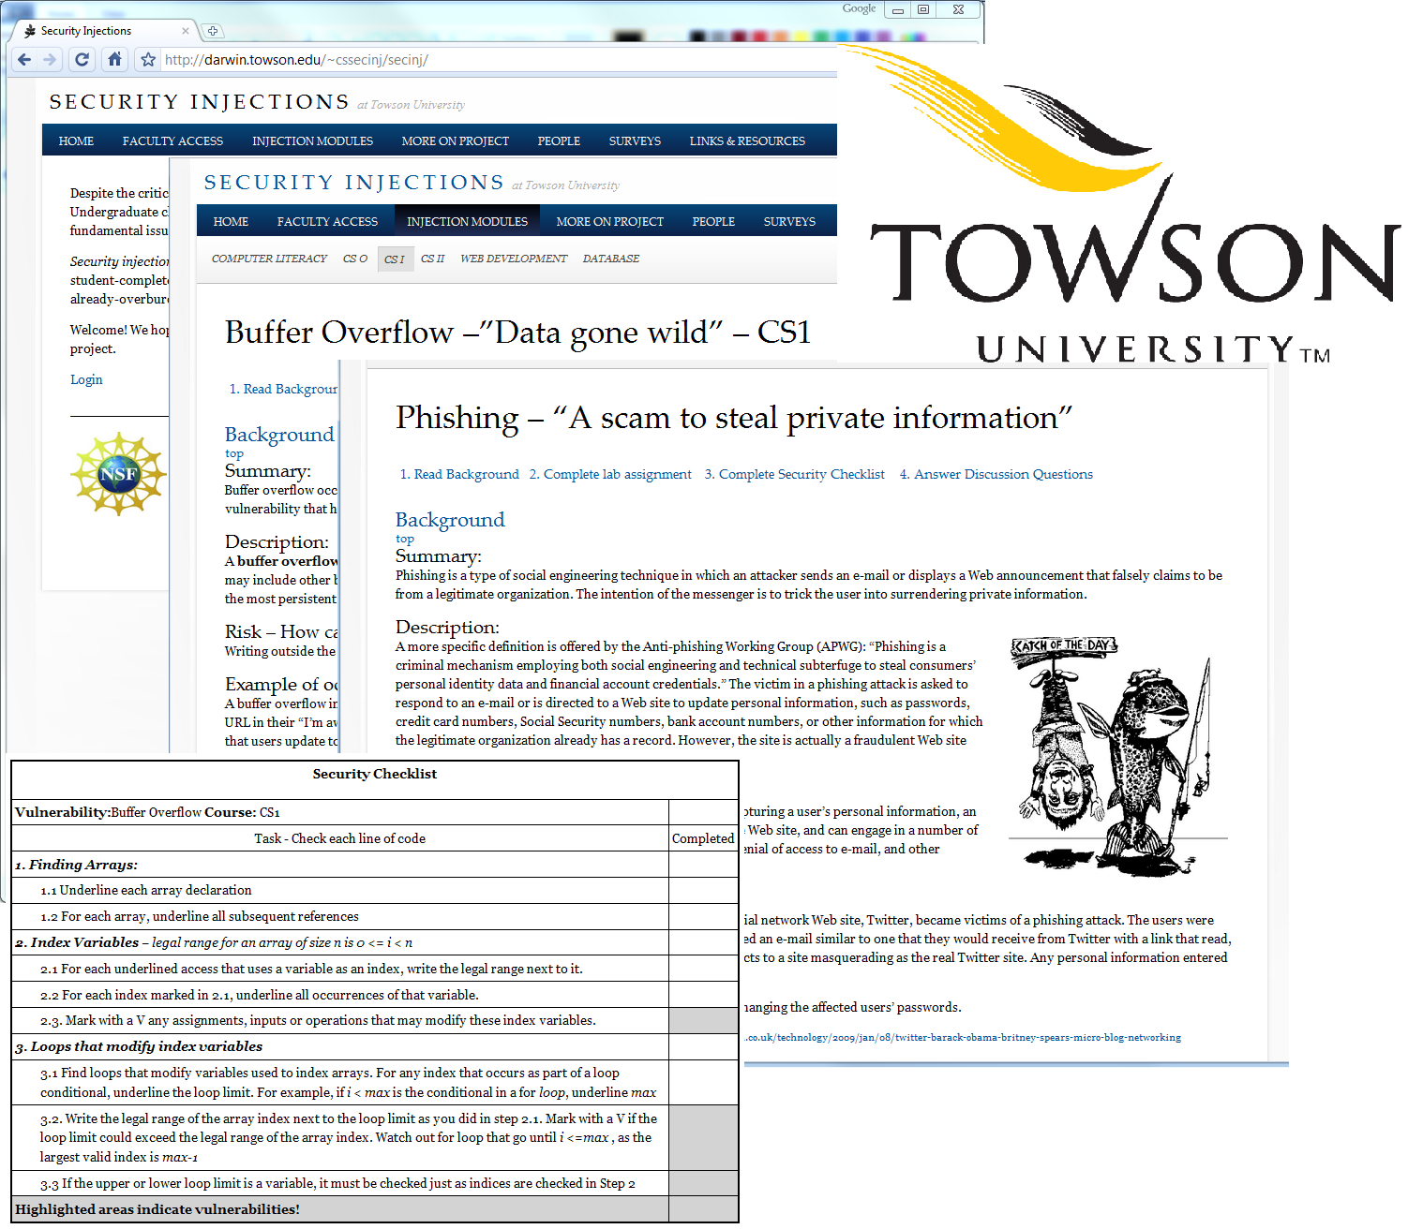
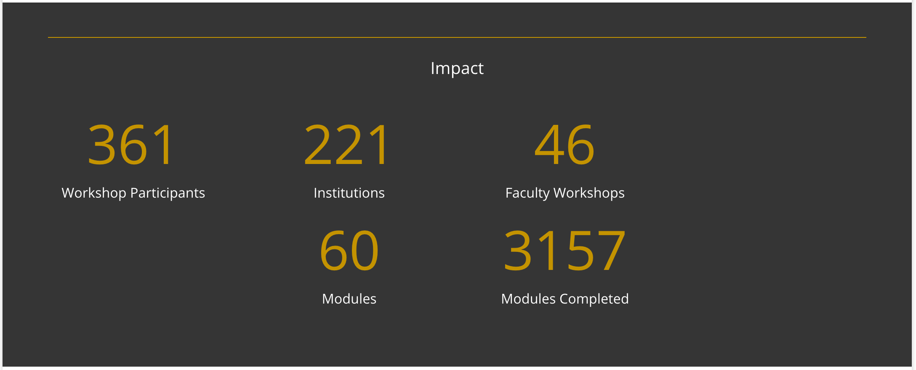
Cyber4All @Towson towson.edu/cyber4all
    Security across the curriculum
    Secure Coding
      CS0, CS1, CS2
      Early and often
      High-impact topics
      Security Checklists
      Minimally Invasive
    Other areas
      Computer Literacy
      Healthcare
      Risk Management
    Over $2 million in funding

Slide 13
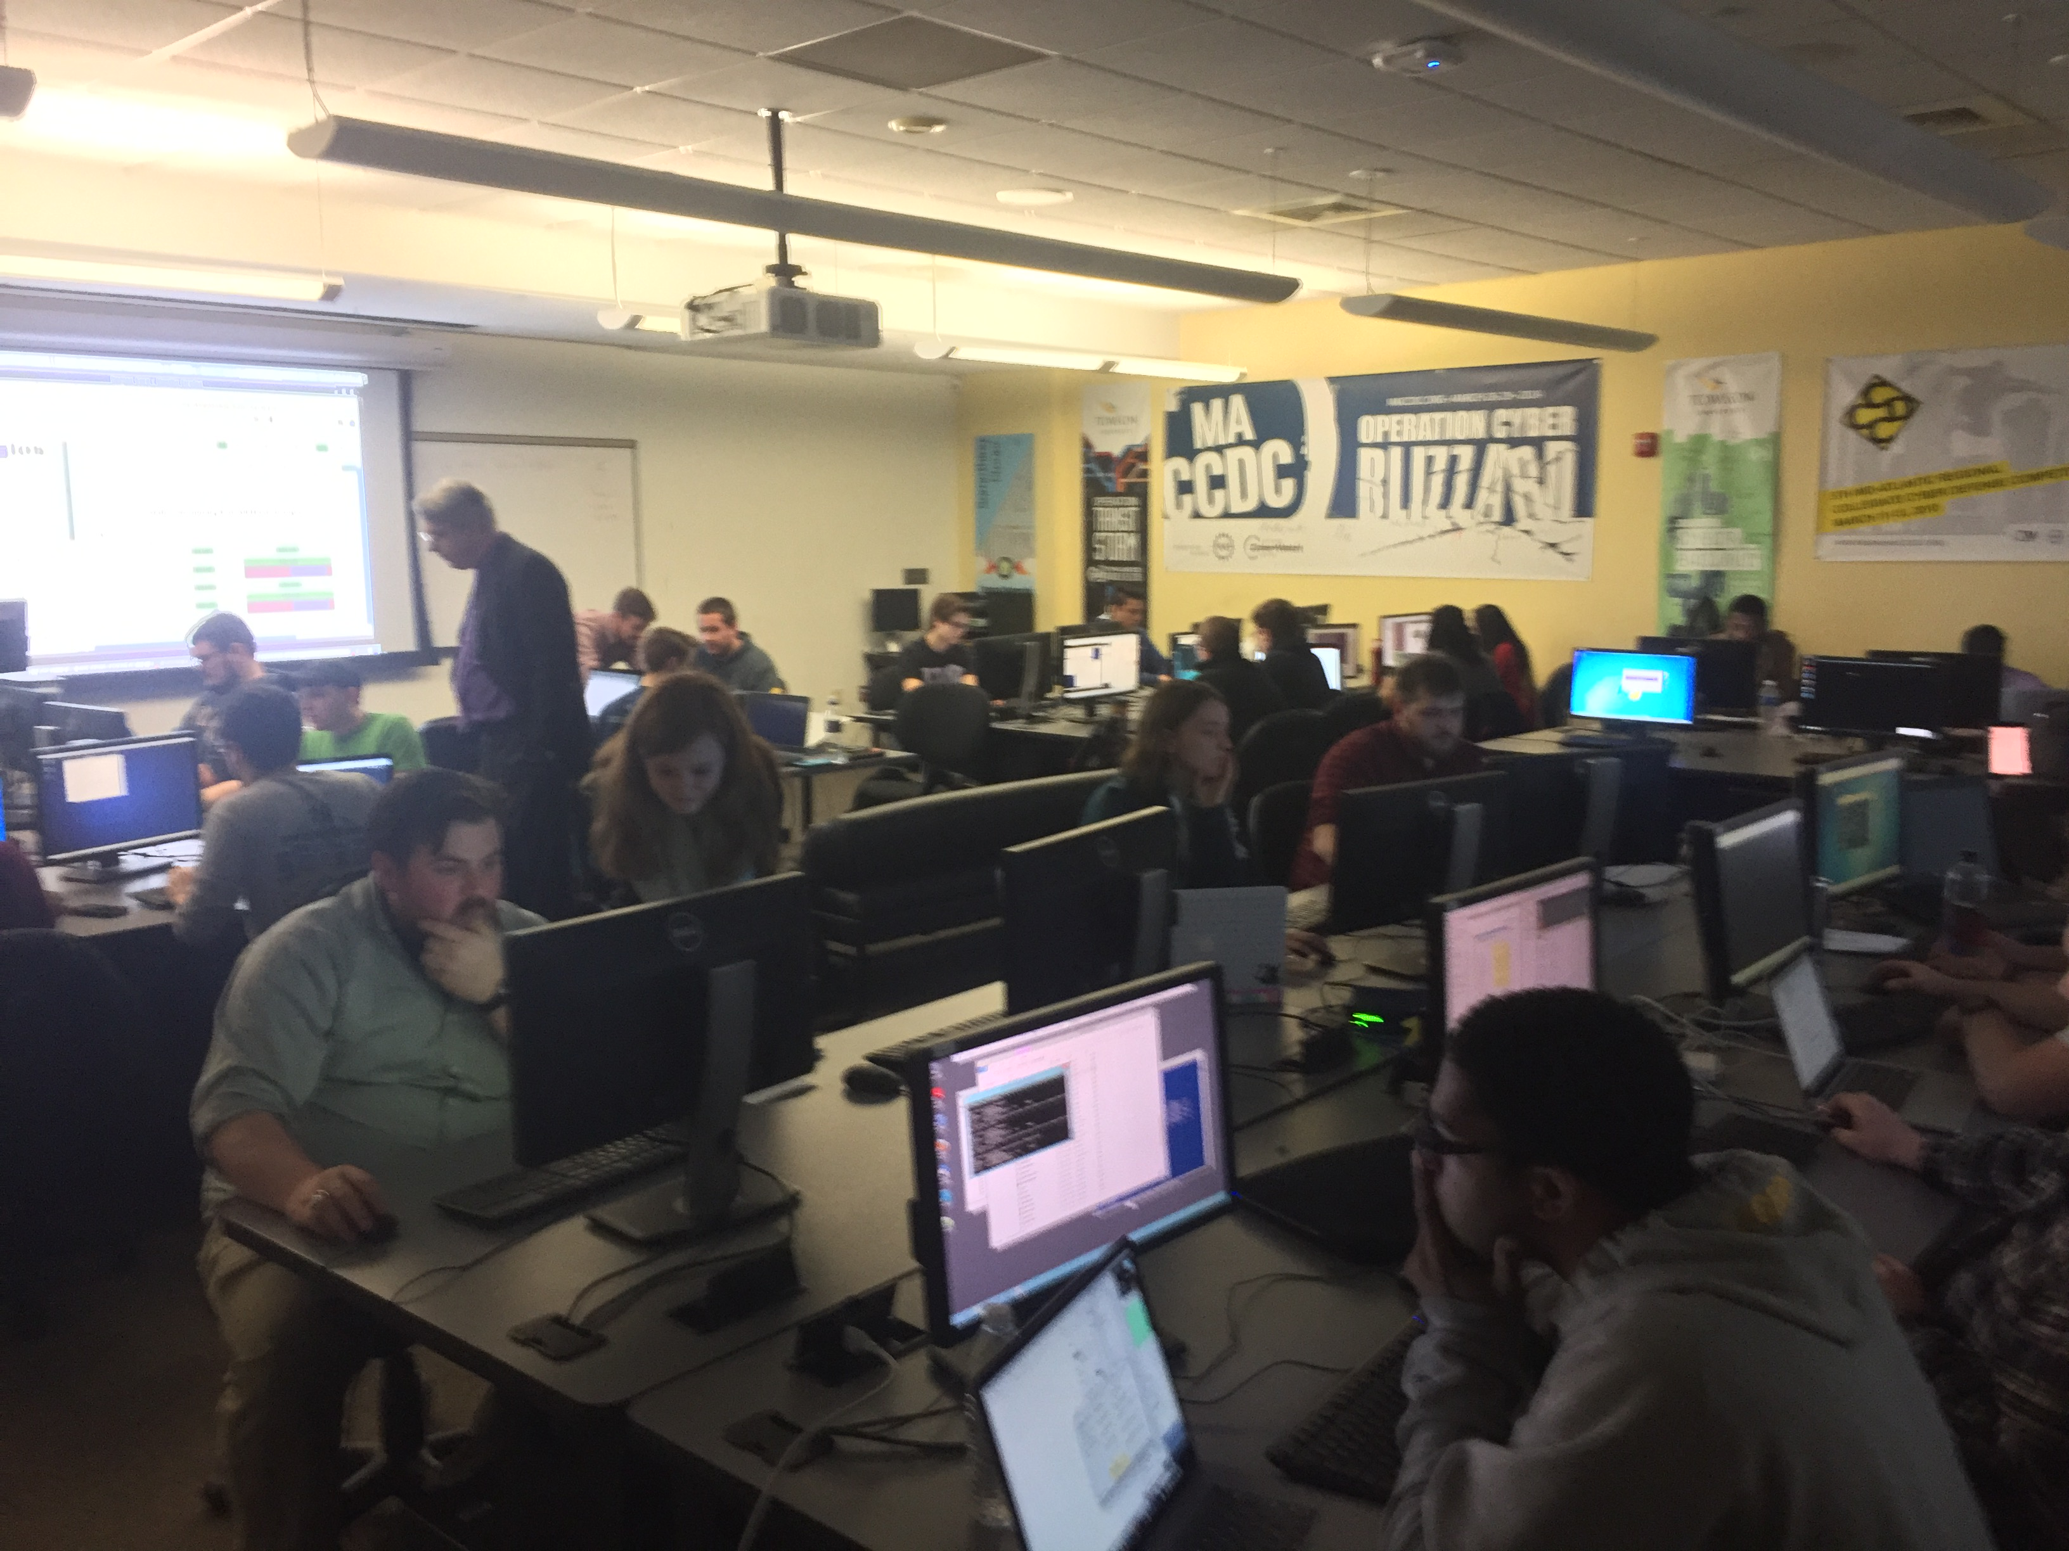
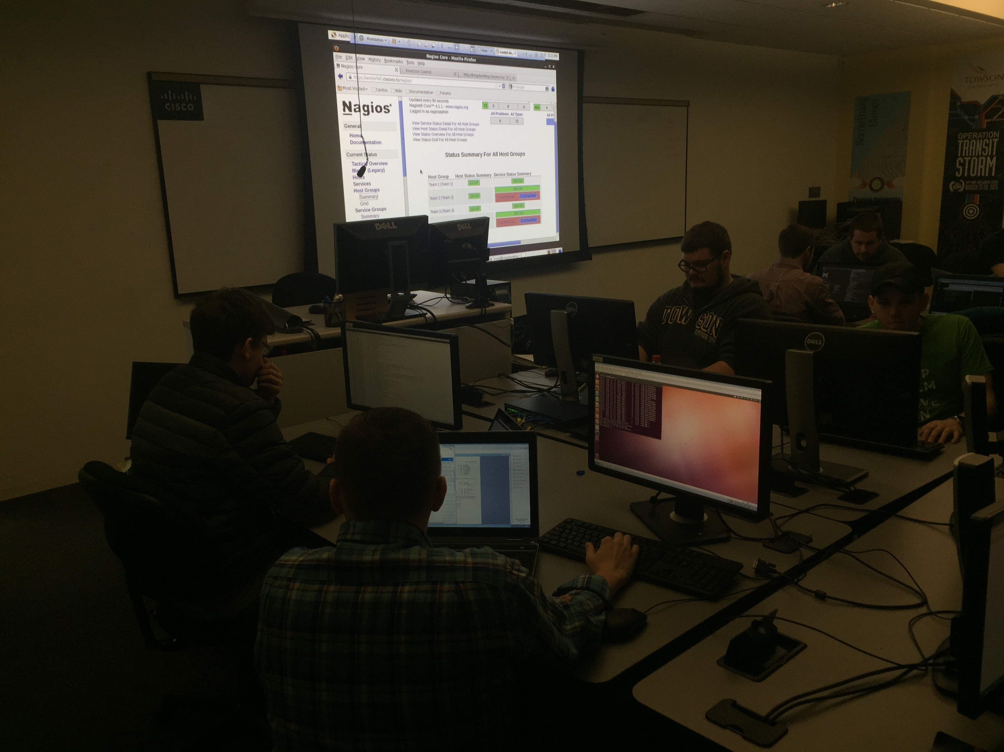
Award Winning Cyber Defense Team
First in mid-Atlantic CCDC - 2010, 2012, 2014 and ranked at the nationals

Slide 14
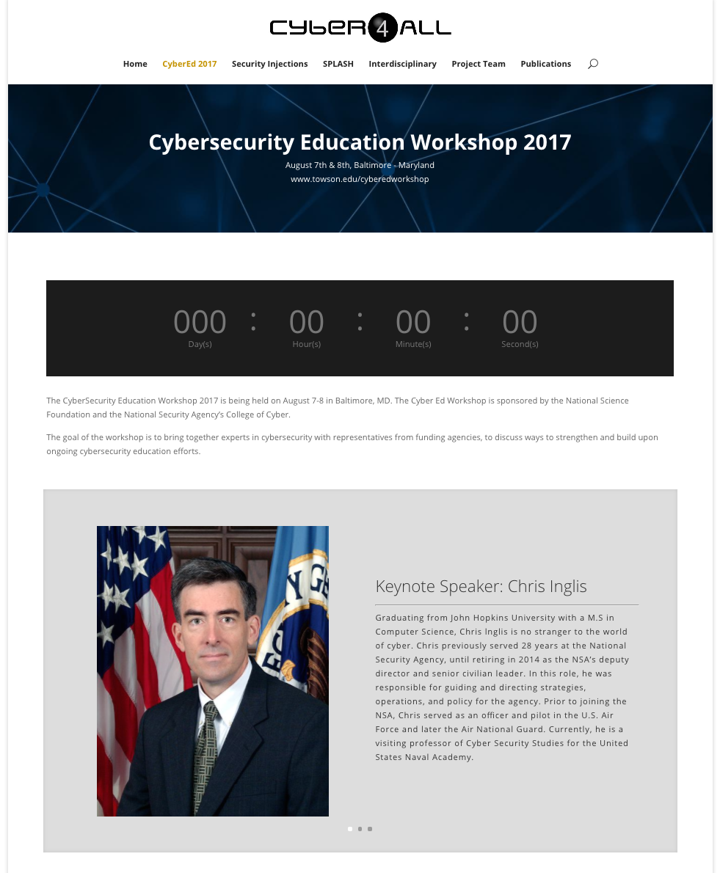
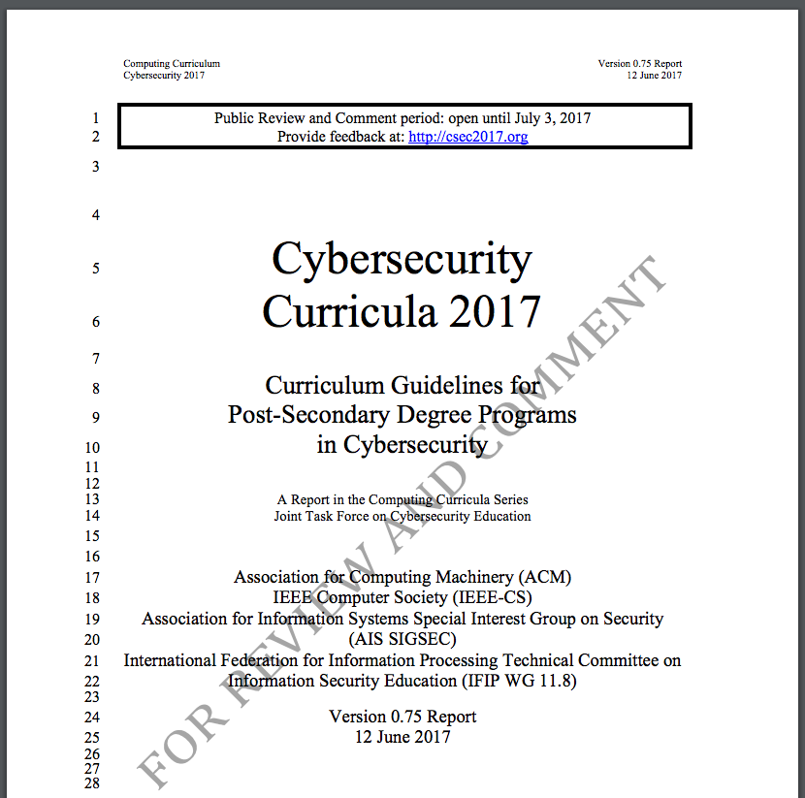
National Efforts
Towson faculty on 11 member task-force involved in writing the first ACM Cybersecurity Curriculum www.csec2017.org
Working with NSA and NSF to organize the Cyber Education Workshop www.towson.edu/cyberedworkshop
First workshop 8/7/17. 100+ attendees. Funding by NSF at Towson until 2022.

Slide 15





CyberCorps®:
Scholarship for Service
    Scholarship Benefits :
      ~$23,000 stipend per year
      Fully paid tuition & fees
      $1,000 for textbooks
      $1,200 for health insurance
      $3,000 for travel to professional conferences and job fairs
http://www.towson.edu/cybercorps

Slide 16

www.towson.edu/cis
@TU_CIS

