Slide 1
Chapter 8 Introduction to HTML
“Computers and Creativity”
Richard D. Webster, COSC 109 Instructor
Office: 7800 York Road, Room 422 | Phone: (410) 704-2424
e-mail: webster@towson.edu
109 website: https://tigerweb.towson.edu/webster/109/index.html

Slide 2
Terms
Web pages Documents that are written in a language called HTML
HTML Stands for Hypertext Markup Language
HTML Markup tags Special codes that tell the Web browser how to display the HTML document
Web browser
An application that can interpret HTML and display the document in the format and layout according to the markup tags
Examples: Firefox, Internet Explorer, Safari, Chrome, Opera

Slide 3
Terms
HTML Document
A plain text file, that can be created using:
a text editor (Notepad in Windows, or TextEdit in Mac OS)
a Web page editor
Web page editor
Example: Microsoft Expression Web, Adobe Dreamweaver
Allows you to create and edit the page visually without having to manually add markup tags

Slide 4
URL
Stands for Uniform Resource Locator
standard for specifying the address of Web pages and other resources on the World Wide Web
Example: http://www.schoolname.edu/departments/compsci/index.html
The address is made up of segments of standard information:
http://
http stands for Hypertext Transfer Protocol
The protocol specifies a set of rules that govern how the information transfer between the Web server and the Web client (the computer that requests to view the page)

Slide 5
URL
Example: http://www.schoolname.edu/departments/compsci/index.html
The address is made up of segments of standard information:
www.schoolname.edu
This is the domain name of the Web server

Slide 6
URL
Example: http://www.schoolname.edu/departments/compsci/index.html
The address is made up of segments of standard information:
departments/compsci/index.html
This is the file path of the document index.html
The file path is the location information of the page on the Web server
In this example, the document index.html is in a folder called compsci, which in turn is located in a folder called departments

Slide 7
Term
XHTML
Stands for Extensible Hypertext Markup Language
Intended to be a replacement for HTML
Most of the tags are the same as those in HTML
Has stricter rules for writing HTML
These stricter rules are also supported but not enforced in HTML

Slide 8
Term
Cascading Style Sheets (CSS)
Widely used for Web page design and layout
Style sheets allow you to define styles to display HTML elements
Multiple style definitions can be combined or cascaded into one—thus the term cascading style sheets
Style sheet files are text files
The styles defined in the files follow specific rules and syntax

Slide 9
Term
JavaScript
A scripting language for Web pages
Can be used to:
add interactivity
generate content on the Web page based on the viewer’s choice
validate online forms before submission
create and track cookies

Slide 10
Term
Dynamic HTML (DHTML)
Not a programming language by itself, but a combination of HTML, CSS, and JavaScript
When combined with CSS, JavaScript can be used to dynamically control properties such as:
text styles
text color
visibility of HTML elements
positioning of HTML elements (and hence create animation)
image file to be used for an image element (and hence create animation)

Slide 11
Term
HTML 5
The newest standard of HTML
Its specifications are still a work in progress (at the time of writing the book)
New features of HTML 5 include:
video and audio tags
content-specfic tags: footer, header, nav, article, section, figure, summary, aside
tags for form elements
canvas element:
allows drawing graphics and displaying images dynamically using JavaScript
commonly used for HTML 5 game development
allowing storage and retrieval of data on the user's device using JavaScript

Slide 12
Markup Tag
Tells the Web browser the format of the text
Surrounded by < >
Examples:
paragraph tag: <p>

Slide 13
Markup Tag
In pairs: start tag and end tag (closing tag)
Example:
start tag: <p>
end tag: </p>
Placement of start and end tags
Example: <p>This is a paragraph.</p>
element content

Slide 14
Tags That Do Not Have Element Content
Examples:
line break: <br></br> can be written as: <br />
image tag: <img></img> can be written as: <img />

Slide 15
Attributes of a Tag
To specify properties of the element that is marked up the tag
Example:
id attribute: <p id="introduction">This is a paragraph.</p>
Placed inside the start tag
In name-value pairs like this: name = "value"

Slide 16
Basic Structure of an HTML Document
<html>
<head>
<title>This is a title.</title>
</head>
<body>
This is the content of the Web page.
</body>
</html>

Slide 17
Document Tags
<html> tag
Encloses the document
Tells the browser that this is the start of an HTML document
End tag </html> is placed at the end of the HTML document
<head> tag
Its element content is information about the document
<title>
function definitions of JavaScript
links to external JavaScript and style sheets
Header information is not displayed in the body of the browser window

Slide 18
Document Tags
<title> Tag
Its element content is the title of the document
The title is displayed on the Window bar of the browser window
The title is used as the bookmark for the page
<body> Tag
Its element content is what will be displayed in the browser window

Slide 19
Nested Tags
Markup elements can be nested in another element (i.e., placed within another element’s content.)
Example:
header and body elements are nested inside <html>
title element is nested inside <head>

Slide 20
End Tag Placement in Nested Tags
Similar to how parentheses are paired in a mathematical equation

Slide 21
More about tags
How to use the HTML tags: <p>, <br>, <h1>-<h6>, <b>, <i>, <strong>, <em>, <a>, <img>, and tags for tables

Slide 22
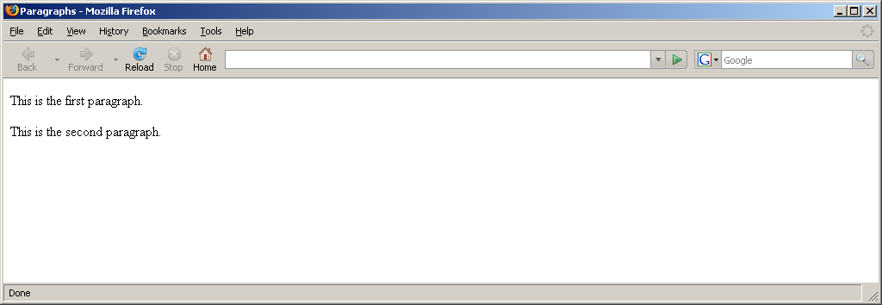
Paragraph: <p></p>
Example: <p>This is the first paragraph.</p> <p>This is the second paragraph.</p>

Slide 23
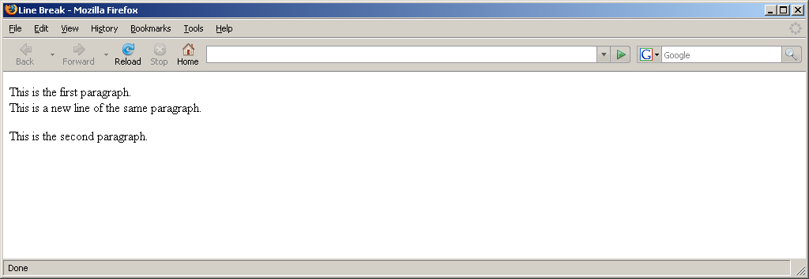
Line Break: <br />
Example: <p>This is the first paragraph.<br />This is a new line of the same
same paragraph.</p> <p>This is the second paragraph.</p>

Slide 24
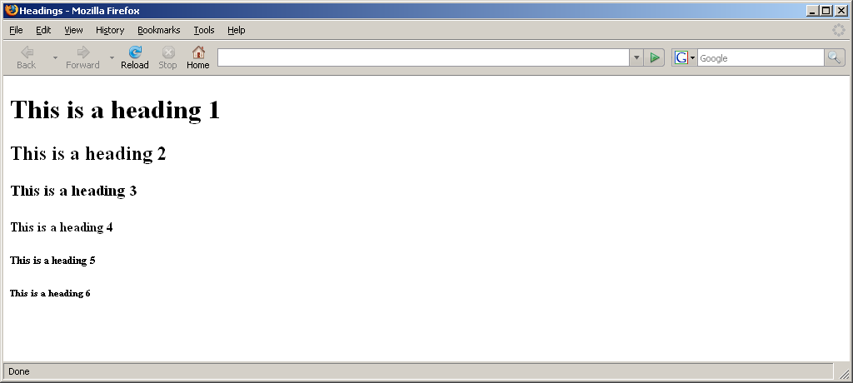
Headings: <h1> - <h6>
Example: <h1>This is a heading 1</h1> <h2>This is a heading 2</h2> <h3>This is a heading 3</h3> <h4>This is a heading 4</h4> <h5>This is a heading 5</h5> <h6>This is a heading 6</h6>

Slide 25
Bold and Italics
Bold:
<b></b>
<strong></strong>
Italics:
<i></i>
<em></em>

Slide 26
Bold and Italics
Example:
<p>This is normal text.</p>
<p>
<b>This text is bold. </b>
<i>This text is italic.</i>
</p>
<p>
<b><i>This text is bold and italic.</i></b>
</p>
<p>
<i><b>This text is also bold and italic.</b></i>
</p>

Slide 27
Bold and Italics
Example:
<p>This is normal text.</p>
<p>
<strong>This text is bold. </strong>
<em>This text is italic.</em>
</p>
<p>
<strong><em>This text is bold and italic.</em></strong>
</p>
<p>
<em><strong>This text is also bold and italic.</strong></em>
</p>

Slide 28
Bold and Italics

Slide 29
List
Ordered list: <ol></ol>
Unordered list: <ul></ul>
List item: <li></li>

Slide 30
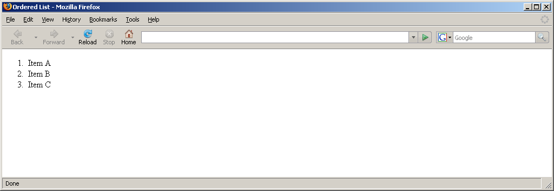
List
Ordered list example:
<ol>
<li>Item A</li>
<li>Item B</li>
<li>Item C</li>
</ol>

Slide 31
Link: <a href="..."></a>
General Syntax:
<a href="url or file path">whatever to be displayed as a clickable link</a>
href is the attribute
Example:
<a href="http://www.google.com/">Google Web Site</a>

Slide 32
Image: <img src="..."></img>
General Syntax:
<img src="url or file path" />
or
<img src="url or file path"></img>
No element content
src is the attribute
Example:
<img src="logo.jpg" />

Slide 33
Table
Table: <table></table>
Table row: <tr></tr>
Table data: <td></td>

Slide 34
Table
Example: A table without a border
<table>
<tr>
<td> row 1, column 1</td>
<td> row 1, column 2</td>
</tr>
<tr>
<td> row 2, column 1</td>
<td> row 2, column 2</td>
</tr>
<tr>
<td> row 3, column 1</td>
<td> row 3, column 2</td>
</tr>
</table>
Example: A table with a border
<table border="1">
<tr>
<td> row 1, column 1</td>
<td> row 1, column 2</td>
</tr>
<tr>
<td> row 2, column 1</td>
<td> row 2, column 2</td>
</tr>
<tr>
<td> row 3, column 1</td>
<td> row 3, column 2</td>
</tr>
</table>

Slide 35
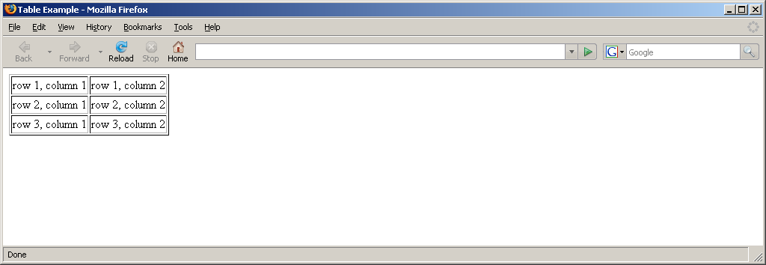
Table
Without a table border
With a table border

Slide 36
File Path
Location of a file on a computer
Like an address to a house
Start with the outermost folder to the inner folders
Folder names are separated by a slash (/)

Slide 37
Types of File Paths for Web Documents
Absolute paths
Document-relative paths
Site root-relative paths

Slide 38
Absolute Paths
Example: http://www.mysite.com/products/coffee/french-roast.html
Full URL to a Web page or any media
Used for linking to files that are on a different Web site

Slide 39
Document-Relative Paths
Example: products/coffee/french-roast.html
Most commonly used in Web authoring
The path is relative to the page that french-roast.html is being requested

Slide 40
Site Root-Relative Paths
Example: /products/coffee/french-roast.html
Starts with a slash (/), meaning starting from the root folder of the site
A root folder is the outermost folder of the site

Slide 41
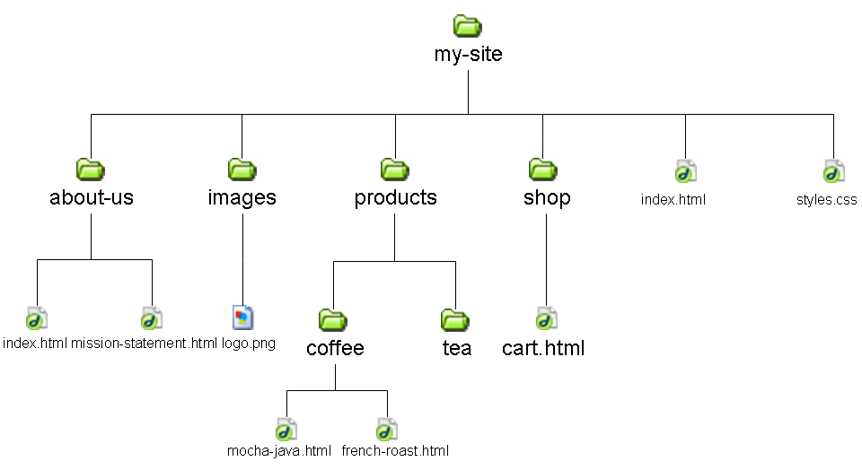
Example Folder Structure of a Site
Root folder
Root folder

Slide 42
Navigating Folders

Slide 43
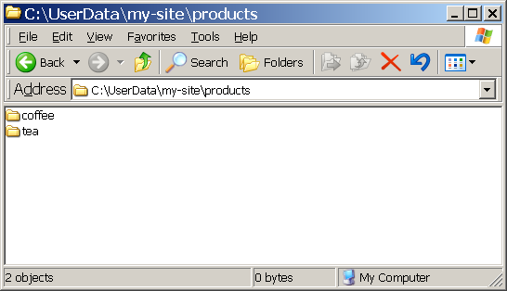
Opening the "products" folder

Slide 44
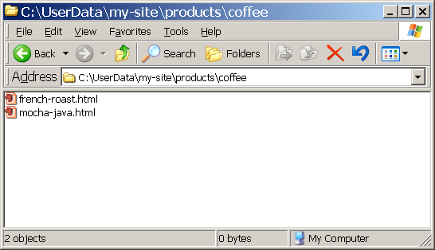
Opening the "coffee" folder that is inside "products"

Slide 45
To Construct a Document-Relative Path
Need to know:
Target page: The page being linked to
Source page: The page containing the link or the page being linked from
Think of the document-relative path as the direction to navigate from the source page to the target page.

Slide 46
To Construct a Document-Relative Path
Rule #1:
To link to another file that is in the same folder as the current document, simply use the filename as the path.

Slide 47
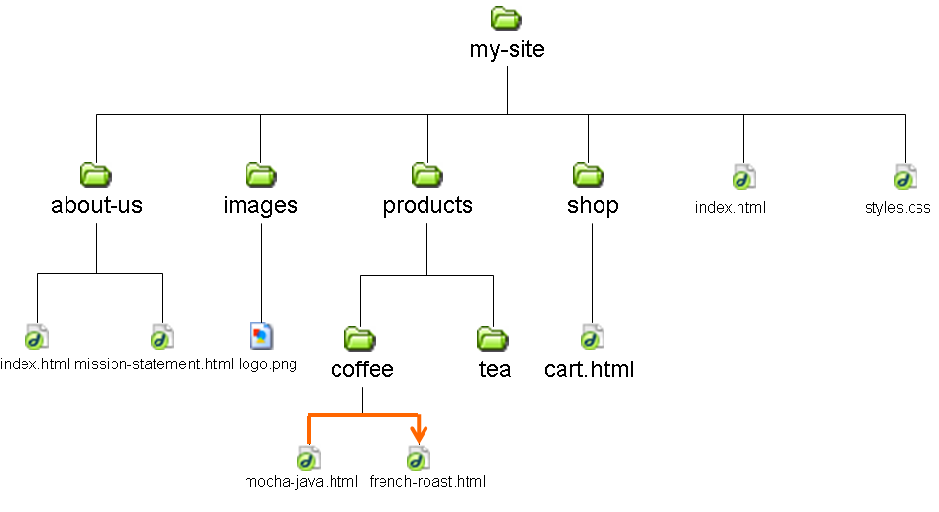
To Construct a Document-Relative Path
Example: To add a link in mocha-java.html (source page) to link to french-roast.html (target page), the file path is simply the filename french-roast.html

Slide 48
Review
HTML files are text files.
Tags are the markup codes in an HTML document that tell a web browser how to format the text when the text is displayed.

