Slide 1
Chapter 6 Fundamentals of Digital Video
“Computers and Creativity”
Richard D. Webster, COSC 109 Instructor
Office: 7800 York Road, Room 422 | Phone: (410) 704-2424
e-mail: webster@towson.edu
109 website: https://tigerweb.towson.edu/webster/109/index.html

Slide 2
Video
motion
a sequence of pictures
frames

Slide 3
Frame Rate
How fast the pictures are captured
How fast the frames are played back is determined by
Frames per second (fps)

Slide 4
Broadcast Standards
Digital video resolution
Color spaces
Frame rate
Influenced by analog TV broadcast standards

Slide 5
Standards for Analog Color TV
NTSC:
designated by U.S.'s National Television Systems Committee
U.S., Japan, Taiwan, parts of the Carribean, South America
PAL:
Phase Alternating Line
Australia, New Zealand, Western Europe, Asian
SECAM:
Séquentiel Couleur avec Mémoire
France, former Soviet Union, Eastern Europe

Slide 6
Frame Rates of Different Broadcast Standards
Video Type | Frame Rate (frames per second)
NTSC (black-and-white) | 30
NTSC (color) | 29.97
PAL | 25
SECAM | 25
Motion-picture film | 24

Slide 7
How CRT Monitors and TVs Display Pictures
Picture displayed on CRT is made up of horizontal lines
NTSC: 525 lines (about 480 lines are picture)
PAL and SECAM: 625 lines (about 576 lines are picture)
Lines are traced across the screen
one line at a time
from top to bottom

Slide 8
Ways of Tracing Lines From Top to Bottom
Progressive scan:
from top to bottom in one pass
Interlaced scan:
in two passes:
even-numbered lines
odd-numbered lines

Slide 9
Interlace Artifacts
Not discernible during normal playback of most videos
DeInterlace
To remove the interlace artifact
Common method:
discard one field
fill in the gaps by duplicating or interpolating the other field

Slide 10
Sampling and Quantization of Motion
Temporal:
sampling rate:
how frequent you take a snapshot of the motion
frame rate
higher sampling rate: higher frame rate
higher frame rate ⇒ more frames for the same duration ⇒ larger file size

Slide 11
Sampling and Quantization of Motion
Each snapshot: a frame
an image
digitized based on the same concepts of sampling and quantization of images
Frame Size
Resolution of the frame image
Measured in pixel dimensions
No ppi setting: Unlike digital images, there is no pixel per inch (ppi) setting for video because video is not intended for print but for on screen display.

Slide 12
Frame Size Examples
 |  | Frame size
NTSC | standard definition | 720 x 480 pixels
 | high definition HDV format | 1280 x 720 pixels 1440 x 1080 pixels
PAL | standard definition | 720 x 576 pixels
Note that the frame size of a video refers to the video’s Resolution.

Slide 13
Frame Aspect Ratio
the ratio of a frame's viewing width to height
NOT equivalent to ratio of the frame’s pixel width to height.

Slide 14
Frame Aspect Ratio Examples
4:3
16:9
Example:
Standard definition NTSC standard format
Examples:
Standard definition NTSC wide-screen format
High definition digital video
High definition TV

Slide 15
Distortion
Pixel Apect Ratios | Distortion
video frame's = display system's | none
video frame's < display system's | stretched horizontally
video frame's > display system's | stretched vertically

Slide 16
Digital Video Standards
Standard definition
High definition
Digital Television

Slide 17
The Term DV
Common simple abbreviation for digital video
DV compression and DV format: specific types of digital video compression and format respectively
In this textbook
DV refers to the specific types of digital video
DV is NOT used to abbreviate digital video

Slide 18
Standard Definition DV25 Format
widescreen format
Pixel Dimensions |  | 720 × 480 (NTSC)
Frame Aspect Ratio |  | 4:3 | 16:9
Pixel Aspect Ratio |  | 0.9 | 1.2
Data Rate | Total (video + audio + control information): | 3.6 megabytes per second (MB/s), i.e. about 4.6 minutes of video per gigabyte of storage space
 | Video data only: | 25 megabits per second (Mbps); compressed at a fixed rate of 5 :1
Color Sampling Method |  | YUV 4:1:1
Audio Setting | Sampling rate and bit depth: | Two options: 48 kHz, 16-bit 32 kHz, 12-bit

Slide 19
High Definition
Common high definition video formats:
HDV
DVCPro HD
AVCHD
AVC-Intra
Different video cameras support different high def. format
The name of the supported format is printed on the body of the video camera

Slide 20
Picture Format Notation
1080
/
60
i
"i": interlaced
"p": progressive
frame/field frequency
frame height

Slide 21
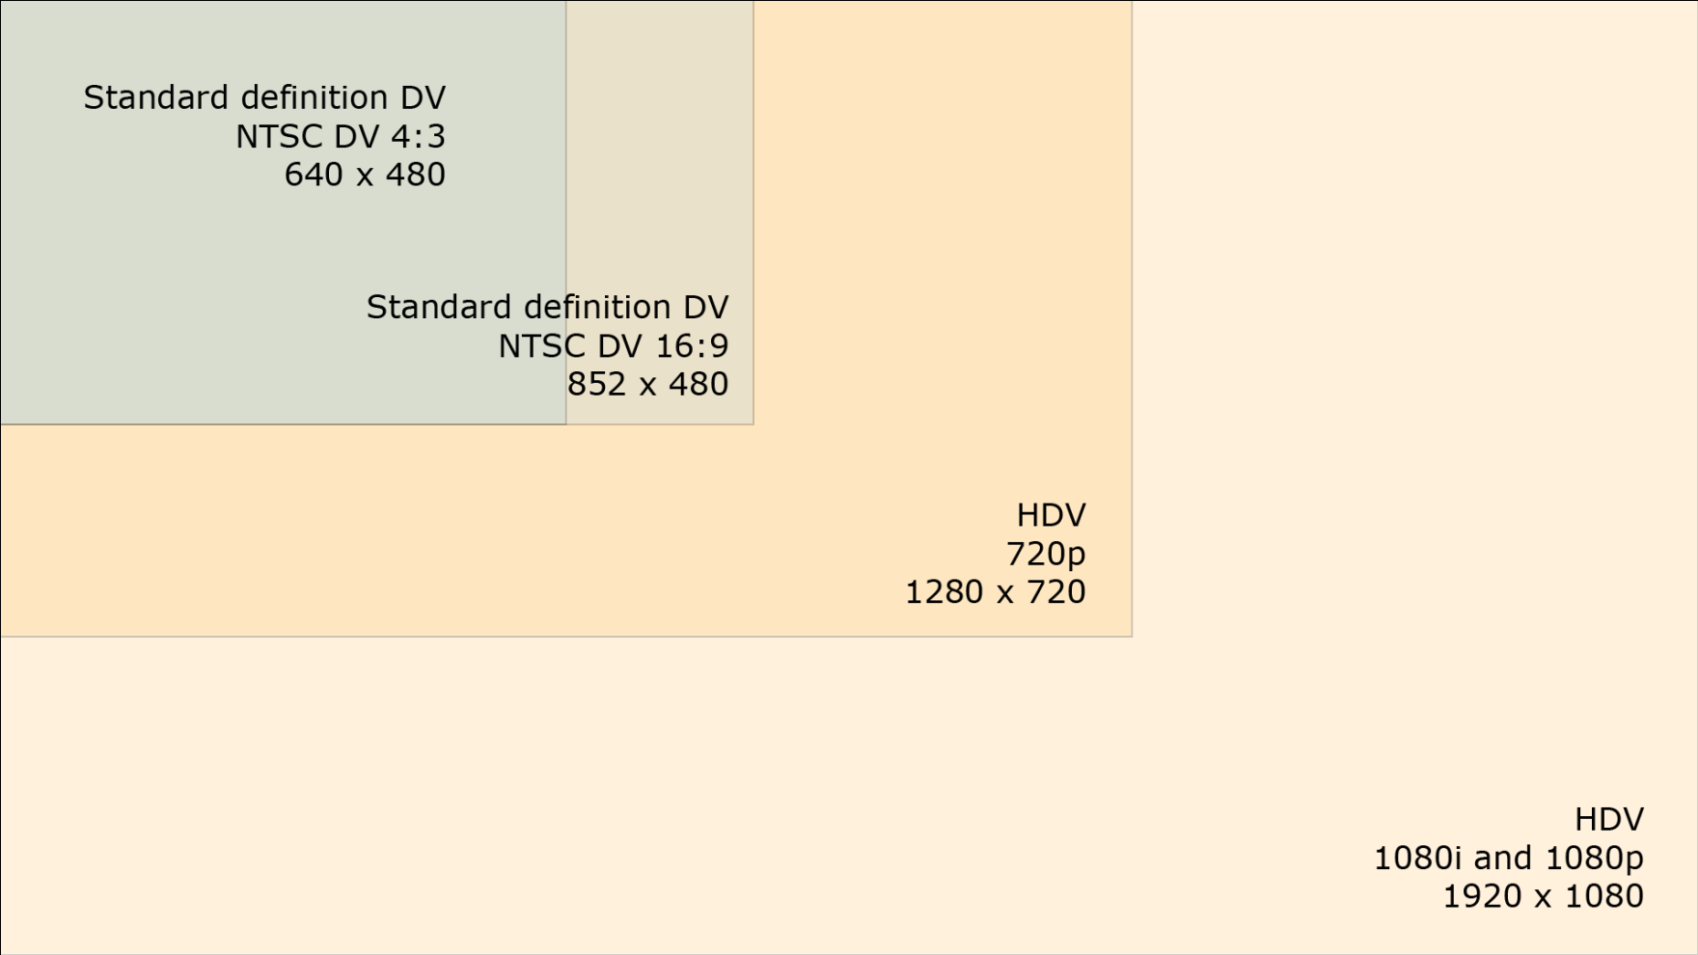
Frame Size (Resolution) Comparison between Standard Definition and High Definition
By viewing frame size

Slide 22
Digital Television (DTV)
Signals of DTV are broadcast and transmitted digitally
Need a digital TV set to watch
Standard definition
704 × 480, 16:9 and 4:3, progressive and interlaced
640 × 480, 4:3, progressive and interlaced
High definition
1920 × 1080, 16:9, progressive and interlaced
1280 × 720, 16:9, progressive and interlaced
MPEG-2

Slide 23
Common Video File Types
File Type | Acronym For | Originally Created By | File Info & Compression | Platforms
.mov | QuickTime movie | Apple | Also audio-only Can be streamed "Fast start" Common compression methods: H.264, Sorenson Video, Animation | Apple QuickTime player, which is available for Mac and Windows
.avi | Audio Video Interleave | Intel | Common compression methods: Microsoft RLE, Intel Indeo Video | Primarily used on Windows but Apple QuickTime player can play AVI files
.mpg .mpeg | MPEG | Motion Picture Experts Group | For DVD-video High definition HDV | Cross-platform
.divx |  | DivX, Inc | Uses DivX codec, which is based on MPEG-4 Popular format for movies because of the high image quality and small file size AVI is a common container file format | May require downloading DivX codec Windows Media Player v11.0 comes with DivX codec

Slide 24
Common Video File Types
File Type | Acronym For | Originally Created By | File Info & Compression | Platforms
.mp4 | MPEG-4 | Moving Pictures Experts Group | Video codec: H.264 Audio codec: AAC One of the HTML5 video formats | Plays in Web browsers that support the MP4 format of HTML5 video (Safari and IE)
.ogg or .ogv | Audio Video Interleave | Xiph.Org Foundation | Video codec: Theora Audio codec: Vorbis One of the HTML5 video formats Compared to the other two HTML5 video formats, it has lower quality for the same file size | Plays in Web browsers that support the OGG format of HTML5 video (Firefox, Chrome, Opera)
.webm |  | An open source video format from Google | Video codec: VP8 Audio codec: Vorbis One of the HTML5 video formats | Plays in Web browsers that support the WebM format of HTML5 video (Firefox, Chrome, Opera)

Slide 25
Common Video File Types
File Type | Acronym For | Originally Created By | File Info & Compression | Platforms
.flv | Flash Video | Adobe | Progressive download Can be streamed Common compression methods: H.264, Sorenson Spark, On2 VP6 | Cross-platform Requires Adobe Media Player to play
.f4v | Flash Video | Adobe | Builds on MPEG-4 Part 12 Supports H.264/ACC-based content | A newer Flash Video format than flv Cross-platform Requires Adobe Media Player to play Can be embedded in Flash SWF files
.wmv | Windows Media | Microsoft |  | Requires Windows Media Player to play

Slide 26
Considerations for File Type
File size restriction
Intended audience
Future editing

Slide 27
File Size Restriction
For Web:
high compression
streaming video
CD-ROM or DVD-ROM playback:
use data rate that can be handled by your target audience's computer
DVD-video:
MPEG-2

Slide 28
Intended audience
Multiple platforms
cross-platform formats: Apple QuickTime, MPEG, Flash video, Real Video
How your target audience is going to watch your video?

Slide 29
Future Editing
If the video will be used as a source for future editing:
Lower compression level
Choose uncompressed, if
the frame size is small
the video duration is extremely short
you have enough disk space

Slide 30
General Strategies for Reducing Video Data Rate
Basic ideas:
A video is a sequence of images + audio
Apply strategies for reducing digital image and audio file size.

Slide 31
General Strategies for Reducing Video File Size
General Strategies for reducing digital image file size
reduce frame size
reduce frame rate
choose a video compressor that allows higher compression
choose the lower picture quality option
Reduce duration of the video so you have less frames
not always possible
will not impact data rate

Slide 32
Why General Strategies for Reducing Digital Image File Size Work for Video
Reduce frame size because:
you have less pixels for each frame
Reduce frame rate because:
you have less frames
Video compression with high compression because:
some data are discarded
Lower picture quality option because:
some data are discarded

Slide 33
Strategies Least Used for Reducing Video Data Rate
Reduce bit depth
Not all video formats support lower bit depth
Live videos need 24-bit to look natural
Some compressors do not support lower bit depth
Reduce sampling rate, bit depth, and channel numbers of the audio
size of the audio is insignificant compared to that of the picture component in a video

Slide 34
Compression and Decompression
Compression:
To reduce file size
Takes time
Often takes more time for higher compression
Decompression:
A compression video file must be decompressed before it is played.
The decompression method or algorithm depends on how it is originally compressed.
Compression and decompression always go together as a pair.
Codec: compressor/decompressor

Slide 35
MPEG
Moving Pictures Experts Group Committee who derives standards for encoding video
Allow high compression
MPEG-1, MPEG-2, MPEG-4
What happened to MPEG-3?
NOT MP3 (which is audio format)
Intended for HDTV
HDTV specifications was merged into MPEG-2

Slide 36
MPEG-1
Video quality comparable to VHS
Originally intended for Web and CD-ROM playback
Frame sizes up to 352 × 240 pixels
Video format for VCD (VideoCD) before DVD became widespread

Slide 37
MPEG-2
Supports DVD-video, HDTV, HDV standards
For DVD video production: Export video into DVD MPEG-2 format
For HDV video production: Export video into HDV's MPEG-2 format

Slide 38
MPEG-4
Newer standard of MPEG family
MPEG-4 targets mobile applications, as in cell phones.

