Slide 1
Chapter 4 Fundamentals of Digital Audio
“Computers and Creativity”
Richard D. Webster, COSC 109 Instructor
Office: 7800 York Road, Room 422 | Phone: (410) 704-2424
e-mail: webster@towson.edu
109 website: https://tigerweb.towson.edu/webster/109/index.html

Slide 2
Sound
A wave that is generated by vibrating objects in a medium such as air
Examples of vibrating objects:
vocal cords of a person
guitar strings
tunning fork

Slide 3
Frequency of Sound Wave
Refers to the number of complete back-and-forth cycles of vibrational motion of the medium particles per unit of time
Unit for frequency: Hz (Hertz)
1 Hz = 1 cycle/second

Slide 4
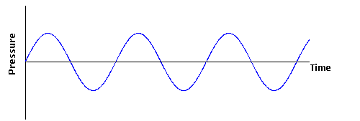
A Cycle
a cycle
a cycle
a cycle
a cycle

Slide 5
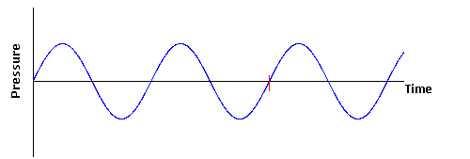
Frequency
Suppose it is1 second
a cycle
a cycle
Frequency = 2 Hz (i.e., 2 cycles/second)

Slide 6
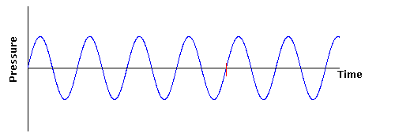
Frequency
Suppose it is1 second
a cycle
a cycle
a cycle
a cycle
Frequency = 4 Hz (i.e., 4 cycles/second)
Higher frequency than the previous waveform.

Slide 7
Pitch of Sound
Sound frequency
Higher frequency: higher pitch
human ear can hear sound ranging from 20 Hz to 20,000 Hz

Slide 8
Sound Intensity vs. Loudness
Sound intensity:
an objective measurement
can be measured with auditory devices
in decibels (dB)
Loudness:
a subjective perception
measured by human listeners
human ears have different sensitivity to different sound frequency
in general, higher sound intensity means louder sound

Slide 9
Application of Decibels
Many audio-editing programs use decibels for the audio amplitude
0 dB:
Threshold of hearing
minimum sound pressure level at which humans can hear a sound at a given frequency
does NOT mean zero sound intensity
does NOT mean absence of sound wave
about 120 dB:
threshold of pain
sound intensity that is 10¹² times greater than 0 dB

Slide 10
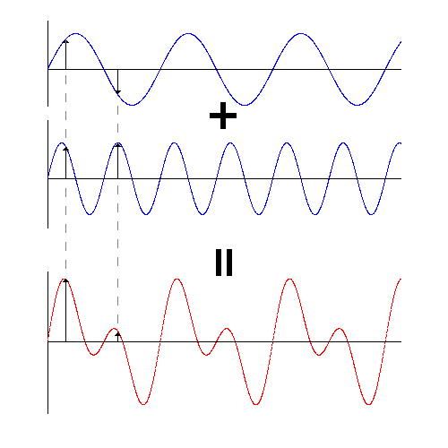
Adding Sound Waves
A sinlge sine wave waveform
A single tone
A second sinlge sine wave waveform
A second single tone
A more complex waveform
A more complex sound

Slide 11
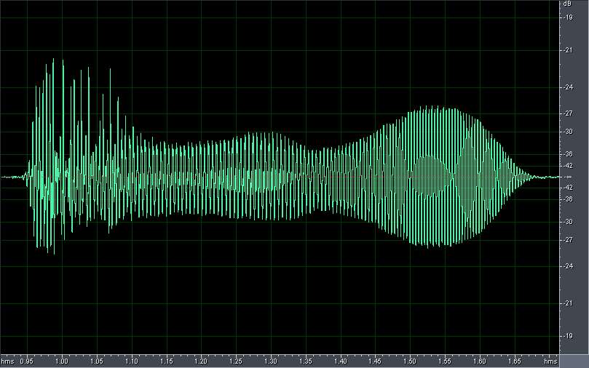
Waveform Example
A waveform of the spoken word "one"

Slide 12
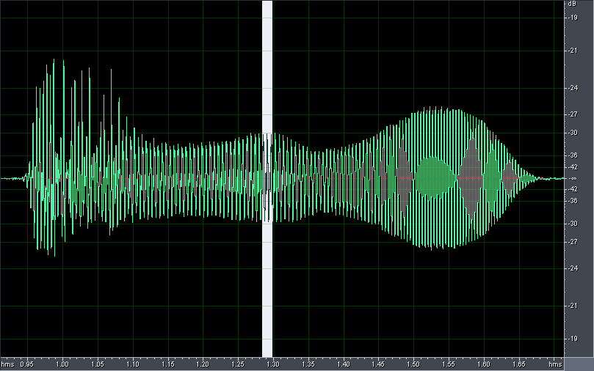
Waveform Example
Let's zoom in to take a closer look

Slide 13
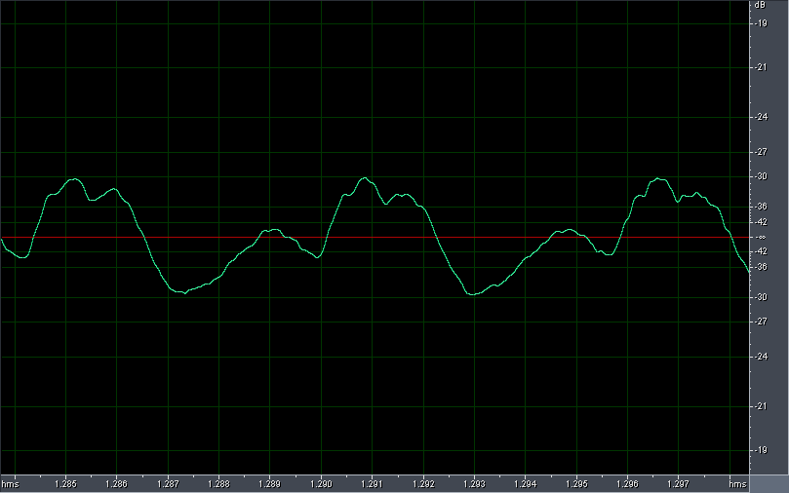
Waveform Example
A closer look

Slide 14
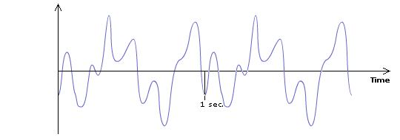
Step 1. Sampling
The sound wave is sampled at a specific rate into discrete samples of amplitude values.

Slide 15
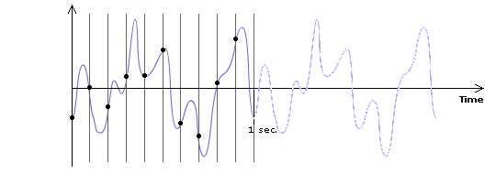
Step 1. Sampling
The sound wave is sampled at a specific rate into discrete samples of amplitude values.
Suppose we sample the waveform 10 times a second, i.e., sampleing rate = 10 Hz.

Slide 16
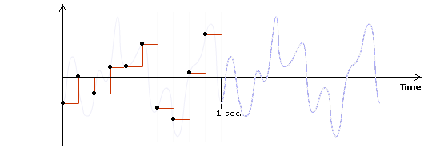
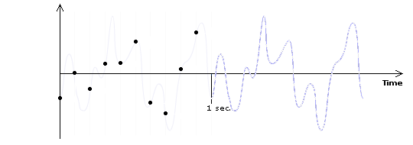
Step 1. Sampling
The sound wave is sampled at a specific rate into discrete samples of amplitude values.
Suppose we sample the waveform 10 times a second, i.e., sampleing rate = 10 Hz.
We get 10 samples per second.

Slide 17
Step 1. Sampling
The sound wave is sampled at a specific rate into discrete samples of amplitude values.
Reconstructing the waveform using the discrete sample points.

Slide 18
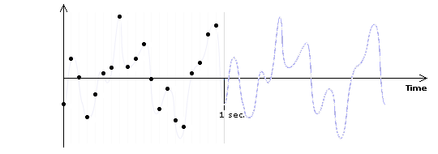
Step 1. Sampling
What if we sample 20 times a second, i.e., sampling rate = 20 Hz?
We get 20 samples per second.

Slide 19
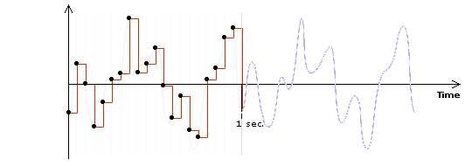
Step 1. Sampling
What if we sample 20 times a second, i.e., sampling rate = 20 Hz?
Reconstructing the waveform using the discrete sample points.

Slide 20
Effects of Sampling Rate
original waveform
sampling rate = 10 Hz
sampling rate = 20 Hz

Slide 21
Effects of Sampling Rate
Higher sampling rate:
The reconstructed wave looks closer to the original wave
More sample points, and thus larger file size

Slide 22
Sampling Rate Examples
11,025 Hz AM Radio Quality/Speech
22,050 Hz Near FM Radio Quality (high-end multimedia)
44,100 Hz CD Quality
48,000 Hz DAT (digital audio tape) Quality
96,000 Hz DVD-Audio Quality
192,000 Hz DVD-Audio Quality

Slide 23
Step 2. Quantization
Each of the discrete samples of amplitude values obtained from the sampling step are mapped and rounded to the nearest value on a scale of discrete levels.
The number of levels in the scale is expressed in bit depth--the power of 2.
An 8-bit audio allows 2⁸ = 256 possible levels in the scale
CD-quality audio is 16-bit (i.e., 2¹⁶ = 65,536 possible levels)

Slide 24
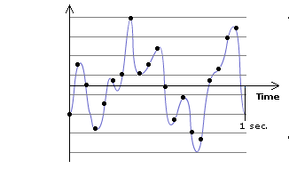
Step 2. Quantization
Suppose we are quantizing the samples using 3 bits (i.e. 2³ = 8 levels).

Slide 25
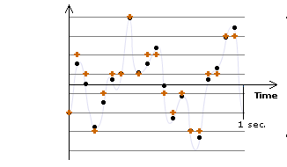
Step 2. Quantization
Now, round each sample to the nearest level.

Slide 26
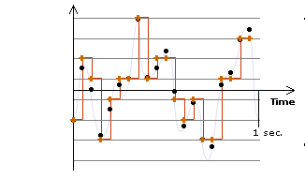
Step 2. Quantization
Now, reconstruct the waveform using the quantized samples.

Slide 27
Effects of Quantization
Data with different original amplitudes may be quantized onto the same level ⇒ loss of subtle differences of samples
With lower bit depth, samples with larger differences may also be quantized onto the same level.

Slide 28
Bit Depth
Bit depth of a digital audio is also referred to as resolution.
For digital audio, higher resolution means higher bit depth.

Slide 29
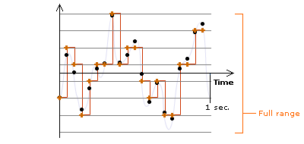
Dynamic Range
The range of the scale, from the lowest to highest possible quantization values
In the previous example:

Slide 30
Choices of Sampling Rate and Bit Depth
Higher sampling rate and bit depth:
deliver better fidelity of a digitized file
result in a larger file size (undesirable)

Slide 31
Estimating 1-minute CD Quality Audio
Sampling rate = 44100 Hz (i.e., 44,100 samples/second)
Bit depth = 16 (i.e., 16 bits/sample)
Stereo (i.e., 2 channels: left and right channels)

Slide 32
File Size of 1-min CD-quality Audio
1 minute = 60 seconds
Total number of samples = 60 seconds × 44,100 samples/second = 2,646,000 samples
Total number of bits required for these many samples = 2,646,000 samples × 16 bits/sample = 42,336,000 bits This is for one channel.
Total bits for two channels = 42,336,000 bits/channel × 2 channels = 84,672,000 bits

Slide 33
File Size of 1-min CD-quality Audio
84,672,000 bits = 84,672,000 bits / (8 bits/byte) = 10,584,000 bytes = 10,584,000 bytes / (1024 bytes/KB) ≅ 10336 KB = 10336 KB / (1024 KB/MB) ≅ 10 MB

Slide 34
General Strategies to Reduce Digital Media File Size
Reduce sampling rate
Reduce bit depth
Apply compression
For digital audio, these can also be options:
reducing the number of channels
shorten the length of the audio

Slide 35
Reduce Sampling Rate
Sacrifices the fidelity of the digitized audio
Need to weigh the quality against the file size
Need to consider:
human perception of the audio (e.g., How perceptibe is the audio with lower sampling rate?)
how the audio is used
music: may need higher sampling rate
short sound clips such as explosion and looping ambient background noise: may work well with lower sampling rate

Slide 36
Human Hearing Range
Human hearing range: 20 Hz to 20,000 Hz
Most sensitive to 2,000 Hz to 5,000 Hz

Slide 37
Nyquist Theorem
We must sample at least 2 points in each sound wave cycle to be able to reconstruct the sound wave satisfactorily.
⇒Sampling rate of the audio ≥ twice of the audio frequency (called a Nyquist rate)
⇒Sampling rate of the audio is higher for audio with higher pitch

Slide 38
Most Common Choices of Bit Depth
8-bit
usually sufficient for speech
in general, too low for music
16-bit
minimal bit depth for music
24-bit
32-bit

Slide 39
Audio File Compression
Lossless
Lossy
gets rid of some data, but human perception is taken into consideration so that the data removed causes the least noticeable distortion
e.g. MP3 (good compression rate while preserving the perceivably high quality of the audio)

Slide 40
Common Audio File Types
File Type | Acronym For | Originally Created By | File Info & Compression | Platforms
.wav |  | IBM Microsoft | Compressed or uncompressed One of the HTML5 audio formats | Windows Plays in Web browsers that support the .wav format of HTML5 audio (Firefox, Safari, Chrome, and Opera)
.mp3 | MPEG audio layer 3 | Moving Pictures Experts Group | Good compression rate with perceivably high quality sound One of the HTML5 audio formats | Cross-platform Plays in Web browsers that support the .wav format of HTML5 audio (Safari and IE)
.m4a | MPEG-4 format without the video data | Moving Pictures Experts Group | AAC compression; same compression as the MPEG-4 H.264 without the video data One of the HTML5 audio formats | Plays in Web browsers that support the AAC format of HTML5 audio (Safari, IE, and Chrome)

Slide 41
Common Audio File Types
File Type | Acronym For | Originally Created By | File Info & Compression | Platforms
.ogg or .oga |  | Xiph.Org Foundation | Usually referred to as Ogg Vorbis format One of the HTML5 audio formats | Plays in Web browsers that support the Ogg Vorbisformat of HTML5 audio (Firefox, Chrome, and Opera)
.mov | QuickTime movie | Apple | Not just for video supports audio track and a MIDI track a variety of sound compressors files can be streamed "Fast Start" technology | Cross-platform; requires QuickTime player

Slide 42
Common Audio File Types
File Type | Acronym For | Originally Created By | File Info & Compression | Platforms
.aiff | Audio Interchange File Format | Apple | compressed, uncompressed | Mac, Windows
.au .snd |  | Sun | compressed | Sun, Unix, Linux
.ra .rm | Real Audio | Real Systems | compressed; can be streamed with Real Server | Cross-platform; requires Real player
.wma | Window Media Audio | Microsoft

Slide 43
Choosing an Audio File Type
Determined by the intended use
File size limitation
Intended audience
Whether as a source file
Is your audio used on the Web?
file types that offer high compression
streaming audio file types

Slide 44
Intended Audience
What is the equipment that your audience will use to listen to your audio?
If they are listening on computers, what are their operating systems?
cross-platform vs. single platform
If you are keeping the file for future editing, choose a file type:
uncompressed
allows lossless compression

