Slide 1
Chapter 3 Capturing and Editing Digital Images
“Computers and Creativity”
Richard D. Webster, COSC 109 Instructor
Office: 7800 York Road, Room 422 | Phone: (410) 704-2424
e-mail: webster@towson.edu
109 website: https://tigerweb.towson.edu/webster/109/index.html

Slide 2
Scanners
Types
Flatbed
Sheet-fed
Handheld
Drum
Resolution
Optical resolution
Enhanced resolution
Reported in dpi (dots per inch)

Slide 3
How Scanners Work
A flatbed scanner has a moving scan head.
A scan head contains an array (or a row) of light sensors.
The scan head moves across the scanner bed during scanning. Its movement is controlled by a stepper motor.

Slide 4
Dot
Each sensor will produce a sample (a color value) corresponding to a position of the picture being scanned.
A sensor: a dot
Each sample (color value) results in a pixel in the scanned image.
Generally speaking, a dot (sensor) produces a sample (pixel).
But a dot is not a pixel.

Slide 5
Scanner Sensor
A scan head only have one row of sensor. So how can it produce color values for a whole picture?
Get a row of color values
Move the scan head forward a little bit
Get another row of color values
Move the scan head forward a little bit
.
.
.

Slide 6
Sampling
Recall sampling and sampling rate in the sampling step in digitization.
Sampling rate in the x-direction of a picture: The number of sensors available in the row
Sampling rate in the y-direction of a picture: The discrete stepwise movement of the scan head

Slide 7
Determining Scanning Resolution
How the scanned image will be used:
Print
physical dimensions of the image
requirement of the printing device (e.g. printing resolution)
Web or on-screen display
pixel dimensions of the image

Slide 8
Digital Cameras
point-and-shoot
D-SLR (digital single-lens reflex)
Most D-SLR cameras use interchangeable-lenses
Digital camera sensors
Types
CCD (charge coupled device)
CMOS (complementary metal-oxide semiconductor)
The size of the sensor and the number of light-sensing sites determine the maximum resolution of the digital camera.

Slide 9
Megapixels Example
1 megapixel = 1,000,000 pixels
An image of 3000 × 2000 pixels has a total number of pixels of: 3000 × 2000 pixels = 6,000,000 pixels = 6,000,000 pixels/1,000,000 pixels/megapixel = 6 megapixels
is an approximate number of total pixels in an image
Does not provide information about the aspect ratio (i.e., relative width and height) of the image

Slide 10
Does a digital camera with more megapixels mean better image quality?
No
Digital photo quality is determined by:
the optics of the lens
the size and quality of the sensor
the camera electronics
the camera’s image processing software

Slide 11
Does a digital camera with a higher megapixel rating give bigger prints?
The print size depends on the printing resolution.
Let's return to our megapixel examples:
6-megapixel image: 3000 × 2000 pixels
2-megapixel image: 1600 × 1200 pixels

Slide 12
Print Sizes of a 6-megapixel Image
Printed at 150 ppi: 3000 pixels / 150 ppi = 20" 2000 pixels / 150 ppi = 13.3"
Printed at 300 ppi: 3000 pixels / 300 ppi = 10" 2000 pixels / 300 ppi = 6.7"
Printed at 600 ppi: 3000 pixels / 600 ppi = 5" 2000 pixels / 600 ppi = 3.3"

Slide 13
Print Sizes of a 2-megapixel Image
Printed at 150 ppi: 1600 pixels / 150 ppi = 10.7" 1200 pixels / 150 ppi = 8"
Printed at 300 ppi: 1600 pixels / 300 ppi = 5.3" 1200 pixels / 300 ppi = 4"
Printed at 600 ppi: 1600 pixels / 600 ppi = 2.7" 1200 pixels / 600 ppi = 2"

Slide 14
Does a digital camera with a higher megapixel rating give bigger prints?
As you see in the examples:
With the same printing resolution, yes, images with more megapixels give bigger prints.
With different printing resolutions, the 2-megapixel image (printed at 150 ppi) gives a bigger print than the 6-megapixel image (printed at 300 ppi).

Slide 15
Basic Steps of Digital Image Retouching
Crop and straighten the image
Repair small imperfections
Adjust the overall contrast or tonal range of the image
Remove color casts
Fine-tune specific parts of the image
Sharpen the image

Slide 16
Step 1. Crop and Straighten
Why?
The image may be tilted.
You may only want part of the image.
Photoshop Tool:
Crop tool

Slide 17
Step 2. Repair Small Imperfections
Why?
Scanned images: dirt and dust
Photoshop Tools:
Clone Stamp
Healing Brush

Slide 18
Step 3. Adjust overall contrast or tonal range of the image
Why?
To maximize the tonal range of the image to improve contrast
Photoshop Tools:
Image > Adjustment > Levels...
Image > Adjustment > Curves...
Image > Auto Tone
Image > Auto Contrast

Slide 19
Step 4. Removing Color Casts
Why?
The image may contain color casts, i.e. appear tinted.
Photoshop Tools:
Image > Adjustments > Color Balance...
Image > Adjustments > Auto Color

Slide 20
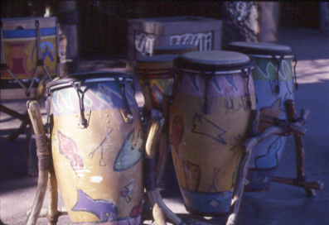
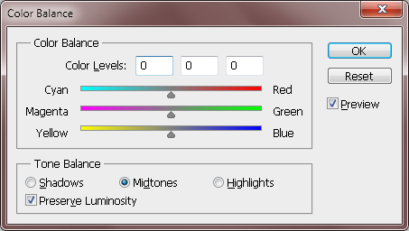
Color Balance Example
An image with a purple tint
Color Balance dialog box

Slide 21
Step 5. Fine-tune specific parts of the image
Why?
There may be small distractions, such as power lines, small airplanes in the sky, a zit on the face.
Photoshop Tools:
Clone Stamp tool

Slide 22
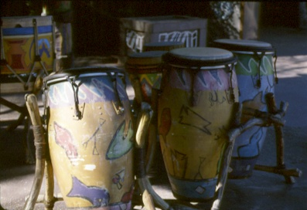
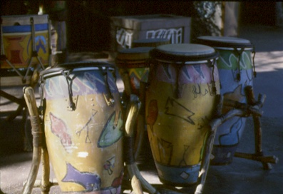
Example Application of Dodge and Burn Tool
The image before fineturning with dodge and burn
The image after fineturning with dodge and burn

Slide 23
Example Application of Clone Stamp Tool
The image before fineturning with the clone stamp tool
The image after fineturning the clone stamp tool
The paint on the drum is restored using the clone stamp tool.

Slide 24
Step 6. Sharpen the image
Why?
Scanned images usually look a little soft-focused.
Scaling an image also can make the image soft-focused.
Even if your image is a straight digital photograph from a digital camera, it is a good idea to experiment with sharpening to see if it improves the image’s overall clarity.
Photoshop Tools:
Filter > Sharpen > Unsharpen Mask...

Slide 25
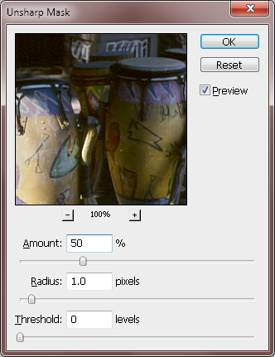
Using Unsharp Mask

Slide 26
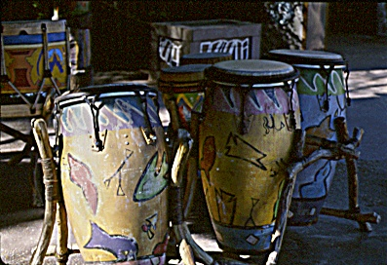
Don't Over-sharpen!

Slide 27
Selection Tools in Image Editing
Crucial in image editing
Let you apply image effect (such as tonal or color changes) on the selected area
Let you move the selected area
The nonselected area is protected from the alteration

Slide 28
Categories of Selection Tools in terms of the way they are designed to work
Predefined shapes
Lasso
By color
By painting with a brush
By drawing an outline around the area

Slide 29
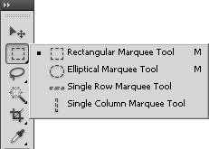
Predefined Shapes
Marquee tools

Slide 30
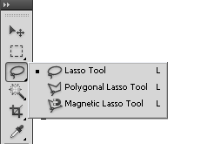
Lasso
Lasso tools

Slide 31
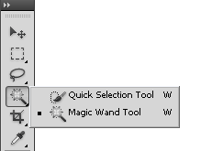
By Color: Magic Wand
Magic Wand

Slide 32
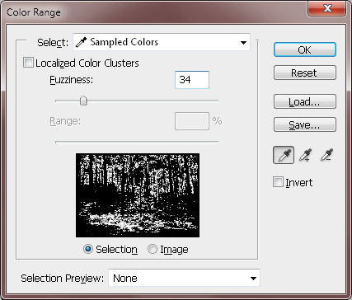
By Color: Color Range
Select > Color Range...

Slide 33
By Painting with a Brush
Edit in Quick Mask Mode

Slide 34
By Drawing an Outline
Pen tool

Slide 35
Layer Basics
Stacking order of layers
Reordering layers
Opacity
Blending mode
Create new layer
Delete layer
Rename layer

Slide 36
Layer: Beyond Basics
Layer style (e.g. drop shadow, bevel effects)
Adjustment layers
Layer mask
Clipping mask

Slide 37
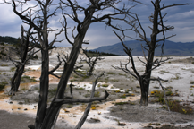
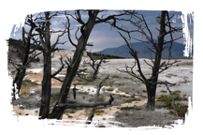
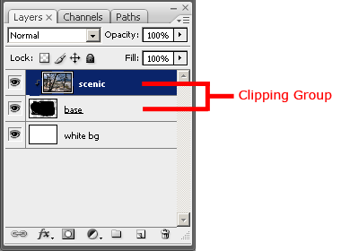
Clipping Mask Example

Slide 38
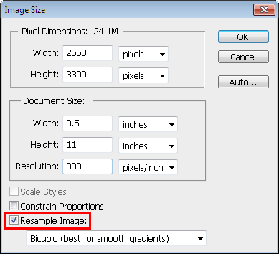
Adjust Output Resolution or Print Size in Photoshop: Image > Image Size...
Scenario 1: Fixed Print Size
If you change the Resolution, the Pixel Dimensions will be updated automatically while keeping the print size fixed.

Slide 39
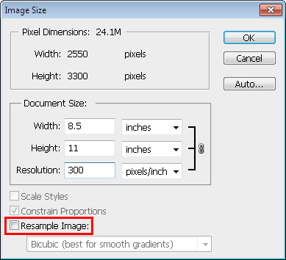
Adjust Output Resolution or Print Size in Photoshop: Image > Image Size...
Scenario 2: Fixed pixel dimensions
You cannot change the pixel dimensions

Slide 40
Adjust Output Resolution or Print Size in Photoshop: Image > Image Size...
Scenario 3: Fixed Print Resolution (PPI)
If you change the Pixel Dimensions or Document Size, the other will be updated automatically while keeping the Resolution fixed.

Slide 41
Resample Image
With the Resample Image option on, the pixel dimensions can be varied.
Scaling the pixel dimensions of an image is referred to as resampling because the number of samples (pixels) is changed.

Slide 42
Common File Formats for Web Images
JPEG
GIF
PNG

Slide 43
JPEG
best with:
continuous-tone images with a broad color range
subtle color and brightness variations
e.g., photographs and images with gradients.
JPEG supports 24-bit color (millions of colors)
JPEG compression: lossy (it loses image data in order to make the file size smaller)

Slide 44
JPEG
Does not work well with:
solid colors
contrast image
contrast edges
Highly compressed JPEG images:
blur the image detail
show a visible artifact around the high contrast edges

Slide 45
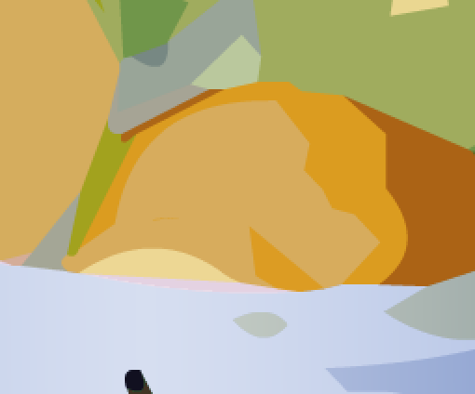
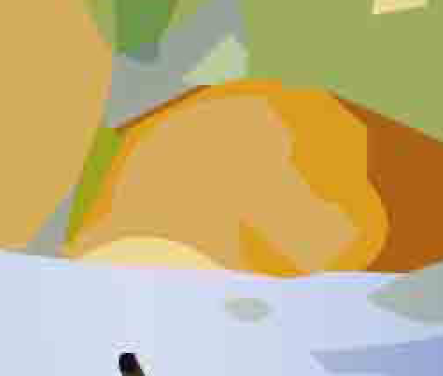
JPEG Compression Artifacts
Original
Highly compressed JPEG
Note the ugly artifacts at the intersection between 2 colors.
The solid colors are not solid colors anymore.

Slide 46
GIF
most effective for images with solid colors such as illustrations, logos, and line art
Up to 8-bit color (256 colors)
supports background transparency
animated GIF

Slide 47
Color Reduction
GIF uses a palette of up to 256 colors to represent the image
Need to reduce the colors if the original image has more than 256 colors
Advantage: Smaller file size after reducing number of colors (i.e., reducing bit-depth or color-depth) (Recall that reducing bit-depth or color depth can reduce file size.)

Slide 48
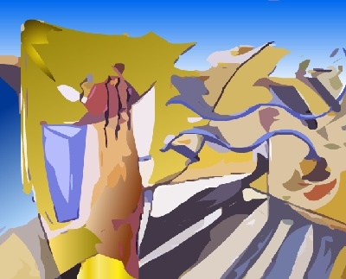
Example: Original TIF (file size: 406 KB)

Slide 49
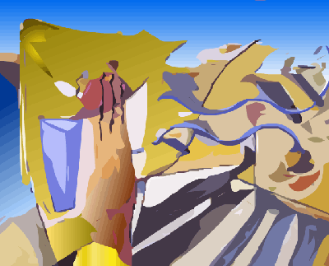
Example: GIF 256 colors, no dither (file size: 28 KB)

Slide 50
Example: GIF 256 colors, no dithering (file size: 28 KB)
Note the stripes in the gradient areas.
This is due to not enough colors.

Slide 51
Color Reduction
Undesirable effects
stripes in smooth gradient areas
some colors are altered (remapped to a different colors on the palette)
Use dithering to reduce the undesirable effects
A technique to simulate colors that are outside of the palette by using a pattern of like colored pixels.

Slide 52
Example: GIF 256 colors, with dithering (file size: 34 KB)
The stripes in the gradient areas are less noticeable.

Slide 53
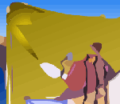
Without and With Dithering
Reduce the stripes effect
Smooth out the color transition

Slide 54
Without and With Dithering
Some colors are not solid anymore, but with dithering

Slide 55
PNG
PNG-8
up to 256 colors (8-bit)
PNG-24
24-bit colors
lossless compression
larger file size than JPEG but without the ugly JPEG compression artifacts

