Slide 1
Chapter 2 Fundamentals of Digital Imaging
“Computers and Creativity”
Richard D. Webster, COSC 109 Instructor
Office: 7800 York Road, Room 422 | Phone: (410) 704-2424
e-mail: webster@towson.edu
109 website: https://tigerweb.towson.edu/webster/109/index.html

Slide 2
In this lecture, you will find answers to these questions
What does digitizing images mean?
How are images sampled and quantized in the digitization process?
How are pixels, image resolution, and bit depth related to sampling and quantizing?
How do the choices of the sampling rate and bit depth affect the image fidelity and details?

Slide 3
Recall: Digitization
To convert analog information into digital data that computers can handle
2-step process:
sampling
quantization

Slide 4
Let's look at the sampling step of digitizing a natural scene as if we are taking a digital photo of a natural scene.

Slide 5
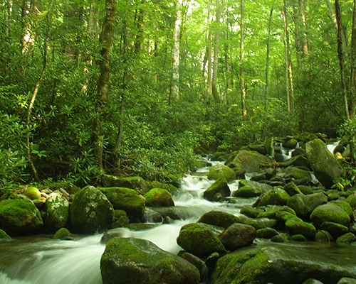
A natural scene
Look up and let your eyes fall on the scene in front of you. Draw an
imaginary rectangle around what you see. This is your “viewfinder.”
Imagine that you are going to capture this view on a pegboard.

Slide 6
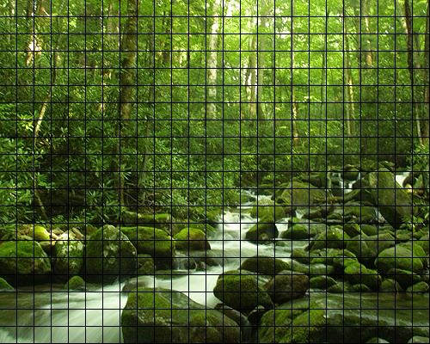
Sample into a grid of 25 × 20 discrete samples
Suppose you are going to sample the scene you see in the "viewfinder" into a pegboard with 25 × 20 holes.

Slide 7
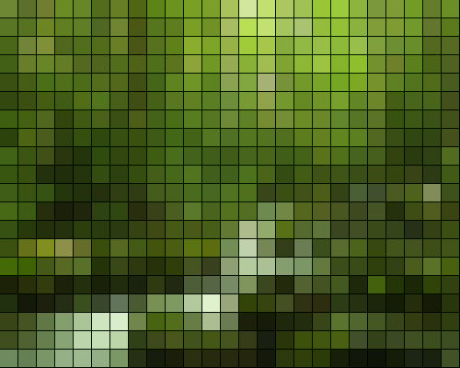
One color for each peg hole.
Each peg hole takes only one peg. Suppose each peg has one solid color. Suppose the color of each of these discrete samples is determined by averaging the corresponding area.

Slide 8
This sampled image looks blocky. Details are lost because the grid is too coarse for this image.

Slide 9
For 25 × 20 sample points, it means you get a digitized image of 25 × 20 pixels.

Slide 10
Let's try a different grid size.

Slide 11
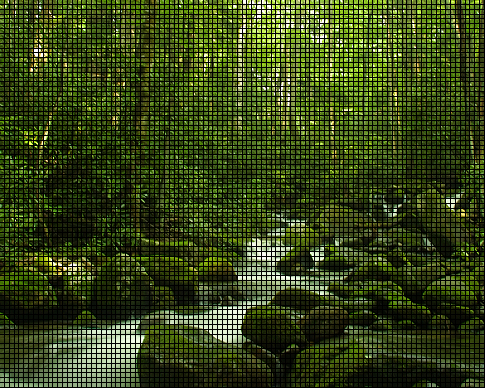
Sample into a grid of 100 × 80 discrete samples
Suppose you are going to sample the scene you see in the "viewfinder" into a pegboard with 100 × 80 holes.

Slide 12
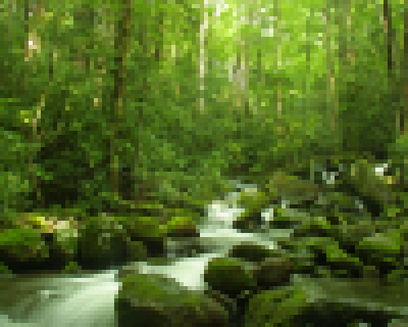
Again, one color for each peg hole.

Slide 13
For 100 × 80 sample points, it means you get a digitized image of 100 × 80 pixels.

Slide 14
Sampling Rate
Refers to how frequent you take a sample
For an image, sampling frequency refers to how close neighboring samples are in a 2-D image plane.
For example, when we change the grid from 25 × 20 to 100 × 80, we say that we increase the sampling rate.
You are sampling more frequently within the same spatial distance.

Slide 15
Resolution
In digital imaging, increasing the sampling rate is equivalent to increasing the image resolution.

Slide 16
Consequences of Higher Resolution
With higher resolution,
You have more sample points (pixels) to represent the same scene, i.e., the pixel dimensions of the captured image are increased.
The file size of the digitized image is larger.
You gain more detail from the original scene.

Slide 17
Resolution of Digital Photos
Note that 25 × 20 and 100 × 80 pixels are by no means realistic pixel dimensions in digital photography.
They are only for illustration purposes here. Most digital cameras can capture images in the range of thousand pixels in each dimension—for example, 3000 pixels × 2000 pixels.

Slide 18
A Pixel is not a Square Block
A pixel is a sample point.
It does not really have a physical dimension associated with it.
When you zoom in on a digital image in an image editing program, you often see the pixels represented as little square blocks.
This is simply an on-screen representation of a sample point of an digitized image.

Slide 19
Colors

Slide 20
Problems
A natural image is colored in continuous tones, and thus it theoretically has an infinite number of colors.
The discrete and finite language of the computer restricts the reproduction of an infinite number of colors and shades.

Slide 21
Quantization Step
To encode an infinite number of colors and shades with a finite list.
Quantizing the sampled image involves mapping the color of each pixel to a discrete and precise value.
First, you need to consider how many possible colors you want to use in the image.
To illustrate this process, let’s return to the example of the 100 × 80 sampled image.

Slide 22
The sampled 100 × 80 image

Slide 23
Say, we want to map the color of each sample points into one of these four colors:

Slide 24
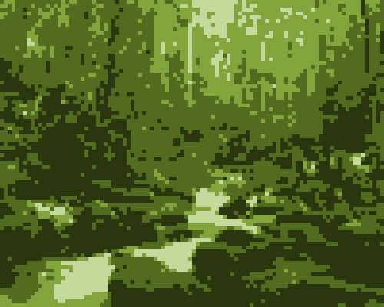
Quantized with 4 Colors

Slide 25
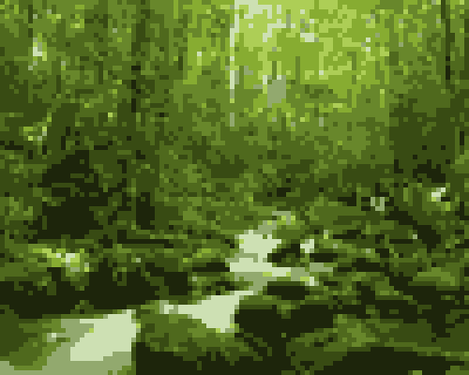
Quantized with 8 Colors

Slide 26
Consequences of Quantization
Reduce the number of allowed colors in the image.
When we reduce the colors, different colors from the original may bemapped to the same color on the palette. This causes the loss of the image fidelity and details.
The details that rely on the subtle color differences are lost during quantization.

Slide 27
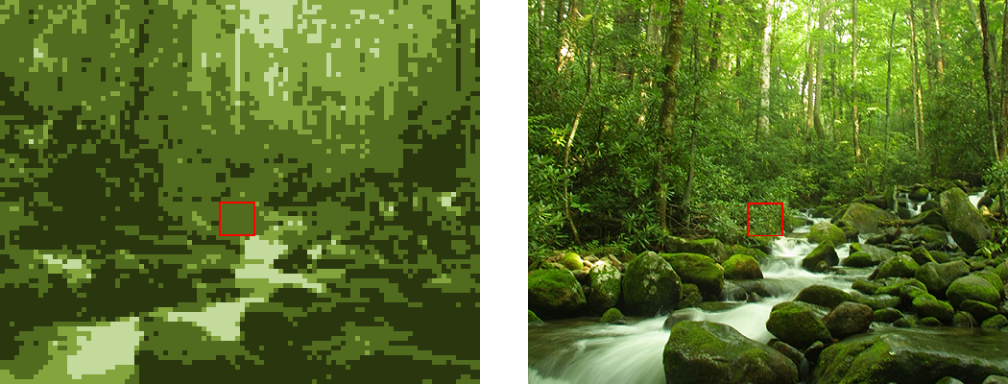
The same area in the 4-color image now has only one color.
The area outlined in red is made up of many different green colors.

Slide 28
Bit Depth
The number of colors used for quantization is related to the color depth or bit depth of the digital image.
A bit depth of n allows 2^{n} different colors. Examples:
A 2-bit digital image allows 2² (i.e., 4) colors in the image.
An 8-bit digital image allows 2⁸ (i.e., 256) colors in the image.
The most common bit depth is 24. A 24-bit image allows 2²⁴ (i.e., 16,777,216) colors.

Slide 29
Will increasing the number of colors in the palette improve the image fidelity?
It depends, and in most cases, can be yes.
The number of colors or the bit depth is not the only determining factor for image fidelity in quantizing an image.
The choice of colors for the quantization also plays an important role in the reproduction of an image.

Slide 30
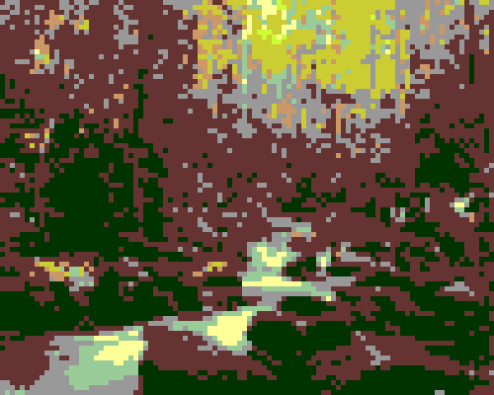
Quantized with 8 Different Colors

Slide 31
Effect of Bit Depth on File Size
Higher bit depth means more bits to represent a color.
Thus, an image with a higher bit depth has a larger file size than the same image with a lower bit depth.

Slide 32
Bitmapped images
Examples:
Web images, e.g. JPEG, PNG, GIF
Adobe Photoshop images

Slide 33
Bitmapped images Characteristics
the image is divided in a grid (think of it as a pegboard)
each cell (think of it as a peghole) in the grid stores only one color value (think of it as a peg)
each cell is called a pixel—picture element
bitmap images are resolution dependent; each image has a fixed resolution
the level of details the image can represent depends on the number these cells, or pixels. A pegboard with more holes lets you create a picture with finer details.
cells

Slide 34
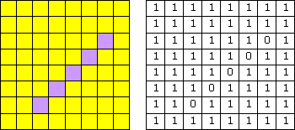
Bitmapped images
If I specify "1" to represent yellow and "0" to represent purple,
the data to describe this image is:
1111111111111111111111011111101111110111111011111101111111111111
The size of the data (the file size) in this example—an 8x8-pixel image is not too bad, but what about we have a 3000x2000-pixel—an image from a 6-megapixel digital camera?

Slide 35
Bitmap vs. Pixmap
Bitmap: In certain contexts, it refers to images with 1 bit per pixel, i.e., each pixel has a value either 0 or 1.
Pixmap: If each pixel has a color value that uses more than 1 bit.
Here we are using the term bitmap or bitmapped images to refer to all pixel-based images.

Slide 36
Vector Graphics
Examples: graphics created in
Adobe Flash
Adobe Illustrator

Slide 37
Bitmap Images vs. Vector Graphics
1111111111111111111111011111101111110111111011111101111111111111
%!
newpath
2 1 moveto
6 5 lineto
stroke
showpage
vector graphic
bitmap image

Slide 38
Vector Graphics
The unit is arbituary, i.e. when you print out an image, you may set one unit as an inch or a foot.
This means vector graphic is resolution independent.
%!
newpath
2 1 moveto
6 5 lineto
stroke
showpage
vector graphic

Slide 39
Printing Bitmap Images
have the same amount of data, i.e. same level of details
print bigger
print smaller
bitmap image

Slide 40
Printing Vector Graphics
print bigger
print smaller
vector graphics

Slide 41
Bitmap Images vs. Vector Graphics Example
Vector graphics:A line defined by two end points.
Vector graphics: The same line is stroked with a certain width.
& (d) The line is converted to a bitmap.

Slide 42
Curve Drawing in Vector Graphics Programs
defined by a set of points; we call them anchor points
the direction handles or tangent handles of a point controls the tangent at that point on the curve

Slide 43
Rastering Vector Graphics
Raster means convert vector graphics into pixel-based images.
Most vector graphics programs let you rasterize vector graphics.
Need to specify a resolution for rasterizing, that is, how coarse or how fine the sampling.

Slide 44
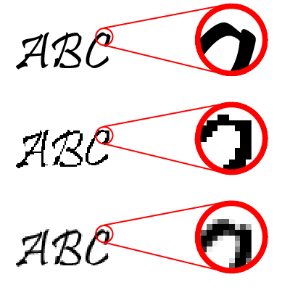
Aliasing
The rasterized image will appear jagged.
This jagged effect is a form of aliasing caused by undersampling (which means insufficient sampling rate.) Recall the musical note on a pegboard example.
Original vector graphics
Rastered vector graphics without anti-aliasing

Slide 45
Anti-aliasing Techniques
To soften the jaggedness by coloring the pixels with intermediary shades in the areas where the sharp color changes occur.
Original vector graphics
Rastered vector graphics without anti-aliasing
Rastered vector graphics with anti-aliasing

Slide 46
Why Compression?
higher resolution or higher bit depth ⇒ larger file size
Without compression, image files would take up an unreasonable amount of disk space.
Larger files take longer time to transfer over the network.

Slide 47
How many bits?
Let’s look at the size of a typical high resolution image file without compression.

Slide 48
How many bits?
Suppose 6-megapixel digital camera may produce digital images of 3000 × 2000 pixels in 24-bit color depth.
Total pixels: 3000 × 2000 pixels = 6,000,000 pixels
File size in bits: 6,000,000 pixels × 24 bits/pixel = 144,000,000 bits
File size in bytes: 144,000,000 bits / (8 bits/byte) = 18,000,000 bytes ≅ 17 MB

Slide 49
Strategies To Reduce File Sizes
Reducing the pixel dimensions
Lowering the bit depth (color depth)
Compress the file

Slide 50
Reducing Pixel Dimensions
Capture the image at a lower resolution in the first place
Resample (resize) the existing image to a lower pixel dimensions
Returning to our calculation of the file size of an image of 3000 × 2000 pixels in 24-bit color depth.
Let's calculate the file size of an image of 1500 × 1000 pixels in 24-bit color depth.

Slide 51
How many bits if half the size in each pixel dimension?
Total pixels: 1500× 1000 pixels = 1,500,000 pixels
File size in bits: 1,500,000 pixels × 24 bits/pixel = 36,000,000 bits
File size in bytes: 36,000,000 bits / (8 bits/byte) = 4,500,000 bytes ≅ 4.3 MB
It's 1/4th of the file size.

Slide 52
Lowering the Bit Depth
Returning to our calculation of the file size of an image of 3000 × 2000 pixels in 24-bit color depth.
Let's calculate the file size of an image if we reduce the bit depth to 8-bit.

Slide 53
How many bits if reduced to 8-bit?
Total pixels: 3000 × 2000 pixels = 6,000,000 pixels
File size in bits: 6,000,000 pixels × 8 bits/pixel = 48,000,000 bits
File size in bytes: 48,000,000 bits / (8 bits/byte) = 6,000,000 bytes ≅ 5.7 MB
It's 1/3rd of the file size.

Slide 54
24-bit vs. 8-bit
24-bit: 2²⁴ (about 16 million) colors
8-bit: 2⁸ (about 256) colors
24-bit → 8-bit:
You lose about 16 million colors!
May cause image quality degradation.
But 8-bit will work well if your image does not need more than 256 colors.

Slide 55
24-bit → 8-bit Without Noticeable Image Quality Degradation
Grayscale images: e.g.
scanned images of black-and-white photos
hand-written notes (may be even lowered to 4-bit, 2-bit, or 1-bit)
Illustration graphics: e.g. poster or logo
contains only a few colors as large areas of solid colors

Slide 56
File Compression Methods
File compression: To reduce the size of a file by squeezing the same information into fewer bits.
Lossless compression method:
e.g., TIFF, PNG, PSD
No information is lost
GIF files also use lossless compression but it limits the number of colors to 256
Lossy compression method:
e.g., JPEG
Some information is lost in the process.
For digital media files, the information to be left out is chosen such that it is not the human sensory system most sensitive to.

Slide 57
Working with Lossy Compression
JPEG files:
JPEG compression, which is lossy (i.e., the lost information cannot be recovered)
Do not use JPEG files as working files for further editing
Repeated saving a JPEG file will degrade the image quality further
Save as JPEG only in the very last step of your editing process. For example, when you have finished editing the image and are ready to post it on the Web.
Avoid using JPEG for images intended for high quality prints

Slide 58
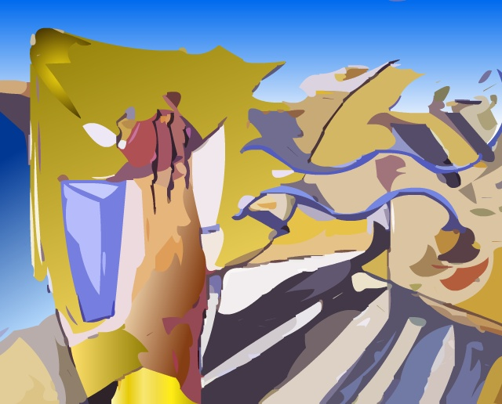
An original TIFF image

Slide 59
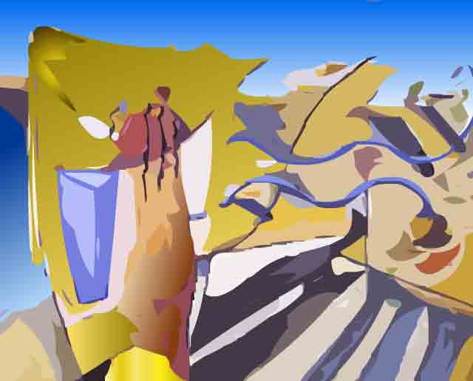
A JPEG with a very low quality setting.
Note the ugly artifacts around the contrast edges.

Slide 60
Closeup view of the JPEG with a very low quality setting.
Note the blockiness and ugly artifacts around the contrast edges.

Slide 61
File Types During Editing or Capturing
PSD
PNG
TIFF
camera RAW

Slide 62
Common File Types of Pixel-based Images
File Type | File Suffix | Standard Color Modes | Use | Compression
JPEG (Joint Photographic Experts Group) | .jpg .jpeg | RGB CMYK | Best for continuous tone images such as photographs can be used for Web images | Lossy compression method called JPEG compression that works well with photographs

Slide 63
Common File Types of Pixel-based Images
File Type | File Suffix | Standard Color Modes | Use | Compression
GIF (Graphics Interchange Format) | .gif | Indexed color, grayscale | Supports up to 8-bit color Best for illustration graphics or cartoon-like pictures with large blocks of solid color and clear divisions between color areas a proprietary format of CompuServe can be used for Web images | Lossless compression method called LZW compression

Slide 64
Common File Types of Pixel-based Images
File Type | File Suffix | Standard Color Modes | Use | Compression
PNG (Portable Network Graphics) | .png | indexed, grayscale, black and white | Supports 8-bit and 24-bit color Can be used for Web images | Lossless compression

Slide 65
Common File Types of Pixel-based Images
File Type | File Suffix | Standard Color Modes | Use | Compression
TIFF (Tag Image File Format) | .tif .tiff | RGB, CMYK, CIE-Lab, indexed, grayscale, black and white | Proprietary format of Adobe Photoshop good for any types of digital images that Photoshop supports stores layers supports alpha channel | Lossless compression

Slide 66
Common File Types of Pixel-based Images
File Type | File Suffix | Standard Color Modes | Use | Compression
PSD (Photoshop Digital Image) | .psd | RGB, CMYK, CIE-Lab, indexed, grayscale, black and white | Supported on both Windows and Mac common file format supports alpha channel | Allows uncompressed, LZW compression (lossless), ZIP (lossless), JPEG (lossy)

Slide 67
Common File Types of Vector Graphics
File Type | File Suffix | Information and Use
Encapsulated PostScript | .eps | Standard file format for storing and exchanging files in professional printing
Adobe Illustrator file | .ai
Adobe Flash file | .fla .swf
Windows Metafile format | .wmf | Many cliparts from Microsoft Office are in this format
Enhanced Metafile format | .emf | Developed by Microsoft as a successor to .wmf

Slide 68
Color Models
Used to describe colors numerically, usually in terms of varying amounts of primary colors.
Common color models:
RGB
CMYK
HSB
CIE and their variants.

Slide 69
RGB Color Model
Primary colors:
red
green
blue
Additive Color System

Slide 70
Additive Color System

Slide 71
CMYK Color Model
Primary colors:
cyan
magenta
yellow
black
Subtractive Color System

Slide 72
Subtractive Color System of CMY

Slide 73
HSB Color Model
Hue:
basic color
0º to 360º : the location on a color wheel
in the order of colors in a rainbow
Saturation:
purity of the color
how far away from the neutral gray of the same brightness
Brightness

Slide 74
HSB Color Model

Slide 75
Problems with RGB and CMYK Color Space
Do not encompass all the colors human can see

Slide 76
Color Gamuts
Refers to the range of colors of a specific system or a device can produce or capture

Slide 77
Difficulties in Reproducing Colors in Digital Images
Digital devices cannot produce all of the colors visible to human
Difficulties exist in reproducing color across devices
different devices have different color gamuts
additive color system for screen display vs. subtractive color system for printing

