Slide 1
Animation Part II:
Interactive Multimedia Authoring with Flash
Flash: Shapes and Symbols
“Computers and Creativity”
Richard D. Webster, COSC 109 Instructor
Office: 7800 York Road, Room 422 | Phone: (410) 704-2424
e-mail: webster@towson.edu
109 website: https://tigerweb.towson.edu/webster/109/index.html

Slide 2
In this lecture, you will learn:
shapes vs. symbols in Flash
3 types of symbols in Flash
Advantages of using symbols
Object Drawing vs. Merge Drawing in Flash

Slide 3
Types of Visual Content
Shapes
Symbols

Slide 4
Shapes

Slide 5
Shapes
Made up of
Strokes
Fills

Slide 6
Stroke
Line created with Pencil, Pen, and Ink Bottle tools
Properties:
  line width
  color
  line style (such as solid, dash)
  can be modified in Property Inspector

Slide 7
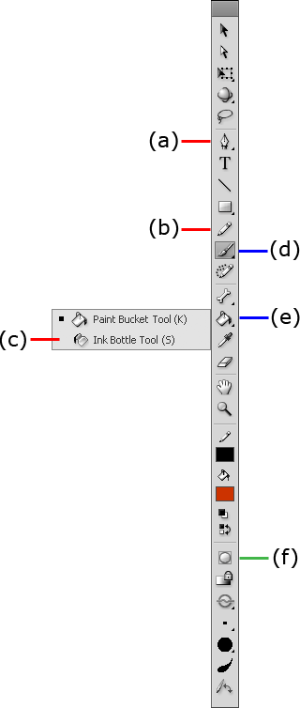
Pencil, Pen, and Ink Bottle tools
Pen
Pencil
Ink Bottle

Slide 8
Example
Pencil and Pen tool let you draw a line or stroke of a shape freehand like this:

Slide 9
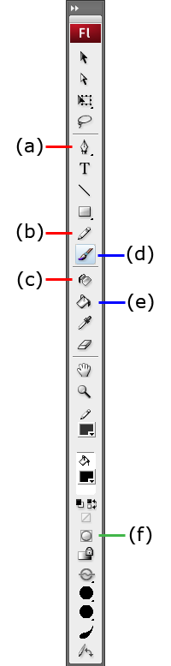
Example
Ink Bottle tool lets you create a stroke outlining a fill like this:

Slide 10
A screen-capture movie shows how to create a simple shape using Pencil, Pen, Ink, and Paint Bucket tools.
Also check out the screen capture video on:
Creating Shapes in Flash

Slide 11
Fill
Area of filled content, such as filled solid color
Tools for creating fills:
  Paint Bucket
  Brush
Properties:
  color
  can be modified in Property Inspector

Slide 12
Paint Bucket and Brush tools
Brush
Paint Bucket

Slide 13
Example
Brush tool lets you paint a fill freehand like this:

Slide 14
Example
Paint Bucket tool lets you fill in an enclosed area like this:

Slide 15
Coloring Strokes and Fills
Color chip for the strokes
Color chip for the fills

Slide 16
A screen-capture movie shows how to modify a shape.
Also check out the screen capture video on:
Modifying Shapes in Flash

Slide 17
Drawing Models for Drawing Shapes
Merge drawing
  Overlapping shapes are merged.
Object drawing
  Each shape can be a self-contained objects
  Overlapping shapes are not merged. They can be repositioned individually.

Slide 18
Drawing Models for Drawing Shapes
Option available when you select these tools:
Pencil
Brush
Pen
Line
Rectangle tool group
Object Drawing
button

Slide 19
Convert Object Drawing Into Merge Drawing
If you unknowing turn on Object Drawing
For future drawing in Merge Drawing mode, turn off the Object Drawing:
  Select each drawing tool on Tools panel
  Toggle the Object Drawing button to off
For existing drawings drawn in Object Drawing mode
  Select the objects
  Choose Modify > Break Apart

Slide 20
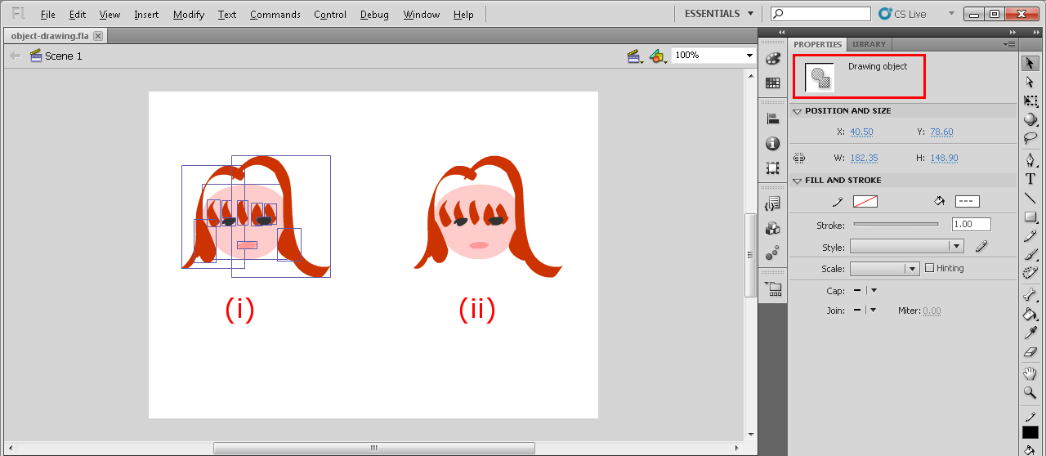
Object Drawing vs. Merge Drawing

Slide 21
Object Drawing vs. Merge Drawing
Drawn in Object Drawing mode.
Each brush drawing is an individual object.
When an object is selected, you see a blue box enclosing the object.

Slide 22
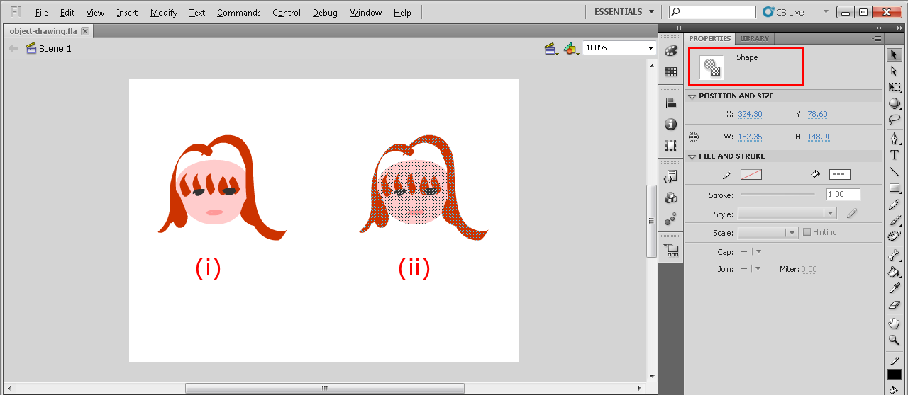
Object Drawing vs. Merge Drawing
Drawn in Merge Drawing mode.
Overlapping brush drawings.are merged into a shape.
When a shape is selected, you see it being highlighted.

Slide 23
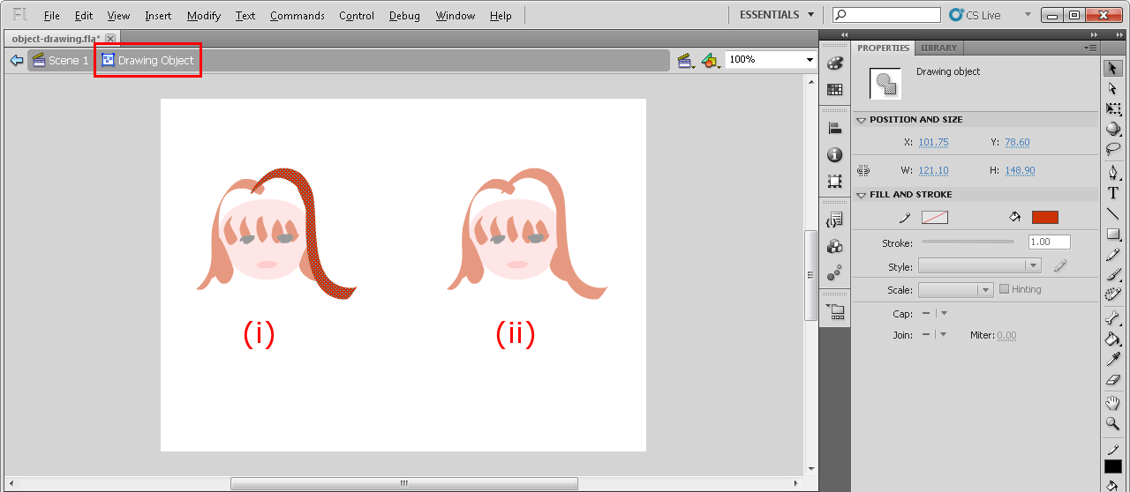
Object Drawing vs. Merge Drawing
Drawn in Object Drawing mode.
You double-click on an object to edit its shape.

Slide 24
Object Drawing vs. Merge Drawing
Drawn in Merge Drawing mode.
You can directly edit the shape.

Slide 25
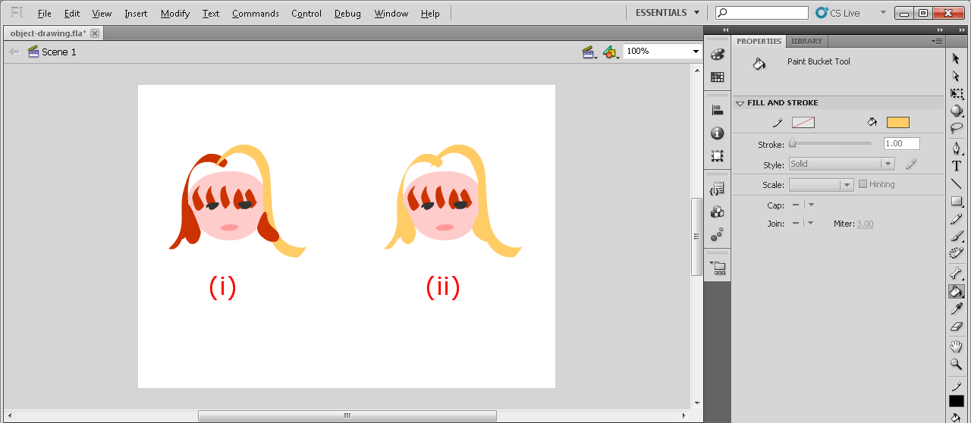
Object Drawing vs. Merge Drawing
Drawn in Object Drawing mode.
Each object can be edited independent of others.
For example, an object is changed from red to yellow without affecting other overlapping objects.

Slide 26
Object Drawing vs. Merge Drawing
Drawn in Merge Drawing mode.
When you change the hair color from red to yellow, the whole merged shape changes.

Slide 27
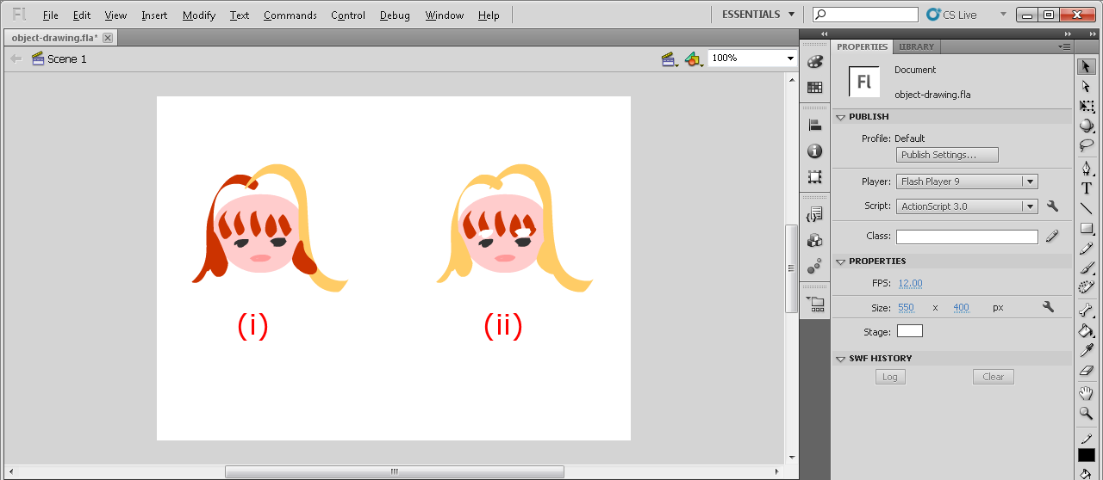
Object Drawing vs. Merge Drawing
Drawn in Object Drawing mode.
Each object can be repositioned independent of others.
For example, if you reposition the eyes, it does not leave holes on the face.

Slide 28
Object Drawing vs. Merge Drawing
Drawn in Merge Drawing mode.
When you reposition the eyes, it leaves holes on the shape for the face.

Slide 29
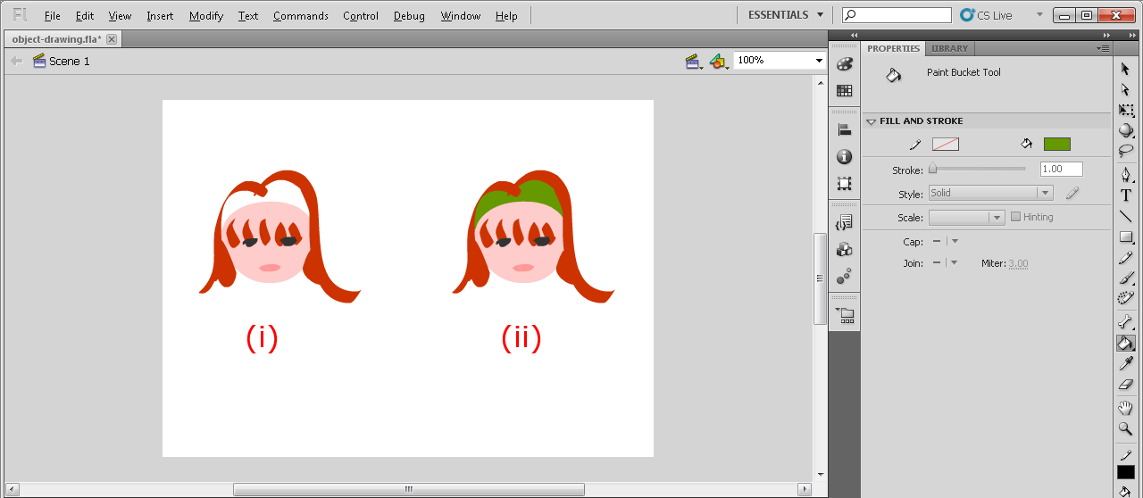
Object Drawing vs. Merge Drawing
Drawn in Object Drawing mode.
A hole formed by the objects is not an enclosed area.
For example, you cannot use Paint Bucket tool to fill the empty space (white area) on top of the head.

Slide 30
Object Drawing vs. Merge Drawing
Drawn in Merge Drawing mode.
You can use Paint Bucket tool to fill the empty space (white area) on top of the head. Here, we fill it with green.

Slide 31
Symbols

Slide 32
Symbols
Stored in the Library panel
Can be used multiple times in the project without increasing the file size of the project

Slide 33
To Create a Symbol
Method 1: Convert an existing shape into a symbol
  Select the shapes
  Choose Modify > Convert to Symbol...
  Or, right-click (Windows) or Control-click (Mac OS) and choose Convert to Symbol...

Slide 34
To Create a Symbol
Method 2: Create a blank symbol, and add shapes or other symbols
  Insert > New Symbol...

Slide 35
A screen-capture movie shows show to create (1) a new symbol and (2) a symbol by converting from a shape.
Also check out the screen capture video on:
Creating Symbols in Flash

Slide 36
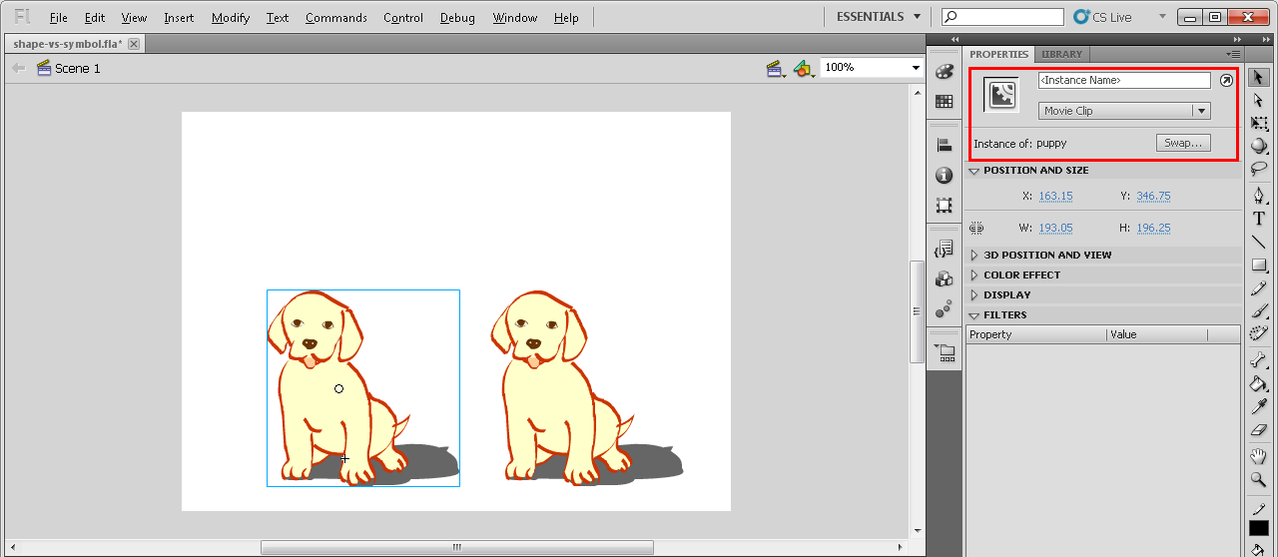
How to Tell Symbols from Shapes on Stage

Slide 37
How to Tell Symbols from Shapes on Stage
Symbol instance:
When it is selected, a blue box appears around it.
Property Inspector also shows that it is a symbol.

Slide 38
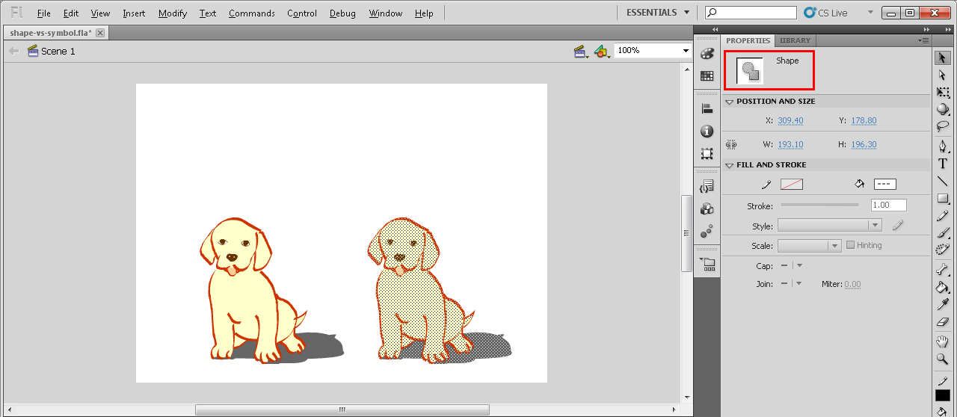
How to Tell Symbols from Shapes on Stage
Shape:
When it is selected, the shape is highlighted with patterned dots.
Property Inspector also shows that it is a shape.

Slide 39
Types of Symbols
Graphic
Button
Movieclip

Slide 40
Graphic Symbol
Purposes: To be used as static graphics
Can be used on the main timeline
Can also be placed in other graphic, button and movieclip symbols
Interactive controls and sounds won’t work in a graphic symbol’s timeline

Slide 41
Button Symbol
Purposes: To be used as interactive buttons in the movie
  mouse clicks
  rollovers
Can be used on the main timeline
Can also be placed inside a movieclip symbol
Cannot be placed inside a button symbol

Slide 42
Button Symbol
Has only four special-purpose frames:
  button up:
  How the button looks at the default state
  over:
  How the button looks when the mouse is over the button
  button down:
  How the button looks when the button is pressed down
  hit:
  To mark the hot spot of the button

Slide 43
Movieclip Symbol
Purposes:
  To be used as reusable pieces of animation
  To allow programming of the behavior of a symbol
Can be used on the main timeline
Can contain copies of other symbols (graphic, buttons, and other movieclips), ActionScript, and sounds
Can also be placed inside a Movieclip or Button symbol
Cannot be placed inside a Graphic symbol

Slide 44
Movieclip Symbol
Have its own timeline
  plays independently from the main movie’s timeline, i.e., it can have its own animation sequence
  think of movieclips as mini-Flash movies inside a main movie
  its animation sequence plays automatically unless you use an Actionscript to stop it
Can be controlled using ActionScript in response to mouse clicks and rollovers.

Slide 45
Movieclip Symbol
If your Flash file uses Movieclip symbols, test play using:
  Control > Test Movie
  NOT Control > Play

Slide 46
Advantages of Using Symbols
Reuse without increasing file size
  But copying and pasting a shape will increase file size
As a master copy
  Changing the symbol updates all the instances of the symbol used in the file
  Great for placeholder
    Use symbols with placeholder content to program or create an animation while waiting for the final art work
    Replace the placeholder content with the final art work without redoing the animation

Slide 47
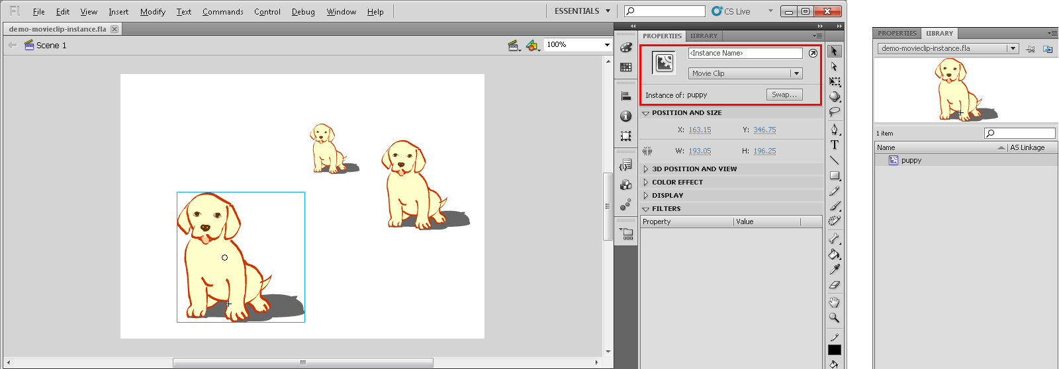
Concept of Master Copy Illustrated
The same symbol of a puppy is used 3 times on the stage.

Slide 48
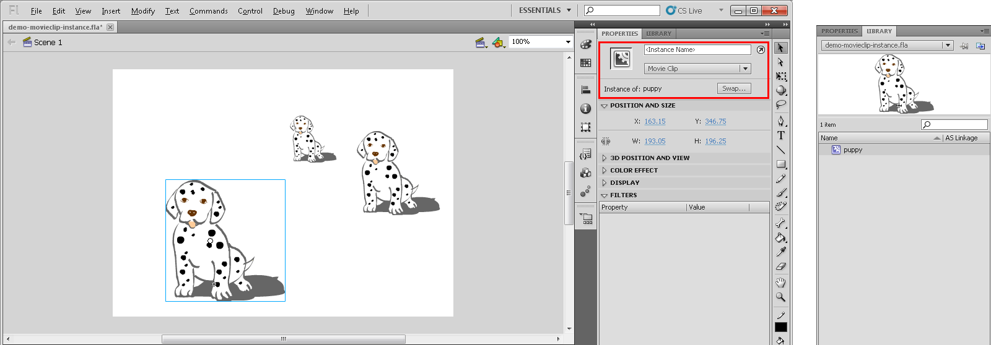
Concept of Master Copy Illustrated
When the puppy symbol is modified into a dalmatian puppy, all of its instances on the stage are automatically updated to dalmatians.

Slide 49
What if the puppies are shapes?
Suppose all three puppies are shapes copied and pasted from the same shape.
Modifying a shape of the puppy into dalmatian only changes that one shape.
All other shapes of puppy remain unchanged.

Slide 50
The Term Instances
When a symbol is used on the stage, it is its copy on the stage.
The copies used on the stage are called the instances of that symbol.

