Slide 1
Innovative Pedagogical Approaches to a Capstone Laboratory Course in Cyber Operations
Mike O’Leary
Towson University
SIGCSE 2017

Slide 2
Talk Outline
Introduction
Course Content
Flipping the Classroom
Live Exercises
Balancing Offense and Defense
Red Team
Reports & Forensics
Grading
Student Expectations
Conclusions

Slide 3
Introduction
Capstone Course
Students
Seniors, Spring semester
Cyber-security track
Operating systems, operating systems security, networking, and network security
End up working for
NSA, Veris Group, MITRE, Cisco, and the FBI
Setting
Isolated classroom laboratory
Extensive use of virtual machines

Slide 4
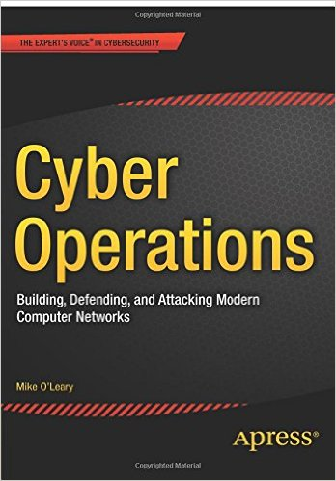
Course Content
Kali; Metasploit
Operational Awareness
BIND
Active Directory, Group Policy
Logging; Network services
Apache; ModSecurity
IIS; ModSecurity
Firewalls
MySQL/MariaDB
Intrusion Detection; Snort
Web Applications
WordPress, Joomla, Zen Cart

Slide 5
Flipping the Classroom
Source material
Motivation for the flip
Pacing
Student reaction
Specialization
Benefits to students
Responsibility

Slide 6
Live Exercises
Houston
DC 10.1.199.99
TampaBay
DC 10.1.199.191
LittleRock
Win. FIle Server 10.1.199.89
SantaFe
Samba
10.1.33.133
Columbus
BIND
10.1.33.101
PaloAlto
BIND
10.1.33.249
Albuquerque
IIS 10.1.199.190
SantaCruz
Apache 10.1.199.135
Minneapolis
Public Linux 10.1.199.76
Team 1 Kali Net
Baltimore
Linux Desktop
10.1.33.19
LasVegas
Apache
10.1.33.70
LosAngeles
IIS
10.1.33.169
Reno
SSH, FTP 10.1.199.237
Phoenix
Win. Destkop 10.1.199.73
10.1.57.0/24
Honolulu
Win. Desktop
10.1.33.214
Cincinnati
Log Server
10.1.33.14
.production.team1.tu
.corp.team1.tu
.sales.team1.tu
Exercise Network
Team 2
10.2.x.0/24
x ε {76,87,93,232}
Seattle
SSH, FTP 10.1.214.149
Milwaukee
Win. Destkop 10.1.214.245
Miami
IIS 10.1.214.242
Orlando
Apache 10.1.214.45
StLouis
Cash Register 10.1.214.30
Team 3
10.3.x.0/24
x ε{106,119.202,246}
Monterey
DC 10.1.214.212
Jacksonville
DC 10.1.214.215
Philadelphia
Win. FIle Server 10.1.214.52
Team 4
10.4.x.0/24
x ε{12,58,125,142}
Exercise Control
10.0.6.250, 251
Red Team
Varies

Slide 7
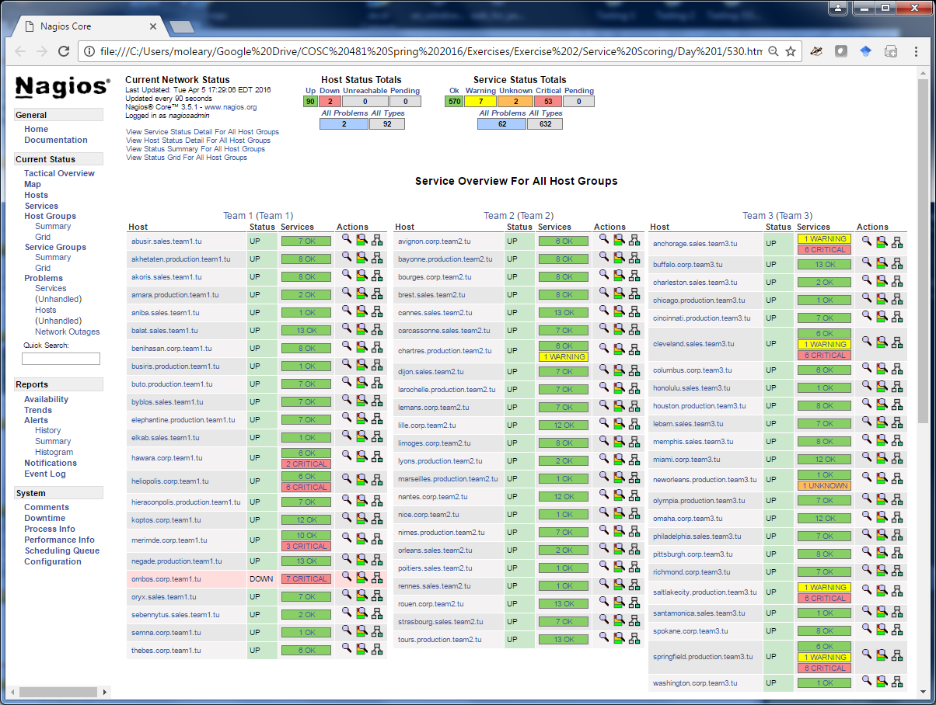
Live Exercises

Slide 8
Live Exercises

Slide 9
Balancing Offense and Defense
How to balance offense & defense?
Class focus is on defense, not offense
Older software (2008-2014)
Multiple known exploits
9,396 allowable passwords
P1# + common 8 letter word
Simon Says
Class email server
Class Stikked server
Blocking by IP

Slide 10
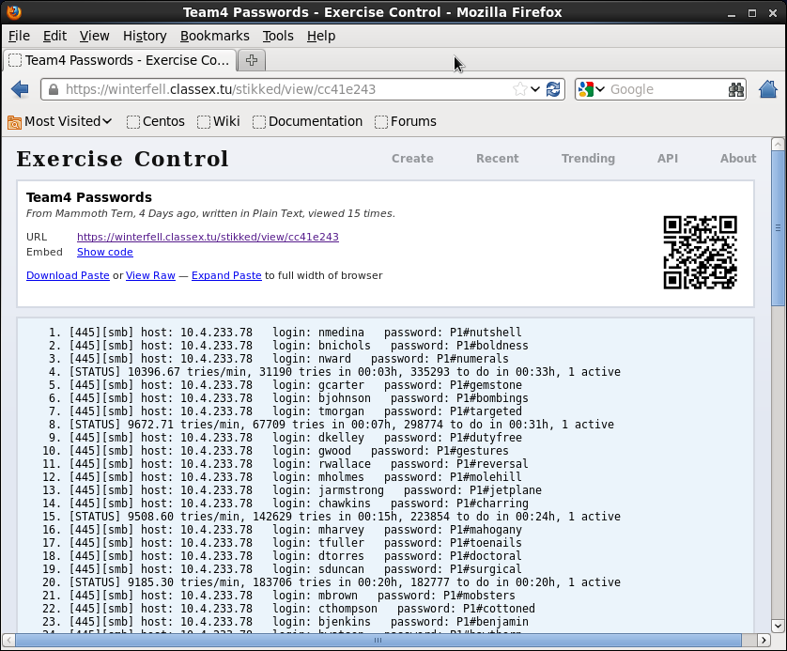
Balancing Offense and Defense

Slide 11
Red Team
Recruiting
4-8 per exercise
Volunteers, primarily recent graduates
Benefits
Student benefits are pedagogical
Red team benefits in corporate / government recruiting
Management
Emphasize pedagogical nature of the experience

Slide 12
Reports and Forensics
Student reports (40-80 pages)
How was the network set up?
How well did it function?
What offensive activity was performed?
How were their networks compromised?
Attack recovery!
Account lock-outs
Cryptolocker
MBR overwrite (Nyan Cat)
Custom malware

Slide 13
Grading
The full state of the network is not known to the instructor, before or after.
Service states (Graded with Nagios)
Reconnaissance / Attacks
Defense
Analysis
Report Quality

Slide 14
Grading Rubric
Each team starts with 20 points, and can lose points due to successful attacks:
(2 points/system up to 10 points) Opponent gains a shell on a system.
(4 points/system up to 20 points) Opponent gains root/administrator access.
(15 points) Opponent gains domain administrator access.
(1 points/file) Opponent gains access to confidential file.
(1 points/file) Opponent dumps some or all of a confidential file in public.
Points lost to a successful attack can be regained through analysis.
If the team correctly identifies an attack, one half of the lost points are recovered.
If the team is also able to identify the source of the attack, the remaining one half of the lost points are recovered

Slide 15
Student Expectations
Students that do not fully engage with the course
Checkpoints
Per-student grading of exercise services
Ethics & Sportsmanship
Mentoring
Red Team!

Slide 16
Conclusions
“Curricula must prepare students for lifelong learning and must include professional practice (e.g., communication skills, team-work, ethics) as components of the undergraduate experience. Computer science students must learn to integrate theory and practice, to recognize the importance of abstraction, and to appreciate the value of good engineering design.“
- ACM curriculum guide

Slide 17
Questions?

