Slide 1
Understanding Operating Systems Seventh Edition
Review Chapters 7,8, 11, 14 & 15

Slide 2
Chapter 7
Features of dedicated, shared, and virtual devices
Concepts of blocking and buffering, and how they improve I/O performance
Roles of seek time, search time, and transfer time in calculating access time
Differences in access times in several types of devices
Strengths and weaknesses of common seek strategies and how they compare
Levels of RAID and what sets each apart

Slide 3
Device Management
Peripheral devices are input / output / storage / communication devices that connect to the computer’s primary computing devices of the processor and main memory (can be internal or external)
Device management involves overseeing the delicate balance of the system’s finite supply of devices with the user’s almost infinite demand for them.
The four basic functions:
Monitoring the status of each device
Enforcing preset policies to determine which process gets device and for how long
Allocating each device
Deallocating each device

Slide 4
Representing Bits
Computers are digital data processors used to turn data into information – they are bit manipulators!
Input → Process → Output
Store Communicate
Computers use at least 3 ways to represent bits:
Magnetic - + - charge
Optical - absence or presence of reflective light
Electricity (voltage) – solid state

Slide 5
Types of Devices
From the OS perspective there are three device types: dedicated, shared, and virtual:
Dedicated device
Assigned to one job at a time
For entire time that job is active (or until released)
Examples: tape drives, printers, and plotters
Disadvantage
Must be allocated for duration of job execution - inefficient if device not used 100 percent of time
Shared device
Assigned to several processes
Example: direct access storage device (DASD)
Virtual device
Dedicated and shared device combination - dedicated device transformed into shared device
Example: printer
Converted by spooling program
Spooling: speeds up slow dedicated I/O device

Slide 6
Management of I/O Requests
OS Device Manager divides I/O task into 3 parts and each is handled by specific software component: I/O traffic controller, scheduler and handler
I/O traffic controller
Watches status of devices, control units, channels
Three main tasks
Determine if path available
If more than one path available, determine which one to select
If paths all busy, determine when one is available
Maintains database containing each unit’s status and connections

Slide 7
Management of I/O Requests (cont'd.)
I/O scheduler
Similar job as process scheduler (Chapter 4)
Allocates devices, control units, and channels
If requests greater than available paths
Decides which request to satisfy first: based on different criteria
I/O device handler
Performs actual data transfer
Processes device interrupts
Handles error conditions
Provides detailed scheduling algorithms
Device dependent

Slide 8
Storage
Storage devices are classified by several factors:
Type of medium
Magnetic (+- charge)
Optical (reflective light)
Solid state (electric voltage)
Access method
Sequential
Direct
Capacity – how much can be stored (# bytes)
Access time – how fast can save \ retrieve data
Seek time – time to locate
Transfer rate – time to transfer between storage & memory
Other factors such as fixed \ removable, etc.

Slide 9
Sequential Access Storage Media
Magnetic tape
Early computer systems: routine secondary storage
Records stored serially
Record length determined by application program
Record identified by position on tape
Record access
Tape rotates passing under read/write head: only when access requested for read or write
Time-consuming process

Slide 10
Sequential Access Storage Media (cont'd.)
Blocking advantages
Fewer I/O operations needed
Less wasted tape space
Blocking disadvantages
Overhead and software routines needed for blocking, deblocking, and record keeping
Buffer space wasted
When only one logical record needed

Slide 11
Direct Access Storage Devices
Directly read or write to specific disk area
Random access storage devices
Three categories
Magnetic disks
Optical discs
Solid state (flash) memory
Access time variance
Not as wide as magnetic tape but record location can directly affect access time

Slide 12
Magnetic Disk Storage
Two recording surfaces (top and bottom)
Each surface formatted
Concentric tracks: numbered from track 0 on outside to highest track number in center
Read/write heads move in unison: virtual cylinder
Accessing a record: system needs three things
Cylinder number
Surface number
Sector number

Slide 13
Access Times
File access time factors
Seek time (slowest)
Time to position read/write head on track
Does not apply to fixed read/write head devices
Search time
Rotational delay
Time to rotate DASD
Rotate until desired record under read/write head
Transfer time (fastest)
Time to transfer data
Secondary storage to main memory transfer

Slide 14
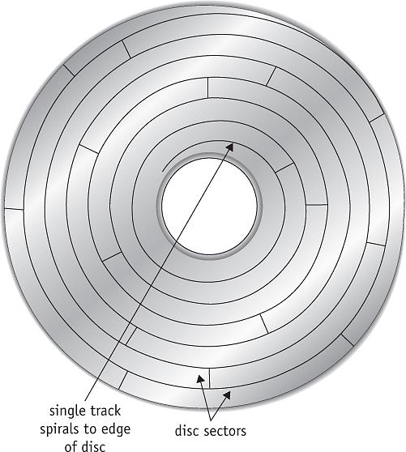
Optical Disc Storage
Design features
Single spiralling track
Same-sized sectors: from center to disc rim
Spins at constant linear velocity (CLV)
More sectors and more disc data than magnetic disk
(figure 7.13)
On an optical disc, the sectors (not all sectors are shown here) are of the same size throughout the disc. The disc drive changes speed to compensate, but it spins at a constant linear velocity (CLV). © Cengage Learning 2014

Slide 15
Optical Disc Storage (cont'd.)
Two important performance measures
Sustained data-transfer rate
Speed to read massive data amounts from disc
Measured in megabytes per second (Mbps)
Crucial for applications requiring sequential access
Average access time
Average time to move head to specific disc location
Expressed in milliseconds (ms)
Third feature
Cache size (hardware)
Buffer to transfer data blocks from disc

Slide 16
CD and DVD Technology
CD
Data recorded as zeros and ones
Pits: indentations & Lands: flat areas
Reads with low-power laser: absence or presence of reflective light
CD-R (compact disk recordable) technology
Contains several layers
Reads on low-power laser
Records with high-power laser
CD cannot be erased after data recorded
CD-RW and DVD-RW: rewritable discs
Record data: beam heats up disc
Erase data: low-energy beam to heat up pits

Slide 17
CD and DVD Technology (cont'd.)
DVDs: compared to CDs
Similar in design, shape, and size
Differs in data capacity
Dual-layer, single-sided DVD holds 13 CDs
Single-layer, single-sided DVD holds 8.6 GB (MPEG video compression)
Differs in laser wavelength
Uses red laser (smaller pits, tighter spiral)
Blu-Ray Disc
Same physical size as DVD/CD
Smaller pits
More tightly wound tracks
Use of blue-violet laser allows multiple layers
Formats: BD-ROM (read only), BD-R (recordable), and BD-RE (rewritable)

Slide 18
Solid State Storage
Stores electrons in a floating gate transistor
Electrons remain even after power is turned off
Flash Storage
Electrically erasable, programmable, and read-only memory (EEPROM)
Nonvolatile and removable
Emulates random access
Difference: data stored securely (even if removed)
Write data: electric charge sent through floating gate
Erase data: strong electrical field (flash) applied

Slide 19
Solid State Drives (SSDs)
Fast but currently pricey storage devices
Typical device functions in smaller physical space than magnetic drives
Work electronically: no moving parts
Require less power; silent; relatively lightweight
Disadvantages
Catastrophic crashes: no warning messages
Data transfer rates: degrade over time
Hybrid drive
Combines SSD and hard drive technology

Slide 20
RAID
Physical disk drive set viewed as single logical unit
Preferable over few large-capacity disk drives
Improved I/O performance
Improved data recovery
Disk failure event
Introduces redundancy
Helps with hardware failure recovery
Significant factors in RAID level selection
Cost, speed, system’s applications
Increases hardware costs

Slide 21
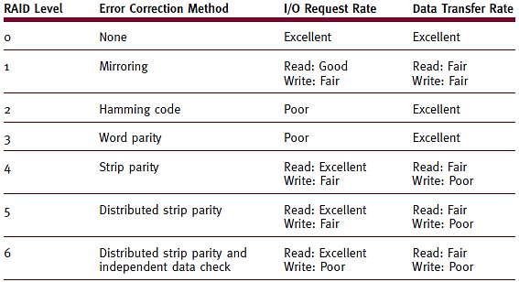
(table 7.7)
The seven standard levels of RAID provide various degrees of error correction. Cost, speed, and the system’s applications are significant factors to consider when choosing a level. © Cengage Learning 2014

Slide 22
Chapter 8
The fundamentals of file management
File-naming conventions, including the role of extensions
The difference between fixed-length and variable-length record format
The advantages and disadvantages of several file storage techniques
Comparisons of sequential and direct file access
Access control techniques and how they compare
The role of data compression in file storage

Slide 23
Introduction
File management system
Software responsible for creating, deleting, modifying, controlling access to files
File Manager’s efficiency directly affected by:
How the system’s files are organized
How files are stored
How each file’s records are structured
How user access to all files is protected

Slide 24
Responsibilities of the File Manager
Four tasks:
File storage
Keeping track of where each file is stored
Policy implementation:
Determine where and how files are stored
Efficiently use available storage space
Determine who (users) will have access
Provide efficient file access for users using device-independent commands
File allocation (once user access cleared)
Activate secondary storage device, load file into memory, and update file
File deallocation
Update file tables, rewrite file (if revised), & communicate file availability

Slide 25
Definitions
Program files
Contain executable instructions
Data (document) files
Contain data – created \ used by programs
Directories (folders)
Listings of filenames and their attributes (used for organization)

Slide 26
Data Definitions / Data Hierarchy
Bit → Byte → Field → Record → File → Database
Bit – smallest data element
Byte – 8 or 16 bits / representing a character
Field – group of related bytes, identified by user (name, type, size)
Record – group of related fields
File – group of related records, data used/generated by specific application program
Database – group of related files, interconnected at various levels, giving users flexibility of access to stored data

Slide 27
Typical Volume Configuration
Volume
Secondary storage unit (removable, nonremovable)
Multi-file volume
Contains many files
Multi-volume files
Extremely large files spread across several volumes
Volume name (label)
File manager manages
Easily accessible
Innermost part of CD, beginning of tape, first sector of outermost track

Slide 28
Introducing Subdirectories
Master file directory (MFD)
Stored immediately after volume descriptor
Lists
Names and characteristics of every file in volume
Subdirectories
Remainder of volume used for file storage
File managers today
Users create own subdirectories (folders)
Related files grouped together
Implemented as inverted tree structure
Efficient system searching of individual directories
May require several directories to reach file

Slide 29
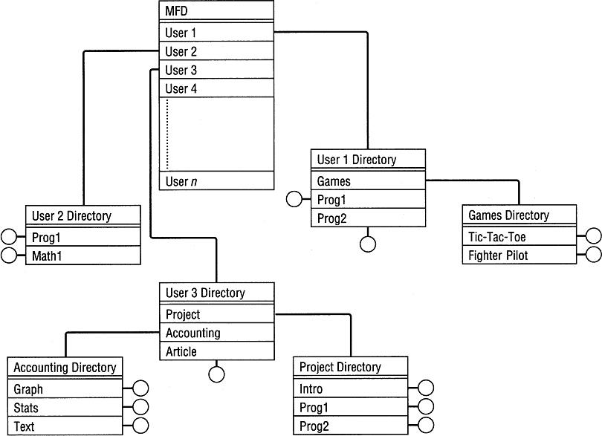
(figure 8.4)
File directory inverted tree structure. The “root” is the MFD shown at the top, each node is a directory file, and each branch is a directory entry pointing to either another directory or to a real file. All program and data files subsequently added to the tree are the leaves, represented by circles. © Cengage Learning 2014

Slide 30
File-Naming Conventions
Filename components
Relative filename and extension
Complete filename (absolute filename)
Includes all path information
Relative filename
Name without path information
Appears in directory listings, folders
Provides filename differentiation within directory
Varies in length (OS specific)
Extensions
Appended to relative filename
Two to four characters
Separated from relative filename by period
Identifies file type or contents and associated program

Slide 31
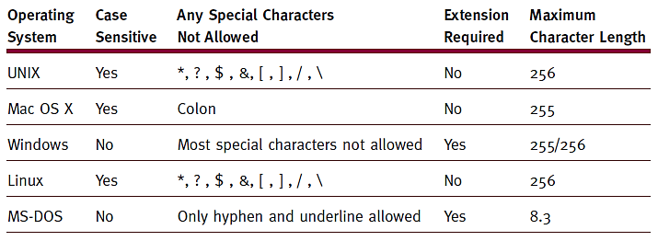
(table 8.1)
File name parameters for several operating systems.
© Cengage Learning 2014

Slide 32
File-Naming Conventions (cont'd.)
Operating system specifics
Windows
Drive label and directory name, relative name, and extension
C:\users\bob\documents\assignment2.docx
UNIX/Linux
Forward slash (root), first subdirectory, sub-subdirectory, file’s relative name
/usr/mary/photos/portrait.jpg

Slide 33
File Organization / Record Format
File organization - arrangement of records within files
Record formats
Fixed-length records
Direct access: easy
Record size critical
Variable-length records
Direct access: difficult
No empty storage space and no character truncation
File descriptor stores record format
Used with files accessed sequentially
Text files, program files
Index used to access records

Slide 34
Physical File Organization
Record arrangement and medium characteristics
Magnetic disks file organization
Sequential, direct, indexed sequential
File organization scheme selection considerations
Data volatility
File activity
File size
Response time

Slide 35
Physical File Organization (cont'd.)
Direct record organization
Direct access files
Requires direct access storage device implementation
Random organization
Random access files
Relative address record identification
Known as logical addresses
Computed when records stored and retrieved
Hashing algorithms
Transform each key into a number

Slide 36
Physical File Organization (cont'd.)
Direct record organization (cont'd.)
Advantages
Fast record access
Sequential access if starting at first relative address and incrementing to next record
Updated more quickly than sequential files
No preservation of records order
Adding, deleting records is quick
Disadvantages
Hashing algorithm collision: records with unique keys may generate the same logical address

Slide 37
Physical File Organization (cont'd.)
Indexed sequential record organization
Best of sequential and direct access
Indexed Sequential Access Method (ISAM) software
Advantage: no collisions (no hashing algorithm)
Generates index file for record retrieval
Divides ordered sequential file into equal sized blocks
Each entry in index file contains the highest record key and physical data block location
Search index file
Overflow areas

Slide 38
Contiguous Storage
Records stored one after another
Advantages
Any record found once starting address, size known
Easy direct access
Disadvantages
Difficult file expansion; fragmentation
(figure 8.8)
With contiguous file storage, File A can’t be expanded without being rewritten to a larger storage area. File B can be expanded, by only one record replacing the free space preceding File C. © Cengage Learning 2014

Slide 39
Noncontiguous Storage
Files use any available disk storage space
File records stored in contiguous manner
If enough empty space
Remaining file records and additions
Stored in other disk sections (extents)
Extents
Linked together with pointers
Physical size determined by operating system
Usually 256 bytes
Advantage
Eliminates external storage fragmentation
Eliminates need for compaction
Disadvantage
No direct access support - cannot determine specific record’s exact location

Slide 40
Access Control Verification
File sharing
Data files, user-owned program files, system files
Advantages
Save space, synchronized updates, resource efficiency
Disadvantage
Need to protect file integrity
File actions
READ only, WRITE only, EXECUTE only, DELETE only, or a combination

Slide 41
Access Control Lists
Contains user names granted file access
User denied access grouped under “WORLD”
Shorten list by categorizing users
SYSTEM (ADMIN)
Personnel with unlimited access to all files
OWNER (USER)
Absolute control over all files created in own account
GROUP
All users belonging to appropriate group have access
WORLD
All other users in system

Slide 42
Data Compression
Compression - technique used to reduce file size
Saves storage space required for files
Improves speed / efficiency of transferring files
Two algorithm types
Lossless: retains all data in the file
Typically used for text or arithmetic files applications
Requires decompression
Lossy: removes some data - often with minimal loss quality
Typically used for image and sound file applications

Slide 43
Image and Sound Compression
Lossy compression
Irreversible: original file cannot be reconstructed
Compression algorithm highly dependent on file type
JPEG: still images
MPEG: video images
International Organization for Standardization (ISO)
World’s leading developer of international standards
MP3
common lossy compression technique that reduces file size (90%) to about 10% of original with some (minimal) loss of sound quality
Example: 3.5 minute song is 35MB file (.wav or .aiff )
compresses to ~3.5 MB file (.mp3)

Slide 44
Chapter 11
The role of the operating system with regard to system security
The effects of system security practices on overall system performance
The levels of system security that can be implemented and the threats posed by evolving technologies
The differences among computer viruses, worms, and blended threats
The role of education and ethical practices in system security

Slide 45
Role of the Operating System in Security
Key role
Operating system level vulnerability opens entire system to attack
Operating system complexity and power increases
More vulnerable to attack
System administrator’s role
Provide operating systems with all available defenses against attack
System Survivability - capability to fulfill mission
Timely manner
In presence of attacks, failures, or accidents

Slide 46
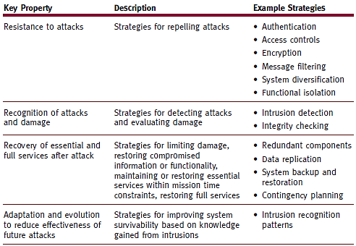
System Survivability (cont'd.)
(table 11.1)
Four key properties of a survivable system and strategies to achieve it. Details about the example strategies shown here can be found at www.cert.org.
© Cengage Learning 2014

Slide 47
Backup and Recovery
Backup – making a copy of system files (data and programs)
Recovery – restoring original files using backup copy
System manager
Uses layered backup schedule
Backups
One set stored off-site
Crucial for disaster recovery
System management essential elements
Written policies and procedures
Regular user training

Slide 48
Security Breaches
System security gaps: malicious or otherwise
Intrusions classifications
Due to uneducated users and unauthorized access to system resources
Purposeful disruption of system operation
Accidental
Examples: hardware malfunctions, undetected errors in operating system or applications, natural disasters
Any security breach can severely damage system credibility

Slide 49
Unintentional Intrusions
Security breach or data modification
Not resulting from planned intrusion
Examples
Accidental incomplete modification of data
Nonsynchronized processes access data records
Modify some record fields
Errors due to incorrect data values storage
Field not large enough to hold numeric value stored

Slide 50
Intentional Attacks
Attack types:
Viruses – malicious programs altering computer operations
Worms - copies itself from one system to next
Trojans - destructive programs disguised as legitimate/ harmless program
Logic bombs - destructive programs with fuse (triggering event)
Time bombs - destructive programs triggered by specific date/time
Blended threat – single program including virus, worm, Trojan, and other malicious code
Wire tapping - uunauthorized users monitor or modify transmission
Denial of service (DoS) - synchronized attempts denying service to authorized users by causing computer to perform repeated unproductive task
Browsing by unauthorized users

Slide 51
System Protection
Threats arise from outsiders and insiders
Multifaceted system protection
Protection methods
Antivirus software, firewalls, restrictive access, and encryption

Slide 52
Antivirus Software
Combats viruses only
Preventive, diagnostic, or both
Preventive programs calculate checksum for each production program
Diagnostic software compares file sizes and looks for replicating instructions or unusual file activity
Removes infection and leaves remainder intact
Sometimes
Cannot repair worms or Trojans
Malicious code in entirety

Slide 53
Firewalls & Encryption
Firewalls
Set of hardware and/or software designed to protect system
Disguises IP address from unauthorized users
Sits between Internet and network
Blocks curious inquiries and potentially dangerous intrusions from outside system
Encryption
Extreme protection method
Sensitive data put into secret code
Communication - data encrypted, transmitted, decrypted, processed
Disadvantages
Increased system overhead
System dependent on encryption process itself

Slide 54
Password Management
Basic techniques protect hardware and software
Good passwords
Careful user training
Good password
Unusual, memorable, not obvious, and changed often
Password files
Stored in encrypted form
Entered password encrypted and compared to encrypted stored password

Slide 55
Password Alternatives
Biometrics
Identifying individuals based on each person’s unique biological characteristics
Current research focus
Analysis of human face, fingerprints, hand measurements, iris/retina, voice prints
Positively identifies person being scanned
Critical factor - Reducing margin of error
Expensive
Picture passwords
Graphics and pattern clicks
Involves touch screen, mouse, or other pointing device
Eliminates keyboard entries

Slide 56
Social Engineering
Technique:
System intruders gain access to information about a legitimate user (often from user)
Learn active passwords
Looking in and around user’s desk for written reminder
Trying logon ID as password
Searching logon scripts
Telephoning friends and coworkers to learn information (family member names, pet names, vacation destinations, hobbies, car model)
Phishing
Intruder pretends to be legitimate entity
Asks unwary user to reconfirm personal / financial information

Slide 57
Ethics
Ethical behavior: Be good. Do good.
IEEE and ACM issued standard of ethics in 1992
Apparent lack of computing ethics
Significant departure from other professions
Consequences of ethical lapses
Illegally copied software: lawsuits and fines
Plagiarism: illegal and punishable by law
Eavesdropping on e-mail, data, or voice communications: sometimes illegal and usually unwarranted

Slide 58
Chapter 14
Design goals for Windows operating systems designers
The role of the Memory Manager and Virtual Memory Manager in Windows
Its use of the Device, Processor, and Network Managers
Windows user interfaces

Slide 59
Brief History
Windows products before Windows 95 operating system
Graphical user interfaces requiring the MS-DOS operating system
Disadvantages:
Multitasking not supported
Little built-in security
Lacked interprocess communication capability
Required customization to work with each system hardware component

Slide 60
Brief History (cont’d.)
Windows products since 1995
Abandoned MS-DOS reliance
More powerful networking products
Windows product version number
Windows XP: version 5.1
Windows 7: version 6.2
Windows 8: version 6.2
Display by pressing Windows logo key and the R key together
Type winver

Slide 61
Design Goals
Windows networking operating systems
Influenced by several operating system models
Employed already-existing frameworks
Introduced new features
Object model: manage and allocate resources
Symmetric multiprocessing (SMP): achieve maximum multiprocessor performance
Five design goals
Extensibility
Portability
Reliability
Compatibility
Performance

Slide 62
Memory Management
Challenge for all Windows operating systems
Run application programs (Windows or POSIX)
Without programs crashing into each other’s memory
Memory layout (recent Windows versions)
Operating system: high virtual memory
User code and data: low virtual memory
User process
Cannot read or write system memory directly
Memory paged to disk
User-accessible memory
System memory segment labeled paged pool
Memory never paged to disk
System memory segment labeled nonpaged pool

Slide 63
Memory Management (cont’d.)
32 bit versions of Windows limited to maximum of 4gb physical memory
64 bit versions of Windows have increased physical memory limits that vary with version:
Windows 7
Starter = 8GB
Home Basic = 8GB
Home Premium = 16GB
Professional = 192GB
Enterprise = 192GB
Ultimate = 192GB Source: zdnet.com

Slide 64
Virtual Memory Implementation
VM manager reliance
Address space management
Paging techniques
Address space management
Upper half of virtual address space
Accessible only to kernel-mode processes
Code in lower part (kernel code and data)
Never paged out of memory

Slide 65
Processor Management
Windows
Preemptive-multitasking, multithreaded operating system
Process contains one thread composed of:
A unique identifier
Volatile set of registers: contents indicate processor’s state
Two stacks used during thread’s execution
Private storage area: used by subsystems and dynamic-link libraries
Multithreading
Systems with multiple processors
Process has as many threads as CPUs available
All threads belonging to one process: share global variables, heap, and environment strings

Slide 66
Device Management
Windows I/O system provides:
Multiple installable file systems (FAT, CDFS, and NTFS)
Services making device-driver development easy
Workable on multiprocessor systems
Drivers: added to or removed from system dynamically
System administrators
Fast I/O processing
Drivers written in high-level language
Mapped file I/O capabilities
Image activation, file caching, and application use

Slide 67
File Management
Windows current versions
Designed to be independent of file system on which they operate
Virtual file
Primary file handling concept (current Windows versions)
Programs perform I/O on virtual files
File handles manipulate them
Executive file object representing all I/O sources and destinations

Slide 68
Network Management
Networking
Integral part of Windows operating system executive
Provides services: user accounts and resource security
Implements communication between computers
Named pipes: provide high-level interface for passing data between two processes (regardless of locations)
Mailslots: provide one-to-many and many-to-one communication mechanisms

Slide 69
Directory Services
Active Directory
Database storing many information types
General-purpose directory service for heterogeneous network
Built entirely around DNS and LDAP
Groups machines into domains
Each domain gets a DNS domain name (e.g., towson.edu)
Each domain must have at least one domain controller
Domain can have more than one domain controller
Active Directory clients use standard DNS and LDAP protocols: locate objects on the network

Slide 70
Security Management
Windows network operating systems
Provide object-based security model
Security object
Represents any resource in system (file, device, process, program, or user)
Allows administrators to give precise security access
Monitor and record how objects used
Windows biggest concern
Aggressive patch management needed
Combat many viruses and worms

Slide 71
User Interface
GUI - Windows 8
Offers same default screen
All devices running the operating system
Laptop or desktop users
Can switch between tile-populated Start screen and Desktop screen
Command-line interface
Available from most Windows desktops
Use Help feature: learn a command’s syntax

Slide 72
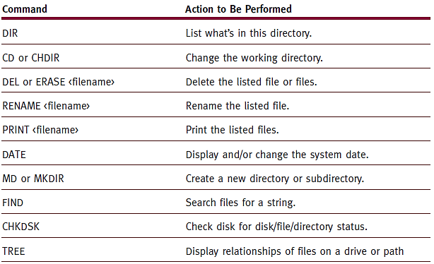
(table 14.4)
Selected commands that can be used in the Command Prompt Window. For a complete listing, see your technical documentation or www.microsoft.com. © Cengage Learning 2014

Slide 73
Chapter 15
The design goals for the Linux operating system
The flexibility offered by using files to manipulate devices
The roles of the Memory, Device, File, Processor, and Network Managers
The impact of open source software
Some strengths and weaknesses of Linux

Slide 74
Introduction
Linux
Originally based on a version of UNIX
Powerful
Inexpensive or free to use
Portable
Versions for cell phones, supercomputers, and computing systems in between
Source code: freely available
Configurable: runs any device; meets any specification
Open source
Source code freely available to anyone for improvement
Under constant development
Contributors around the world: not paid for their work

Slide 75
Brief History
Developed by Linus Torvalds (1991)
Original purpose
Maximize Intel 80386 microprocessor’s limited capabilities
Roots
MINIX: miniature UNIX with more functionality
First version meant for small microcomputer
Expensive commercial computer features
Flexibility and functionality
Brought UNIX features to small computer

Slide 76
Brief History (cont'd.)
User interface
First Linux operating systems: command-driven interface
Sometimes cryptic commands
Recent years
Graphical user interfaces (GUI)
Written and distributed under the GNU General Public License
Fedora Project responsible for the open-source development of the Linux kernel
Common \ popular distributions: Fedora, Ubuntu, Cent OS
The foundation of Android operating system (most popular mobile OS)

Slide 77
Design Goals
Three goals
Modularity
Simplicity
Portability
Numerous standard utilities
Eliminate need to write special code
Used in combination for specific tasks
Numerous functions
IEEE POSIX (Portable Operating System Interface) specifications conformity
Programs’ portability

Slide 78
Memory Management
Space allocation (32 bit)
Kernel: 1 GB high order memory
Executing processes: 3 GB memory
Process execution
Fixed-size segment
System calls change segment size
Memory protection
Based on information type stored in address space region for process
Memory limits vary with 64 bit Linux distributions but generally in terabytes (TB) – 1,000s of GBs
Uses same parent-child process management design found in UNIX
Supports “personality” concept
Allows processes from other operating systems to be executed

Slide 79
Device Management
Device independent
Improves portability
Device drivers
Supervise data transmission
Between main memory and peripheral unit
Devices assigned
Name
Descriptors
Further identify each device
Stored in device directory
Three standard classes
Character devices
Block devices
Network devices

Slide 80
Filename Conventions
Path name rules
Path name starting with slash: begins at root directory
Path name
One name or list of names separated by slashes
Last name on list: name of file requested
Two periods (..) in path name
Move upward in hierarchy: closer to root
Only way to go up the hierarchy

Slide 81
User Interface
Early Linux versions
Required typed commands
Thorough knowledge of valid commands required
Current versions
Include powerful and intuitive menu-driven interfaces
Several graphical user interfaces available
Can still use Terminal mode - type commands similar to those used for UNIX
Many Linux versions
Equipped with Windows-compatible word processors, spreadsheet, and presentation applications

Slide 82
Setting Permissions
Network administrators
Full control: manage access to files and directories
Three levels of access
Owner
Group
Others
Access level settings: under properties option
Access types
Create and delete files, list files only, access files, and none

