Slide 1
Understanding Operating Systems Review Chapters 1, 2, 3, 4, 5 & 6

Slide 2
Chapter 1
After completing this chapter, you should be able to describe:
How operating systems have evolved through the decades
The basic role of an operating system
How operating system software manages its subsystems
The role of computer system hardware on the development of its operating system
How operations systems are adapted to serve batch, interactive, real-time, hybrid, and embedded systems
How operating systems designers envision their role and plan their work

Slide 3
Introduction
Operating systems
Manage computer system hardware and software
This text explores:
What they are
How they work
What they do
Why they do it
This chapter briefly describes:
The workings of operating systems

Slide 4
What is an Operating System?
Computer system
Software (programs)
Hardware (tangible machine/electronic components)
Operating system
Chief software component
Manages all hardware and all software and controls:
Every file, device, section of main memory, and moment of processing time
Who can use the system and how system is used

Slide 5
Operating System Software (1 of 2)
Includes 6 essential subsystem managers
Memory Manager
Processor Manager
Device Manager
File Manager
User Interface
Network Manager
Each manager:
Works closely with other managers
Performs a unique role

Slide 6
Main Memory Management (1 of 2)
In charge of main memory
Random access memory (RAM)
Requires constant flow of electricity to hold data
Responsibilities include:
Checking validity and legality of memory space request
Reallocating memory to make more useable space available
Deallocating memory to reclaim it
Protecting space in main memory occupied by operating system

Slide 7
Main Memory Management (2 of 2)
Read-only memory (ROM)
Another type of memory
Critical when computer is powered on
Holds firmware: programming code
When and how to load each piece of the operating system after the power is turned on
Non-volatile
Contents retained when the power is turned off

Slide 8
Processor Management
Allocation of Central Processing Unit (CPU)
Tracks process status
Program’s “instance of execution”
Comparable to a traffic controller
When a process is finished or maximum computation time expired
Processor Manager reclaims the CPU and allocates to next waiting process
Computer with multiple CPUs
More complex management

Slide 9
Device Management
In charge of connecting with every available device
Printers, ports, disk drives, etc.
Responsibilities include:
Choosing most efficient resource allocation method
Based on scheduling policy
Identifying each device uniquely
Starting device operation (when appropriate)
Monitoring device progress
Deallocating the device

Slide 10
File Management
In charge of tracking every file in the system
Data files and program files
Responsibilities include:
Enforcing user/program resource access restrictions
Uses predetermined access policies
Controlling user/program modification restrictions
Read-only, read-write, create, delete
Allocating space for a file on secondary storage
One large storage area or smaller linked pieces
Retrieving files efficiently

Slide 11
Network Management
Included in operating systems with networking capability
Authorizes users to share resources
Overall responsibility for every aspect of network connectivity
Devices, files, memory space, CPU capacity, etc.

Slide 12
User Interface
Portion of the operating system
Direct interaction with users
Two primary types
Graphical user interface (GUI)
Input from pointing device
Menu options, desktops, and formats vary
Command line interface (CMD)
Keyboard-typed commands that display on a monitor
Strict requirements for every command: typed accurately; correct syntax; combinations of commands assembled correctly

Slide 13
Cooperation Issues
No single manager performs tasks in isolation
Each element of an operating system
Performs individual tasks and
Harmoniously interacts with other managers
Incredible precision required for operating system to work smoothly
More complicated when networking is involved

Slide 14
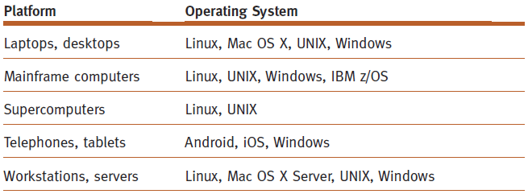
An Evolution of Computing Hardware
Computer classification
At one time: based on memory capacity
Current platforms
(table 1.1)
A brief list of platforms and a few of the operating systems designed to run on them, listed in alphabetical order.
© Cengage Learning 2018

Slide 15
Chapter 2
After completing this chapter, you should be able to describe:
How four memory allocation schemes in this chapter manage incoming jobs
How two memory allocation systems work: best-fit and first-fit
How a memory list is used to keep the status of available memory
The essential role of memory deallocation, and the consequences if it isn’t performed
How compaction can improve memory allocation efficiency

Slide 16
Introduction (1 of 2)
Main memory management is critical
Entire system performance is dependent on two items:
Amount of memory available
Optimization of memory during job processing

Slide 17
Introduction (2 of 2)
This chapter introduces:
Role of main memory (RAM)
Four types: memory allocation schemes
Single-user systems
Fixed partitions
Dynamic partitions
Relocatable dynamic partitions

Slide 18
Single-User Contiguous Scheme
Entire program: loaded into memory
Contiguous memory space: allocated as needed
Jobs: processed sequentially
Memory Manager: performs minimal work
Evaluates incoming process size: loads if small enough to fit; otherwise, rejects and evaluates next incoming process
Monitors occupied memory space; when process ends, makes entire memory space available and returns to Step 1

Slide 19
Fixed Partitions (1 of 2)
Permits multiprogramming / multitasking
Main memory: partitioned
Each partition: one job
Static: reconfiguration requires system shut down
Responsibilities
Protecting each job’s memory space
Matching job size with partition size

Slide 20
Fixed Partitions (2 of 2)
Characteristics
Requires contiguous loading of entire program
Job allocation method
First available partition with required size
To work well:
All jobs have similar size and memory size known ahead of time
Arbitrary partition size leads to undesired results
Partition too small
Large jobs have longer turnaround time
Partition too large
Memory waste: internal fragmentation

Slide 21
Dynamic Partitions
Main memory: partitioned
Jobs: given requested memory when loaded
One contiguous partition per job
Job allocation method
First come, first serve
Memory waste: comparatively small within partitions
Disadvantages
Full memory utilization: only when first jobs loaded
Subsequent allocation: memory waste
External fragmentation: fragments between blocks

Slide 22
Deallocation
Deallocation: releasing allocated memory space
For fixed-partition system:
Straightforward process
Memory Manager: resets the job’s memory block status to “free” upon job completion
Any code may be used: e.g., 0 = free and 1 = busy

Slide 23
Relocatable Dynamic Partitions (1 of 2)
Memory Manager: relocates programs
All empty blocks: gathered together
Empty blocks: compacted
Make one memory block: large enough to accommodate some or all waiting jobs
Compaction (memory defragmentation): operating system reclaims fragmented memory space sections
Most or all programs in memory: relocated
Contiguous arrangement
Operating system: distinguishes between addresses and data values
Every address and address reference: adjusted to match the program’s new memory location
Data values: left alone

Slide 24
Relocatable Dynamic Partitions (2 of 2)
Compacting and relocating: optimizes memory use
Improves throughput
Compaction: overhead
Compaction timing options
When a certain memory percentage is busy
When there are waiting jobs
After a prescribed time period has elapsed
Goal: optimize processing time and memory use; keep overhead as low as possible

Slide 25
Conclusion
Four memory management techniques
Single-user systems, fixed partitions, dynamic partitions, and relocatable dynamic partitions
Common to all four techniques
Entire program: 1) loaded into memory; 2) stored contiguously; 3) resides in memory until completed
All schemes
Place severe restrictions on job size: limited by the largest petition
Groundwork for more complex memory management.
New modern memory management trends in late 1960s and early 1970s
Discussed in next chapter
Common characteristics of modern memory schemes
Programs are not stored in contiguous memory
Not all segments reside in memory during job execution

Slide 26
Chapter 3
After completing this chapter, you should be able to describe:
How complex memory allocation methods function
How page allocation methods spawned virtual memory
How several page replacement policies compare in function and best uses
How paging works and how a memory allocation scheme determines which pages should be swapped out of memory
How the concept of the working set is used in memory allocation schemes
How cache memory issued by the operating system to improve response time

Slide 27
Introduction
Virtual Memory – appearance of vast amounts of physical memory (using storage)
Evolution of virtual memory
Paged, demand paging, segmented, segmented/demand paging
Foundation of current virtual memory methods
Areas of improvement from the need for:
Continuous program storage
Placement of entire program in memory during execution
Enhanced Memory Manager performance: cache memory

Slide 28
Paged Memory Allocation (1 of 2)
Incoming job: divided into pages of equal size
Best condition
Pages, sectors, and page frames: same size
Exact sizes: determined by disk’s sector size
Memory manager tasks: prior to program execution
Determine number of pages in program
Locate enough empty page frames in main memory
Load all program pages into page frames

Slide 29
Paged Memory Allocation (2 of 2)
Program: stored in noncontiguous page frames
Advantages: more efficient memory use; compaction scheme eliminated (no external fragmentation)
New problem: keeping track of job’s pages (increased operating system overhead)

Slide 30
Demand Paging Memory Allocation (1 of 3)
Loads only a part of the program into memory
Removes restriction: entire program in memory
Requires high-speed page access (from storage)
Exploits programming techniques
Modules: written sequentially
All pages: not needed simultaneously
Examples
Error-handling modules instructions
Mutually exclusive modules
Certain program options: mutually exclusive or not always accessible

Slide 31
Demand Paging Memory Allocation (2 of 3)
Made virtual memory possible
Appearance of vast amounts of physical memory
Less main memory required than paged memory allocation scheme
Requires high-speed direct access storage device (DASDs): e.g., hard drives or flash / solid-state storage
Swapping: how and when pages passed between memory and secondary storage
Depends on predefined policies

Slide 32
The Importance of the Working Set
Working Set of pages residing in memory: accessed directly without incurring a page fault
Demand paging schemes: improves performance
Requires “locality of reference” concept
Well structured programs (most): only small fraction of pages needed during any execution phase.
A poorly structured program might require that all pages be resident in memory to begin or may consistently reference pages that are not resident in memory (page faults).
Working set typically changes over the execution of the job.
System needs definitive values:
Number of pages comprising working set
Maximum number of pages allowed for a working set
Notes:
Working set typically changes over the execution of the job.
Most programs are well structured which leads to locality of reference – during any phase of execution the program references a small portion of its pages and they are already resident in memory.
A poorly structured program might require that all pages be resident in memory to begin or may consistently reference pages that are not resident in memory (page faults).

Slide 33
Segmented Memory Allocation (1 of 2)
Each job divided into several segments: different sizes
One segment for each module: related functions
Reduces page faults
Loops: not split over two or more pages
Main memory: allocated dynamically
Program’s structural modules: determine segments
Each segment numbered when program compiled/assembled
Segment Map Table (SMT) generated

Slide 34
Segmented Memory Allocation (2 of 2)
Two-dimensional addressing scheme
Segment number and displacement
Disadvantage
External fragmentation
Major difference between paging and segmentation
Pages: physical units; invisible to the program
Segments: logical units; visible to the program; variable sizes

Slide 35
Segmented/Demand Paged Memory Allocation
Subdivides segments: equal-sized pages
Smaller than most segments
More easily manipulated than whole segments
Segmentation’s logical benefits
Paging’s physical benefits
Segmentation problems removed
Compaction, external fragmentation, secondary storage handling
Three-dimensional addressing scheme
Segment number, page number (within segment), and displacement (within page)
Disadvantages
Overhead: managing the tables
Time required: referencing tables

Slide 36
Virtual Memory (1 of 2)
Made possible by swapping pages in/out of memory
Program execution: only a portion of the program in memory at any given moment
Requires cooperation between:
Memory Manager: tracks each page or segment
Processor hardware: issues the interrupt and resolves the virtual address

Slide 37
Virtual Memory (2 of 2)
Advantages
Job size: not restricted to size of main memory
More efficient memory use
Unlimited amount of multiprogramming possible
Code and data sharing allowed
Dynamic linking of program segments facilitated
Disadvantages
Higher processor hardware costs
More overhead: handling paging interrupts
Increased software complexity: prevent thrashing

Slide 38
Cache Memory (1 of 2)
Small, high-speed intermediate memory unit
Computer system’s performance increased
Faster processor access compared to main memory
Stores frequently used data and instructions
Cache levels
L2: connected to CPU; contains copy of bus data
L1: pair built into CPU; stores instructions and data
Data/instructions: move between main memory and cache
Methods similar to paging algorithms

Slide 39
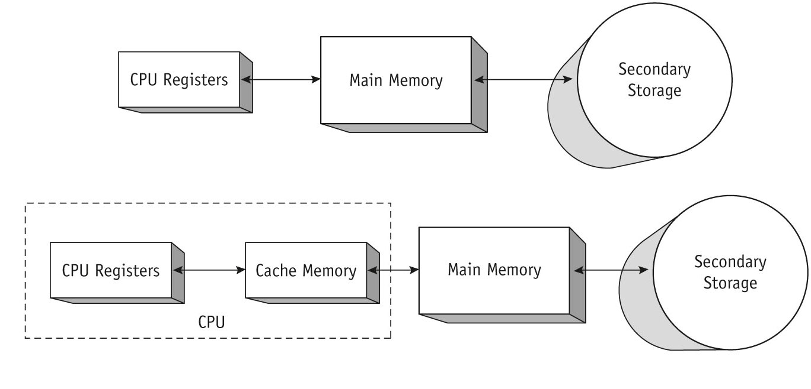
Cache Memory (2 of 2)
(figure 3.19)
The traditional path used by early computers was direct: from secondary storage to main memory to the CPU registers, but speed was slowed by the slow connections (top). With cache memory directly accessible from the CPU registers (bottom), a much faster response is possible. © Cengage Learning 2018

Slide 40
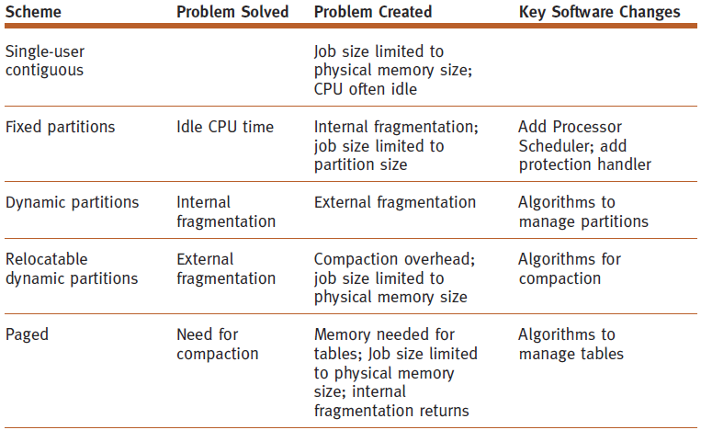
Conclusion (1 of 2)
(table 3.7)
The big picture. This is a comparison of the memory allocation schemes discussed in Chapters 2 and 3.
© Cengage Learning 2018

Slide 41
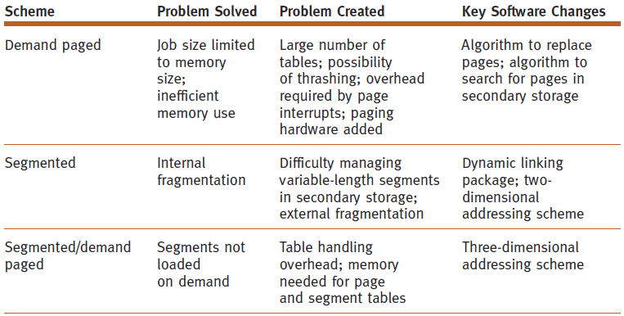
Conclusion (2 of 2)
(table 3.7) (cont’d.)
The big picture. This is a comparison of the memory allocation schemes discussed in Chapters 2 and 3. © Cengage Learning 2018

Slide 42
Chapter 4
After completing this chapter, you should be able to describe:
How job scheduling and process scheduling compare
How several process scheduling algorithms work
How the process scheduling policies can be implemented
How processes and threads compare
How the interrupt handler manages pauses in processing

Slide 43
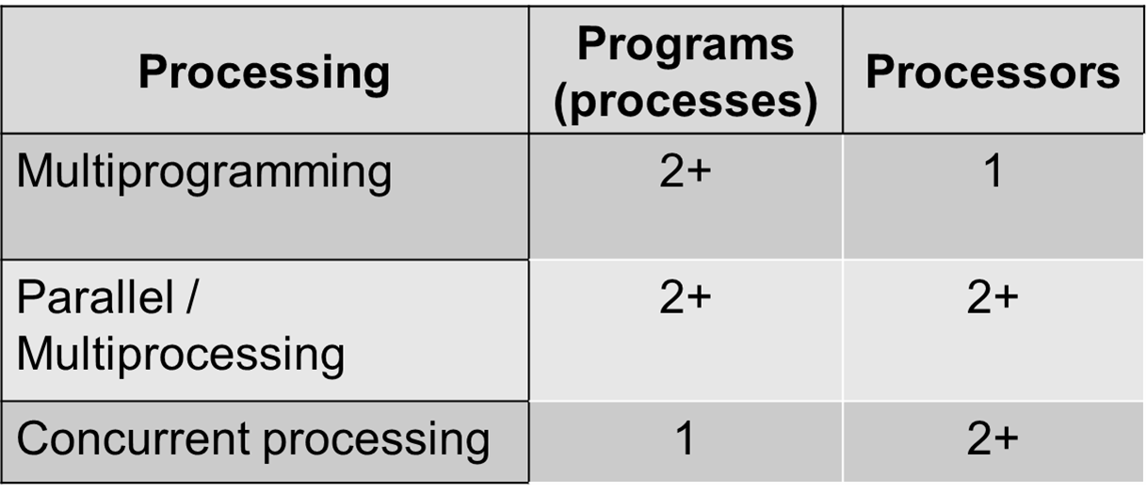
Overview

Slide 44
Overview
Simple system
Single user
One processor: busy only when executing the user’s job or system software
Multiprogramming environment: multiple processes competing to be run by a single CPU
Requires fair and efficient CPU allocation for each job
Single processor systems
Addressed in this chapter

Slide 45
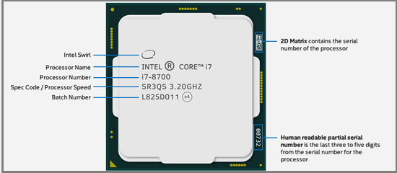
CPU Chip

Slide 46
Definitions (1 of 3)
Processor (CPU)
Performs calculations and executes programs
Program (job)
Inactive unit, e.g., file stored on a disk
Unit of work submitted by the user
Process (task)
Active entity
Requires resources (processor, special registers, etc.) to perform function
Executable program single instance

Slide 47
Definitions (2 of 3)
Thread
Portion of a process
Runs independently
Multithreading
Allows applications to manage a separate process with several threads of control
Example: Web browsers
Multiprogramming
Processor allocated to each job or each process for a time period
Deallocated at appropriate moment: delicate task

Slide 48
Definitions (3 of 3)
Interrupt
Call for help
Activates higher-priority program
Context switch
Saving job processing information when interrupted
Completed jobs
Finished or terminated
Single processor
May be shared by several jobs (processes)
Requires scheduling policy and scheduling algorithm

Slide 49
About Multi-Core Technologies
Dual-core, quad-core, or other multi-core CPU
More than one processor (core): located on computer chip
Single chip may contain multiple cores
Multi-core engineering
Resolves electrical current leakage and heat problems
Multiple calculations may occur simultaneously
More complex Processor Manager handling: discussed in Chapter 6

Slide 50
Scheduling Submanagers (1 of 2)
Processor Manager: composite of two submanagers
Job Scheduler and Process Scheduler: hierarchical scheduling system
Job Scheduler: higher-level scheduler
Job scheduling responsibilities
Job initiation based on certain criteria
Process Scheduler: lower-level scheduler
Process scheduling responsibilities
Determines execution steps
Process scheduling: based on certain criteria

Slide 51
Scheduling Submanagers 2 of 2)
Job Scheduler functions
Selects incoming job from queue
Places in process queue
Decides on job initiation criteria
Process scheduling algorithm and priority
Goal
Sequence jobs
Efficient system resource utilization
Balance I/O interaction and computation
Keep most system components busy most of time

Slide 52
Process Scheduler (1 of 2)
Process Scheduler functions
Determines job to get CPU resource
When and how long
Decides interrupt processing
Determines queues for job movement during execution
Recognizes job conclusion
Determines job termination
Lower-level scheduler in the hierarchy
Assigns CPU to execute individual actions: jobs placed on READY queue by the Job Scheduler

Slide 53
Process Scheduler (2 of 2)
Exploits common computer program traits
Programs alternate between two cycles
CPU and I/O cycles
Frequency and CPU cycle duration vary
General tendencies
I/O-bound job
Many brief CPU cycles and long I/O cycles (printing documents)
CPU-bound job
Many long CPU cycles and shorter I/O cycles (math calculation)

Slide 54
Job and Process States
Status changes: as a job or process moves through the system
HOLD
READY
WAITING
RUNNING
FINISHED
Referred to as job status or process status, respectively

Slide 55
Scheduling Policies and Algorithms (1 of 2)
Multiprogramming environment
More jobs than resources at any given time
Operating system pre-scheduling task
Resolve three system limitations
Finite number of resources (disk drives, printers, tape drives)
Some resources cannot be shared once allocated (printers)
Some resources require operator intervention before reassigning

Slide 56
Scheduling Policies (2 of 2)
Types of scheduling policies
Preemptive
Interrupts job processing and transfers CPU to another job
Used in time-sharing environments
Nonpreemptive
Functions without external interrupts ( interrupts external to the jobs)
job remain in the processing state uninterrupted until its finished or issues an I/O request.

Slide 57
Conclusion
Processor Manager allocates processor among all users
Job scheduling
Based on characteristics
Process and thread scheduling
Instant-by-instant allocation of CPU
Interrupt handler: generates and resolves interrupts
Each scheduling algorithm is unique
Characteristics, objectives, and applications
System designer selects best policy and algorithm
After careful strengths and weaknesses evaluation

Slide 58
Chapter 5
After completing this chapter, you should be able to describe:
How system deadlock and livelock can occur
How processes can become deadlocked
How to detect and recover from deadlocks
How to detect and recover from starvation
The concept of a race and how to prevent it

Slide 59
Consequences of Poor Synchronization (1 of 3)
Resource sharing perspectives
Memory management and processor sharing
Many programs competing for limited resources
Lack of process synchronization consequences
Deadlock
Livelock
Starvation

Slide 60
Consequences of Poor Synchronization (2 of 3)
Narrow staircase analogy
Staircase = system; steps and landings = resources
Stairs: only wide enough for one person
Landing at each floor: room for two people
Deadlock: two people meet on the stairs
Neither retreats
Livelock: two people on a landing
Each time one takes a step to the side, the other mirrors that step; neither moves forward
Starvation: people wait on landing for a break to go up the stairs
Break never comes

Slide 61
Consequences of Poor Synchronization (3 of 3)
Affects entire system
Affects more than one job
Not just a few programs
All system resources become unavailable
More prevalent in interactive systems
Real-time systems
Deadlocks quickly become critical situations
OS must prevent or resolve

Slide 62
Several Examples of a Deadlock
Nonsharable/nonpreemptable resources
Allocated to jobs requiring same type of resources
Resource types locked by competing jobs
File requests
Databases
Dedicated device allocation
Multiple device allocation
Spooling
Disk sharing

Slide 63
Strategies for Handling Deadlocks (1 of 2)
Prevention
Prevent occurrence of one condition
Mutual exclusion, resource holding, no preemption, circular wait
Avoidance
Avoid deadlock if it becomes probable
System knows ahead of time
Sequence of requests associated with each active process
Detection
Detect deadlock when it occurs – ( detection algorithm)
Recovery
Resume system normalcy quickly and gracefully

Slide 64
Strategies for Handling Deadlocks (2 of 2)
Recovery methods
Terminate every job active in system
Restart jobs from beginning
Terminate only jobs involved in deadlock
Ask users to resubmit jobs
Identify jobs involved in deadlock
Terminate jobs one at a time
Stop new jobs from entering system
Allow non-deadlocked jobs to complete
Releases resources when complete

Slide 65
Strategies for Handling Deadlocks (2 of 2)
Recovery methods
Terminate every job active in system
Restart jobs from beginning
Terminate only jobs involved in deadlock
Ask users to resubmit jobs
Identify jobs involved in deadlock
Terminate jobs one at a time
Stop new jobs from entering system
Allow non-deadlocked jobs to complete
Releases resources when complete

Slide 66
Starvation
Job execution prevented
Where a single job is prevented from completing its execution because it is wanting for resources that never become available.
Results from conservative resource allocation
Less resource is allocated at first
Starvation avoidance
Implement algorithm tracking how long each job has been waiting for resources (aging)
Starvation detected: block new jobs until starving jobs satisfied
Note: While deadlock affects system wide performance, starvation affects individual jobs or processes.

Slide 67
Conclusion (1 of 2)
Operating systems
Must dynamically allocate resources while avoiding deadlock and starvation
Four methods for dealing with deadlocks
Prevention, avoidance, detection, and recovery
Prevention
Remove simultaneous occurrence of one or more conditions: system will become deadlock-free
Prevention algorithms
Complex algorithms and high execution overhead

Slide 68
Conclusion (2 of 2)
Avoidance
Clearly identify safe and unsafe states
Keep reserve resources to guarantee job completion
Disadvantage
System not fully utilized
When there is no prevention support:
System must detect and recover from deadlocks
Detection relies on selection of victim

Slide 69
Chapter 6
After completing this chapter, you should be able to describe:
The differences among common configurations of multiprocessing systems
How processes and processors compare
How multi-core processor technology works
How a critical region aids process synchronization
Process synchronization software essential concepts
How several processors work cooperatively together
How jobs, processes, and threads are executed
How concurrent programming languages manage tasks

Slide 70
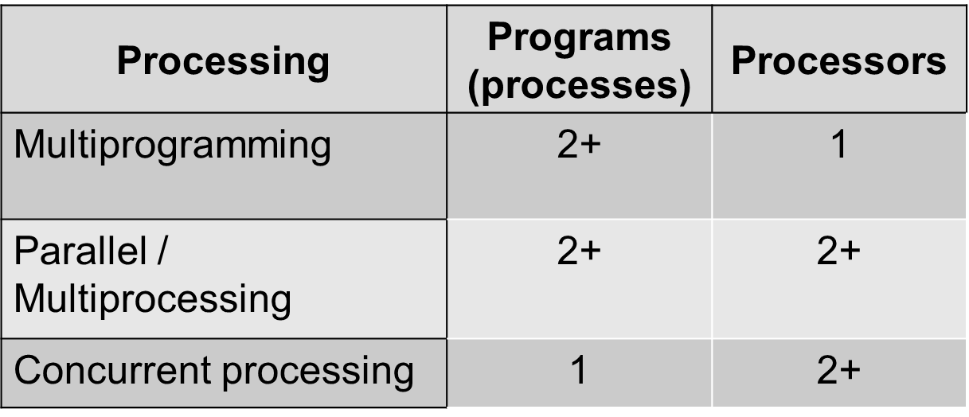
Overview

Slide 71
What Is Parallel Processing? (1 of 3)
Parallel processing or Multiprocessing
Two or more processors operate in one system at the same time
Work may or may not be related
OR
Two or more CPUs execute instructions simultaneously
Processor Manager
Coordinates activity of each processor
Synchronizes interaction among CPUs

Slide 72
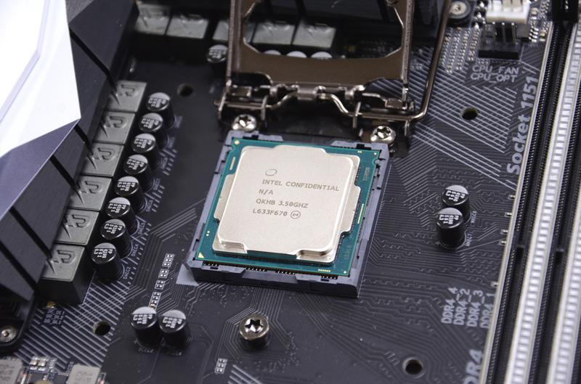
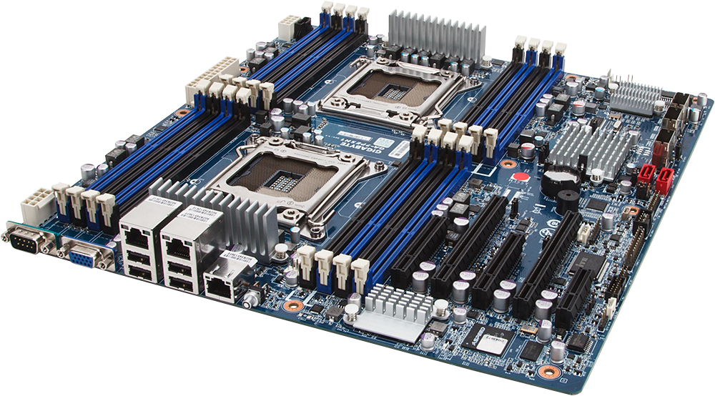
CPU in Socket Slot
Motherboard with 2 CPU Socket

Slide 73
What Is Parallel Processing? (2 of 3)
Benefits:
Increased reliability
More than one CPU that can share the load
If one processor fails, others take over: must be designed into the system
Faster processing
Instructions processed in parallel two or more at a time

Slide 74
What Is Parallel Processing? (3 of 3)
Faster instruction processing methods
CPU allocated to each program or job
CPU allocated to each working set or parts of it
Individual instructions subdivided
Each subdivision processed simultaneously
Concurrent programming
Two major challenges
Connecting processors into workable configurations
Orchestrating processor interaction

Slide 75
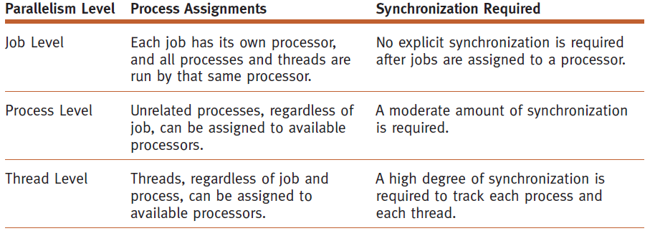
Levels of Multiprocessing
Multiprocessing occurs at three levels
Job level
Process level
Thread level
Each level requires different synchronization frequency

Slide 76
Introduction to Multi-Core Processors
Multi-core processing
Several processors placed on single chip
Problems solved
Current leakage (tunneling) and heat
Solution
Single chip with two processor cores in same space
Allows two sets of simultaneous calculations
Two cores each run more slowly than single core chip … but together better than one.

Slide 77
Process Synchronization Software
Successful process synchronization
Lock up resource in used
Protect from other processes until released
Only when resource is released
Waiting process is allowed to use resource
Mistakes in synchronization can result in:
Starvation
Leave job waiting indefinitely
Deadlock
If key resource is being used

Slide 78
Concurrent Programming
Another type of multiprocessing
Concurrent processing system
One job uses several processors
Executes sets of instructions in parallel
Requires programming language and computer system support

Slide 79
Conclusion (1 of 2)
Multiprocessing
Single-processor systems
Interacting processes obtain control of CPU at different times
Systems with two or more CPUs
Control synchronized by processor manager
Processor communication and cooperation
System configuration
Master/slave, loosely coupled, and symmetric
Synchronize processes using hardware and software mechanisms

Slide 80
Conclusion (2 of 2)
Multiprocessing: several configurations
Single-processor with interacting processes
Multiple processors: synchronized by Process Manager
Avoid typical problems of synchronization
Missed waiting customers
Synchronization of producers and consumers
Mutual exclusion of readers and writers
Concurrent processing innovations
Threads and multi-core processors

